Slide 1
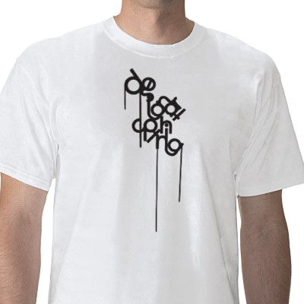

Slide 2
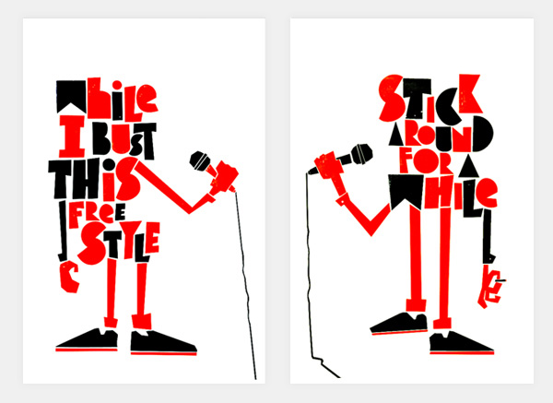
Richard Perez / Silk Screen

Slide 3
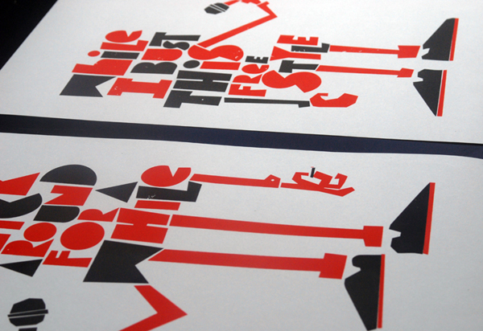

Slide 4
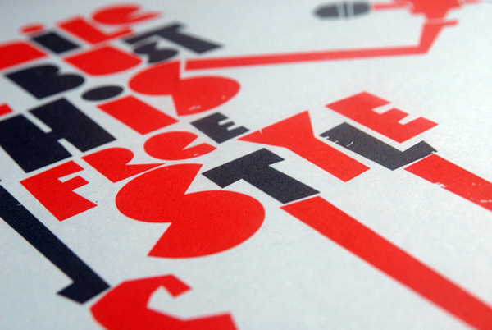

Slide 5

Jell-o Packaging, Promotional, Various - Objective: Re-branding of identity and packaging for Jell-o, repositioning the target market toward kids, and still appealing to adult consumers familiar to Jell-o from their childhood. - Description The re-branding of Jell-o sought to recreate the classic feeling of joy the gelatin dessert had brought to previous generations without relying on nostalgia. - By introducing a cast of fun stylized characters and a visual vocabulary that feels fresh and fun, the new Jell-o identity burst with vibrancy and joy. The simple graphic fruit characters, bright color-palette and naive typography makes the brand feel playful and pop without veering into overtly saccharine or Saturday morning cartoon territory.

Slide 6
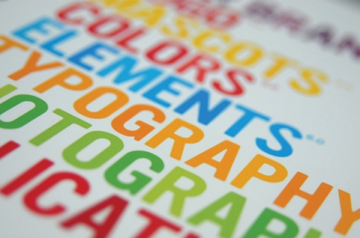
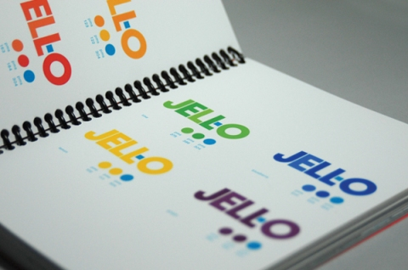

Slide 7
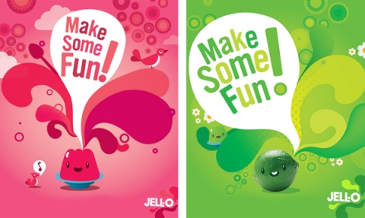

Slide 8
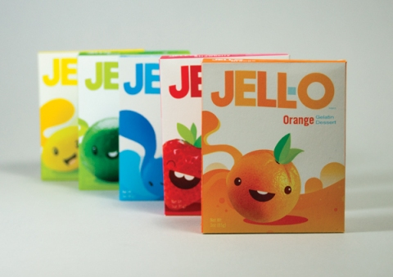

Slide 9
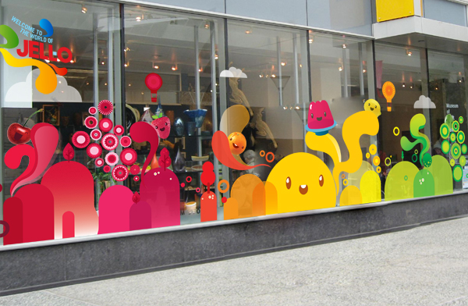

Slide 10


Slide 11


Slide 12


Slide 13
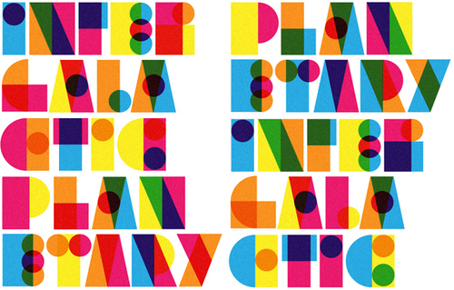

Slide 14

Keep on exploring
Richard Perez

Slide 15

Friday Afternoon - Narrative illustration chronicling a rather unproductive afternoon at an office job.

Slide 16


Slide 17
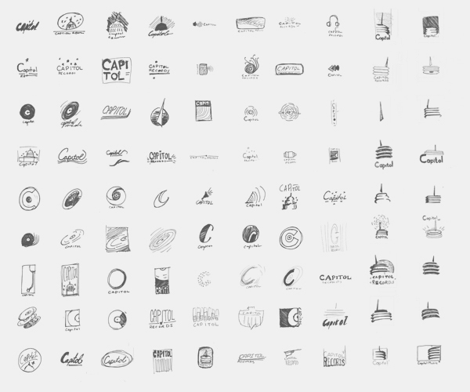

Slide 18
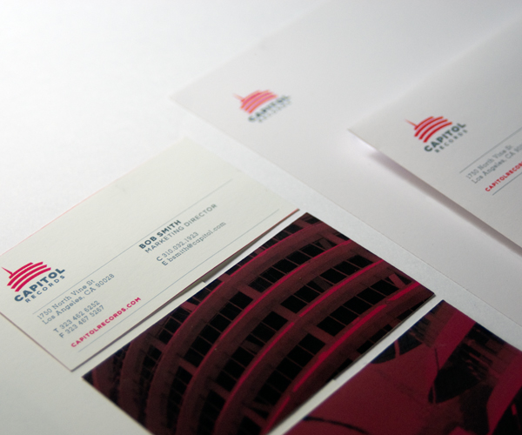

Slide 19
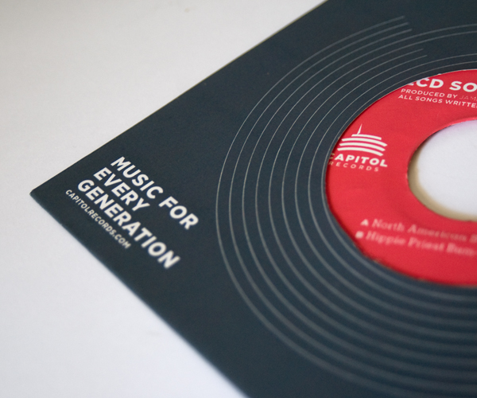

Slide 20
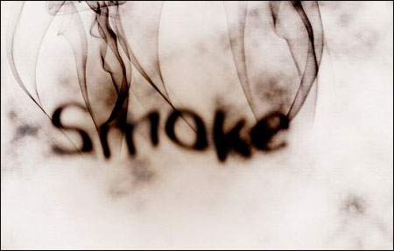

Slide 21
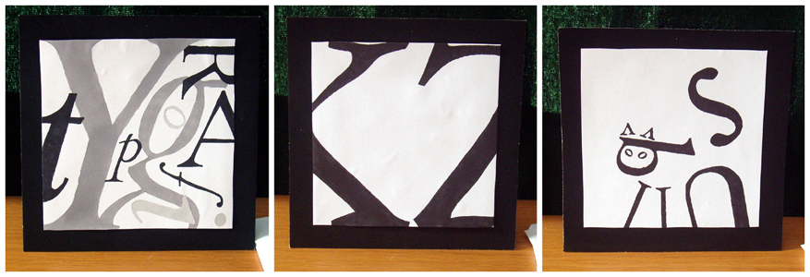

Slide 22


Slide 23

Students explore and understand the basic structure of letter-forms. They create a color composition using all of the letters in their first name. Every letter can be a different typeface and the sizes can vary, as can the case (upper or lower case. For each letter, students can scale, rotate, or change colors exploring a variety of compositions and visually choreographing the space.

Slide 24

Students explore the use of typography to make words expressive. In the first of three exercises, using only a limited number of typeface families, they choose four different single words that have visually expressive content such as hot, cold, happy, sad, love, hate... Using different typefaces, students communicate the expressive features of the words.

Slide 25
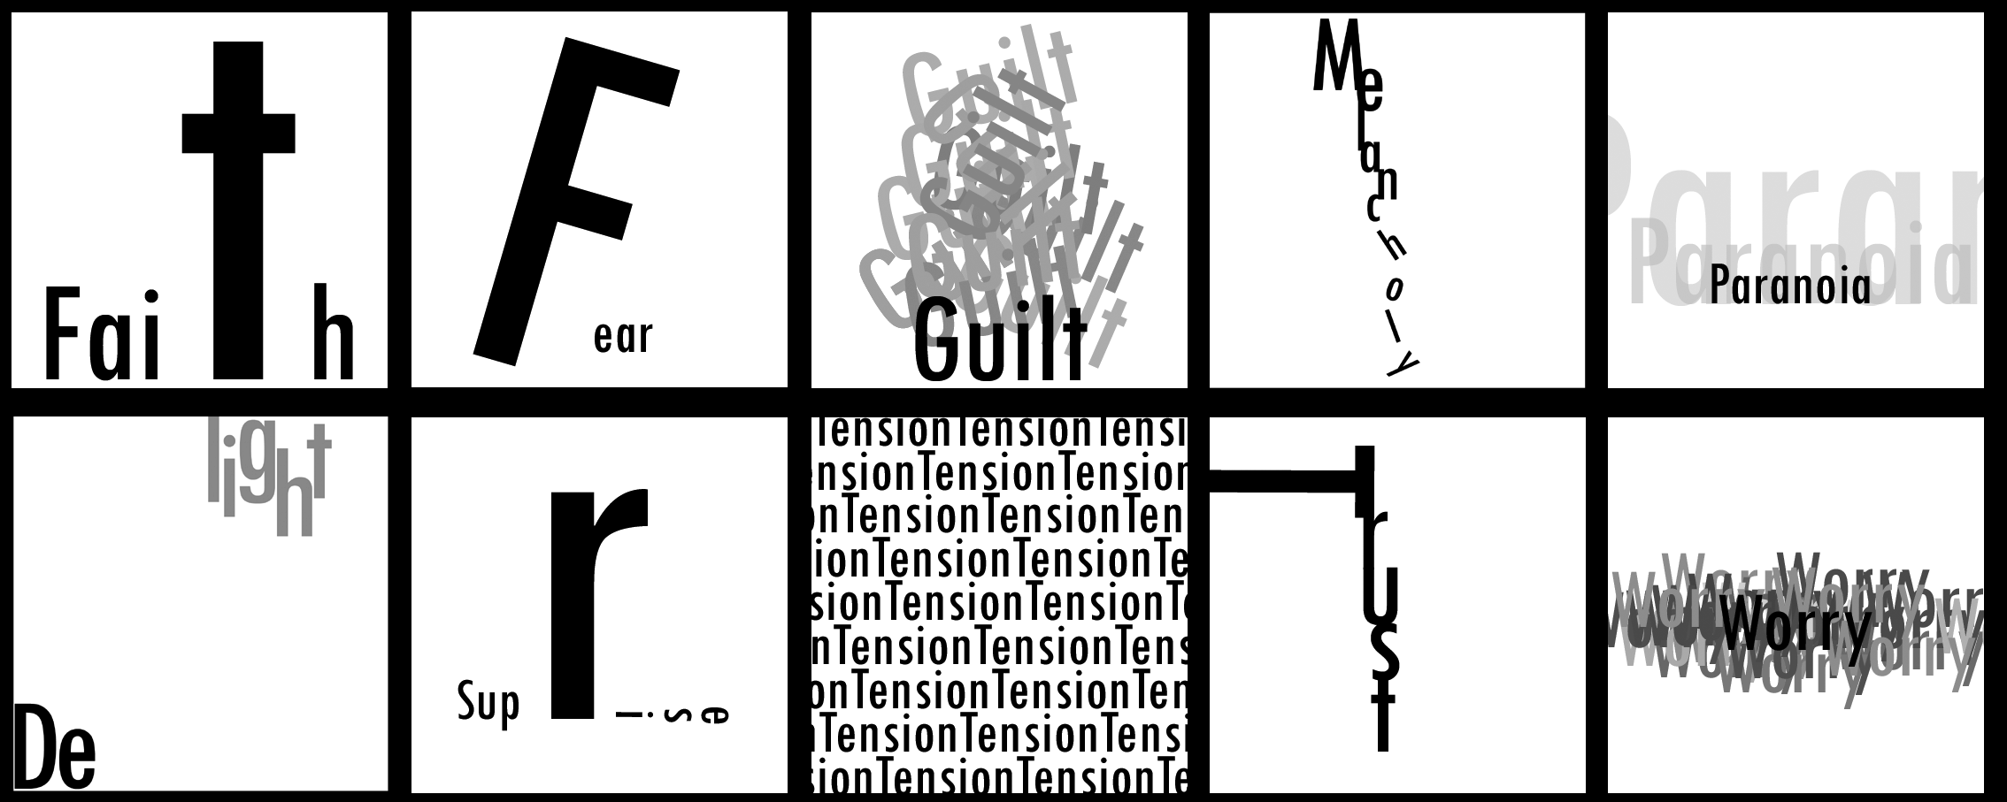

Slide 26


Slide 27
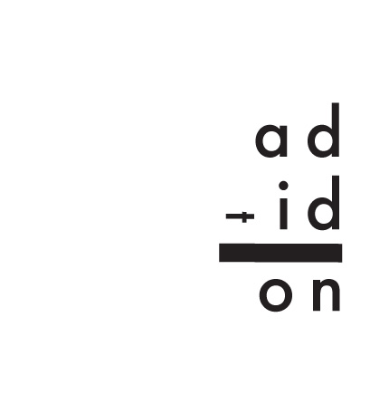

Slide 28
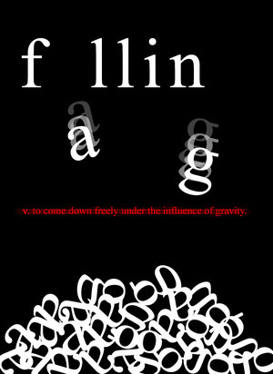


Slide 29
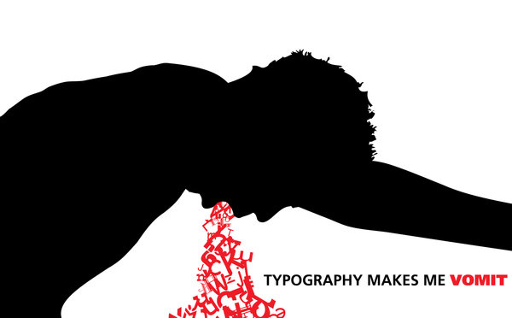

Slide 30


Slide 31


Slide 32
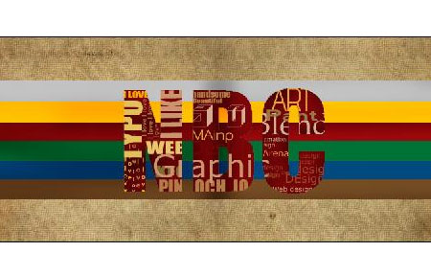

Slide 33


Slide 34


Slide 35
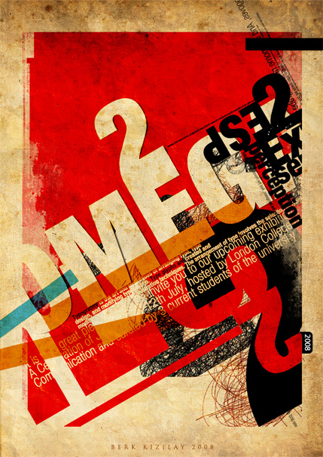

Slide 36
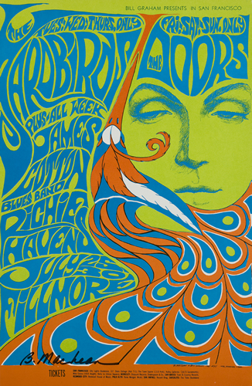

Slide 37
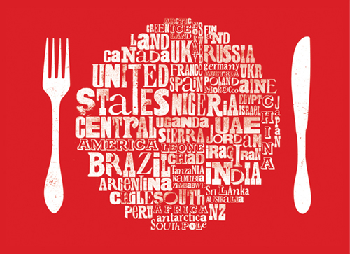

Slide 38


Slide 39


Slide 40


Slide 41
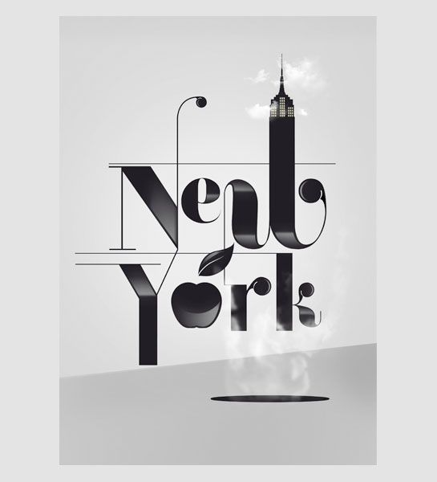

Slide 42


Slide 43
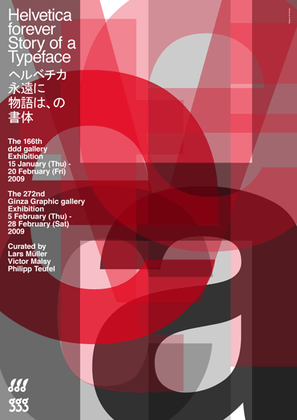

Slide 44
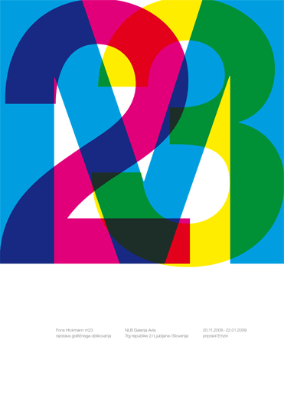

Slide 45


