Slide 1
DETERMINING A
RDBMS STRUCTURE
(Data Normalisation)
Informatics

Slide 2


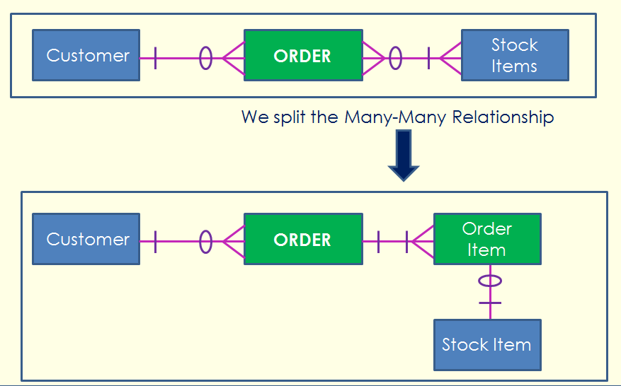
What is RDBMS ?
The acronym “RDBMS” stands for:
Relationship Database Management System
which is the full technical name for a Database.
When we have far too much data to handle in a Spreadsheet, we need to use a Database.
Eg. Online Shop, School Information, Car Registrations, Police Crimes, Medicare, Taxes, etc.
Database has Tables containing Fields
Book has Chapters containing Pages
USB Stick or SD card has Folders containing Files
Chest of Drawers has separate sock drawer, shirts drawer, etc
A stack of Unit 3 and 4 folders has topics for Y12 subjects.

Slide 3
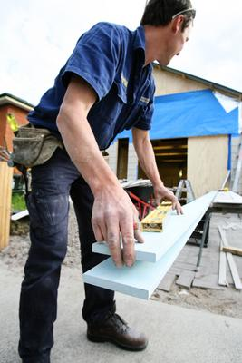
Planning a Database
Creating a database takes some thought. We must first plan the structure, get it right, then start entering the data.
It is a bit like building a house – you don’t want to have to tear down a half built house, because you got the foundations and Frame wrong, and now it is all “wonky”.
So before we get to the input of data stage, (Development Stage of the PSM) we need to make sure that we get the structure and design as close to perfect as possible.

Slide 4
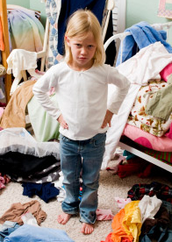
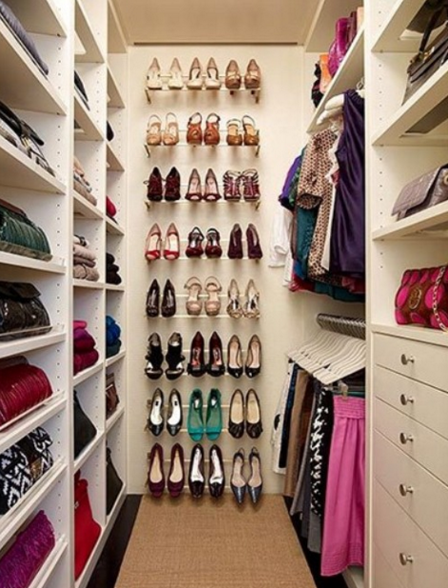

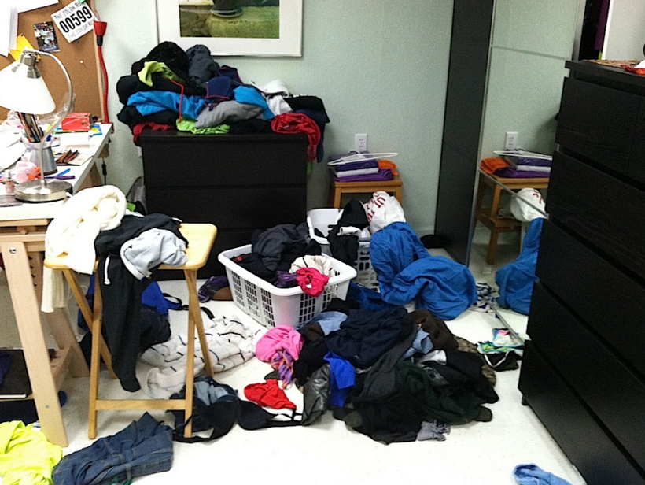

Planning a Database
Designing a database is a lot like getting your room organised, so that you can find things easily, and add new things to the right location.

Slide 5

What is RDBMS Structure ?
Once we have identified that a relational database is required to solve a problem, we need to establish how to break up the data that will be supplied by the client into fields and tables.
It is extremely important to plan this carefully in order to maximise the efficiency of a relational database structure.
Once the fields and tables have been decided upon, the next step will be to apply the table Normalisation Rules to ensure that there are no fields that are not needed, or unnecessarily duplicated, and that the “integrity” (organisation and accuracy) of the data is maintained.

Slide 6
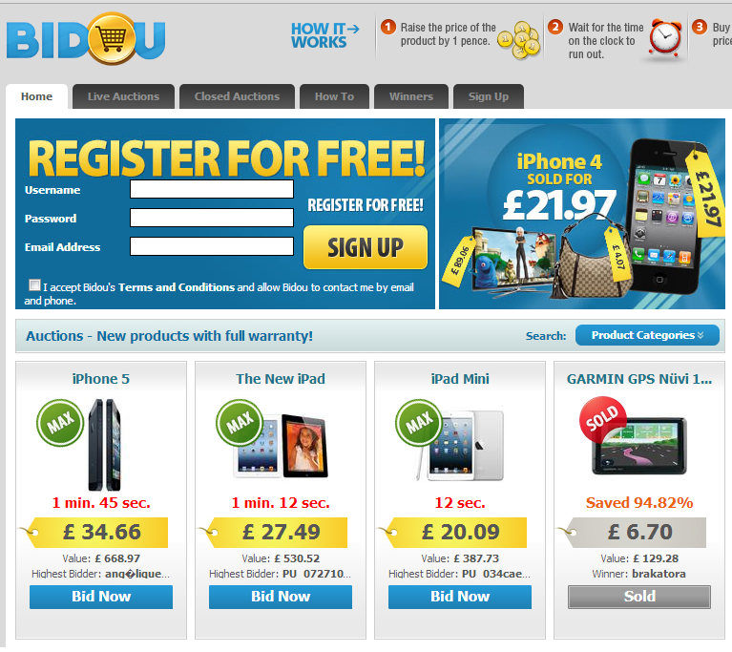
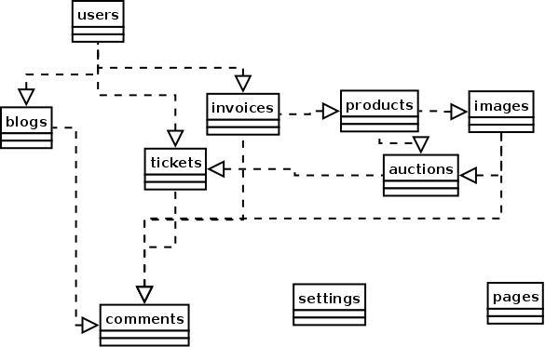
What is RDBMS Structure ?
An Online Auction Site, like a simplified eBay, needs many different Tables in its Database. The Table setup needs to be well designed.
We cannot just make up a big spreadsheet for each Customer!

Slide 7

What is Table Normalisation?
Normalising the tables will need to occur after you breakdown the relevant data into fields and tables.
It also relates to organising the data in a relational database so that : -
  Data repetition is minimised
  Data access is maximised
The normalisation rules are intended to give you as the designer of the database, a tool to ensure that data integrity is maintained.
Data Integrity ensures that all data in a database is complete, and is sufficiently broken down to avoid duplication and repeats.

Slide 8

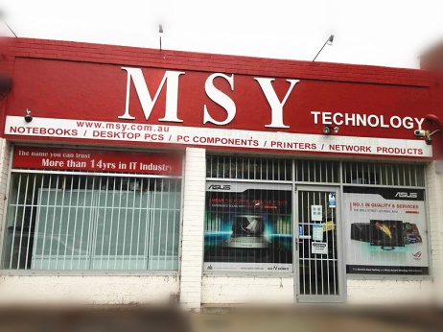
Why Normalise?
Removing data repetition saves lots of storage space, speeds up data access and reduces errors.
Changes need only be made in one place rather than in many places. (Eg. Change Address only in Student Table, not also in Fees Table, and Reports Table).
More powerful data access is possible
when fields are broken down properly.
(Eg. Address has Street, Suburb and Postcode as separate fields)
Eg. Find what Postcodes have your biggest customers for business location and/or advertising and marketing purposes.

Slide 9
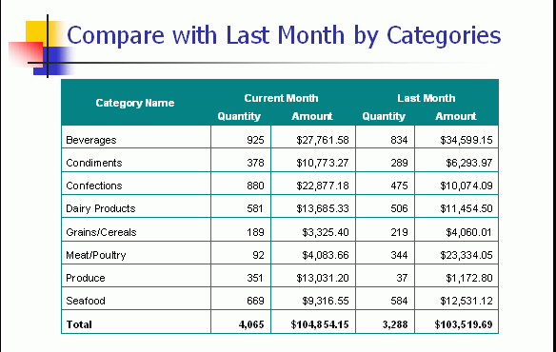
Why Normalise?
Allows more information to be easily Stored and Reported
Allows users to get all sorts of information out of the stored data i.e. How many products did we sell each month?

Slide 10
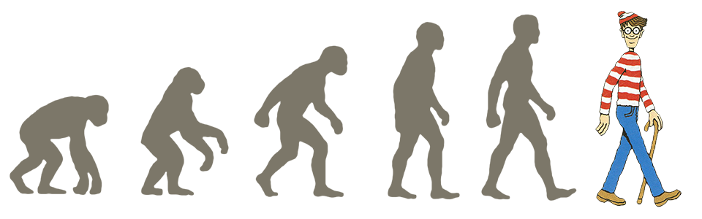
The 6 “Normal” Forms
There are 6 normal forms and each rule is applied successively from the first normal form (1NF) to the sixth normal form (6NF). Although only the first three are used for the majority of databases.
If you have planned your database well, it will automatically comply with the normalisation rules.
The rules are actual guidelines (not laws) for the actual structuring of database tables and fields.

Slide 11
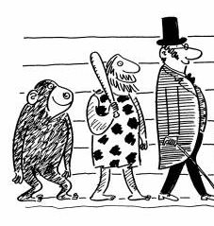


Getting to Third Normal Form
REMEMBER – 1st and 2nd normal forms are stages/steps to achieving the objective, which is 3rd normal form.

Slide 12



The Normal Forms
First Normal Form (1NF) – fields split up properly into individual component parts
Second Normal Form (2NF) – first stage of breaking up the data into meaningful groupings called tables, (Everything in a Table is relevant for that Table)
Third Normal Form (3NF) – data completely broken up into tables
and linked by ID Codes / Keys

Slide 13

1NF - First Normal Form
The 1NF guidelines are basically common sense.
  Eliminate duplicate data where possible
  Break up fields so only one data item is in each field
  Convert data into correct format
  Start to organise the data into meaningful groupings

Slide 14
Your turn… attempt to repair this table using 1NF
Customer ID | Name | Phone
111 | Fred Smith | 024566 3456
222 | Mary Jones | 024567 8900
333 | Tim Blogs | 073254 5676
  Eliminate duplicate data where possible
  Break up fields so only one data item is in each field
  Convert data into correct format
  Start to organise the data into meaningful groupings

Slide 15

Repaired using 1NF rules
Customer ID | FirstName | LastName | PhoneNbr
111 | Fred | Smith | 024566 3456
222 | Mary | Jones | 024567 8900
333 | Tim | Blogs | 073254 5676
This table now allows customers to be sorted and searched by first name and/or surname separately.
Also, the names can be used individually, like “Dear Fred” instead of “Dear Fred Smith”

Slide 16
Your Turn: Repair This using 1NF rules
Customer ID | Address
111 | 66 Lake Rd, Mentone, 3198
222 | 2/45 Richmond Lane, Richmond, 3121
333 | 135 Spring St, Melbourne, 3000
  Eliminate duplicate data where possible
  Break up fields so only one data item is in each field
  Convert data into correct format
  Start to organise the data into meaningful groupings
Hint:
An address like “3 Fred St, Sale, 3586” has 3 pieces of data: street address, town, and postcode.

Slide 17
Repaired!
Customer ID | Street | Suburb | Postcode
111 | 66 Lake Rd | Mentone | 3198
222 | 2/45 Richmond Lane | Richmond | 3121
333 | 135 Spring St | Melbourne | 3000
Now each field can be searched & sorted and used individually (e.g. addressing envelopes, or finding the suburbs most customers live in for an upcoming Marketing Campaign)

Slide 18
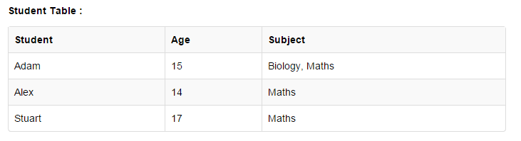
Your Turn: Repair This using 1NF rules
  Eliminate duplicate data where possible
  Break up fields so only one data item is in each field
  Convert data into correct format
  Start to organise the data into meaningful groupings
Note:
It is okay for Maths to be duplicated, as several different students are studying it.

Slide 19
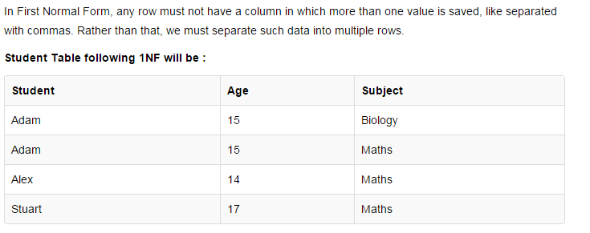
Repaired!
We need to store each subject for a particular student as a separate record, not all bunched up in one column as multiple items.

Slide 20

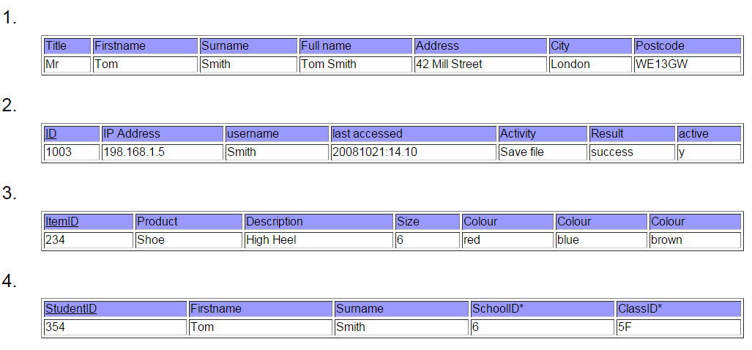
Are these Tables in 1NF ?
  Eliminate duplicate data where possible
  Break up fields so only one data item is in each field
  Convert data into correct format
  Start to organise the data into meaningful groupings

Slide 21
ANSWERS: Are these Tables in 1NF ?
  Table 1: Not in 1NF because “Full Name” is duplicate data
  Table 2 is in 1NF (No Duplicates, Data items broken down ok)
  Table 3 is Not in 1NF – Duplicate Colour Fields all named the same
  Table 4 is in 1NF (No Duplicates, Data items broken down ok

Slide 22

2NF – Second Normal Form
Achieving 2NF means 1NF has already been achieved
Each normal form builds on the previous forms
Removes more duplicate data, and moves this data to other tables.
Deals with design problems that could threaten data integrity.

Slide 23
2NF – Second Normal Form
Remove subsets of data that apply to multiple rows of a table and places them in separate tables.
Creates relationships between these new tables and their predecessors using unique keys.
Look at Tables 1.4 to 1.9 of your textbook which shows how 2NF has been used to create separate tables, where everything in each table is fully dependant on the Primary Key

Slide 24
2NF – Second Normal Form
Here is our previous 1NF Table:
This Table is NOT in Second Normal Form
The Problem here is that we store a student’s Age many times, by putting it in with each subject they do. (Eg. Adam who is 15 years old)
What we really need is to have a Separate Table to store Age.

Slide 25
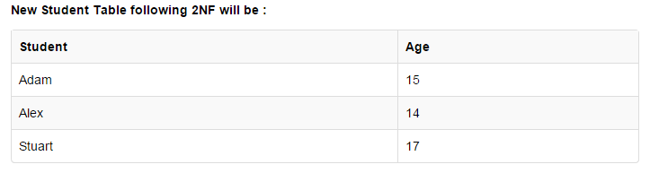
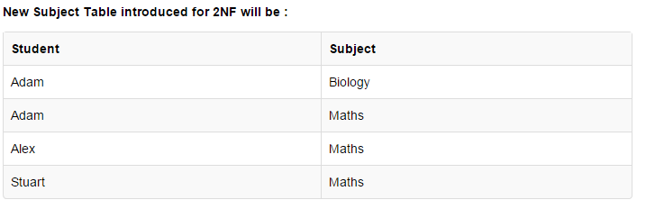
2NF Repaired!
Age Table
Subjects Table
We now have two separate tables where data items are not unnecessarily duplicated for any Student.

Slide 26
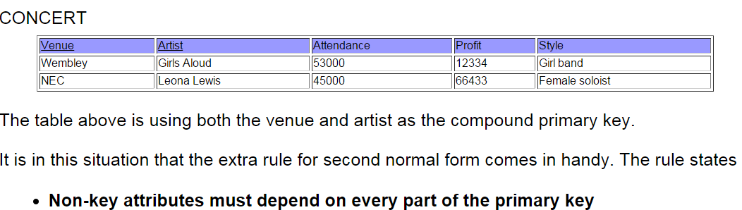
2NF – Second Normal Form
Here is a Table About Concerts:
This Table is NOT in Second Normal Form
The Problem here is that the “Style” of the Performer is not totally relevant to how many people attended and how many $ were made.
What we really need is to have a Separate Table to store Styles.

Slide 27
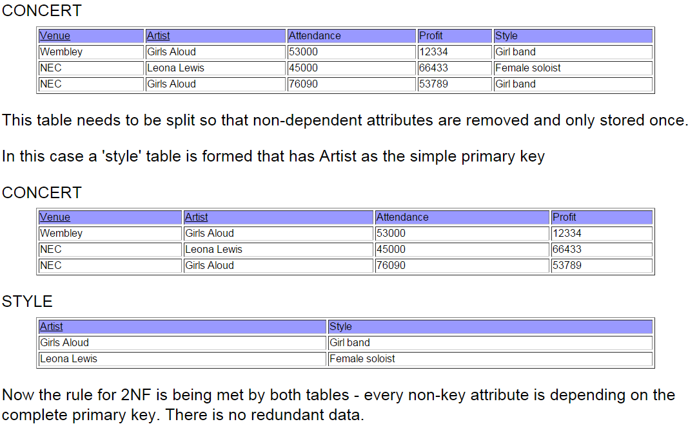
2NF Repaired!
Not in
2NF!
Concert
Table
Style
Table

Slide 28
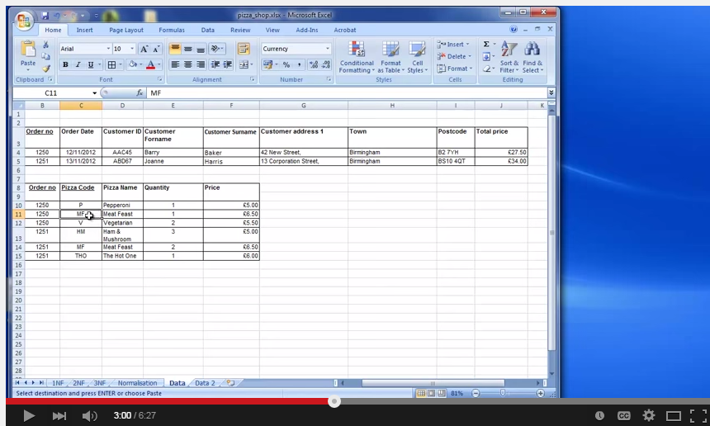
2NF – Second Normal Form
2NF not related items duplication can
be tricky as shown in this video:
https://www.youtube.com/watch?v=8PwomfwMMyQ

Slide 29

3NF – Third Normal Form
Third normal form (3NF) goes one step further:
Uses ID codes and Number IDs to minimize the amount of storage
Uses these codes as links to other tables so we can find any information we need
Sets up relationships between tables
In each table we must have fields that are only dependant on the primary key
Also separates data into reference and transaction data.

Slide 30
Normalise this data using the rules 1NF, 2NF & 3NF
 | Bounces Online Books
Name | Address | Book purchased | Item Cost | Date of purchase | Quantity | Total Cost
Tom Jones | 56 Latrobe Street,Melbourne, VIC 3000 | The Girl in the Hornet's Nest | $24.95 | 08/03/2011 | 1 | $24.95
Tom Jones | 65 Landon Street,Melbourne, VIC 3000 | Curiosity Killed the Cat | $14.95 | 08/03/2011 | 1 | $14.95
Mary Small | 236 Smith Street, Collingwood VIC 3002 | Lord of the Necklaces | $18.95 | 10/03/2011 | 2 | $37.90
Mary Small | 237 Smith Street, Collingwood VIC 3002 | The Girl in the Hornet's Nest | $24.95 | 10/03/2011 | 1 | $24.95
Fred Blogs | 45 High Street, Sydney, NSW, 2000 | The Hobby | $13.95 | 12/03/2011 | 2 | $27.90
Fred Blogs | 45 High Street, Sydney, NSW, 2000 | Lord of the Necklaces | $24.95 | 12/03/2011 | 1 | $24.95
Fred Blogs | 45 High Street, Newcastle, NSW, 2000 | The Girl in the Hornet's Nest | $24.95 | 12/03/2011 | 1 | $24.95

Slide 31
First stage - 1NF
First Name | Last Name | Address1 (Billing) | Address2 (Delivery) | Suburb | State | Postcode | Book purchased | Item Cost | Date of purchase | Quantity | Total Cost
Tom | Jones | 56 Latrobe Street |  | Melbourne | VIC | 3000 | The Girl in the Hornet's Nest | $24.95 | 08/03/2011 | 1 | $24.95
Tom | Jones | 65 Landon Street |  | Melbourne | VIC | 3000 | Curiosity Killed the Cat | $14.95 | 08/03/2011 | 1 | $14.95
Mary | Small | 236 Smith Street |  | Collingwood | VIC | 3002 | Lord of the Necklaces | $18.95 | 10/03/2011 | 2 | $37.90
Mary | Small | 236 Smith Street |  | Collingwood | VIC | 3002 | The Girl in the Hornet's Nest | $24.95 | 10/03/2011 | 1 | $24.95
Fred | Blogs | 45 High Street |  | Sydney | NSW | 2000 | The Hobby | $13.95 | 12/03/2011 | 2 | $27.90
Fred | Blogs | 45 High Street |  | Sydney | NSW | 2000 | Lord of the Necklaces | $24.95 | 12/03/2011 | 1 | $24.95
Fred | Blogs | 45 High Street |  | Sydney | NSW | 2000 | The Girl in the Hornet's Nest | $24.95 | 12/03/2011 | 1 | $24.95

Slide 32
Second Stage – 2NF
The 1NF Data is about Customers and Books Purchased.
It needs to be broken into two tables:
Customer Details and Books Purchased.
There are also other problems such as customers
having identical names.
1. Customer Details Table – Introduce an ID Number Code
(3NF concept) to deal with Duplicate Customer names.
CustCode | First Name | Last Name | Address1 | Address2 | Suburb | State | Postcode
116 | Tom | Jones | 56 Latrobe Street |  | Melbourne | VIC | 3000
117 | Tom | Jones | 65 Landon Street |  | Melbourne | VIC | 3000
457 | Mary | Small | 236 Smith Street |  | Collingwood | VIC | 3002
890 | Fred | Blogs | 45 High Street |  | Sydney | NSW | 2000
See next Slide for Books Purchased Table

Slide 33
Second Stage – 2NF
2. Books Purchased Table
CustCode | Book purchased | Item Cost | Date of purchase | Quantity | Total Cost
116 | The Girl in the Hornet's Nest | $24.95 | 08/03/2011 | 1 | $24.95
116 | Curiosity Killed the Cat | $14.95 | 08/03/2011 | 1 | $14.95
457 | Lord of the Necklaces | $18.95 | 10/03/2011 | 2 | $37.90
457 | The Girl in the Hornet's Nest | $24.95 | 10/03/2011 | 1 | $24.95
890 | The Hobby | $13.95 | 12/03/2011 | 2 | $27.90
890 | Lord of the Necklaces | $24.95 | 12/03/2011 | 1 | $24.95
890 | The Girl in the Hornet's Nest | $24.95 | 12/03/2011 | 1 | $24.95

Slide 34

Third Stage - 3NF
Customer Table
CustomerCode | First Name | Last Name | Address1 | Address2 | Suburb | State | Postcode
116 | Tom | Jones | 56 Latrobe Street |  | Melbourne | VIC | 3000
457 | Mary | Small | 236 Smith Street |  | Collingwood | VIC | 3002
890 | Fred | Blogs | 45 High Street |  | Sydney | NSW | 2000
Purchases Table
CustomerCode | BookCode | Date of purchase | Quantity | Total
116 | 1 | 08/03/2011 | 1 | $24.95
116 | 15 | 08/03/2011 | 1 | $14.95
457 | 36 | 10/03/2011 | 2 | $37.90
457 | 1 | 10/03/2011 | 1 | $24.95
890 | 44 | 12/03/2011 | 2 | $27.95
890 | 36 | 12/03/2011 | 1 | $28.95
890 | 1 | 12/03/2011 | 1 | $24.95
Note that we do not
store the Total because
It can be calculated
as needed by looking
up the Price in the
Books Table.
Books Table
BookCode | Book Name | Genre | Item Cost
1 | The Girl in the Hornet's Nest | Murder Mystery | $24.95
15 | Curiosity Killed the Cat | Romance | $14.95
36 | Lord of the Necklaces | Fantasy | $18.95
44 | The Hobby | Fantasy | $13.95

Slide 35

Benefits of Normalisation
The database does not have redundant data, it is smaller in size so less money needs to be spent on storage
Because there is less data to search through, it is much faster to run a query on the data
Because there is no data duplication there is better data integrity and less risk of mistakes.
Because there is no data duplication there is less chance of incorrectly storing two or more different copies of the data
A change or Update can be made which can then instantly be cascaded across to any related records.

Slide 36

Problems with Normalisation
You need to be careful with trying to make data atomic. Just because you can split some types of data further, it isn't always necessarily the correct thing to do.
  For example, telephone number might contain the area code “03” followed by the number 03 97026580. It wouldn't be sensible to separate out these two items.
You can end up with many more tables to deal with than in an un-normalised database.
The more tables and the more complex the database, the slower queries can be to run
It is necessary to assign more relationships to interact with the larger numbers of tables
With more tables, setting up queries can become more complex

Slide 37

Glossary Terms to Know
Table
Fields
Records
Field types – including Boolean
Validation
  range, type, existence, existence in limited list
Key field, primary key, match field
Foreign key
Relational
Flat-file
Relationships
  1:1
  1:many
  many:many

Slide 38

Exam Knowledge
Students are required to be able to answer the following questions: -
  Define data integrity.
  Explain the difference between all 3 forms of normalisation?
  Explain why normalisation is important?
  Name the 3 different forms of relationships?
  Describe what is a primary key and how is it different to a foreign key?
Students are also required to normalise to 3NF using data provided.

Slide 39
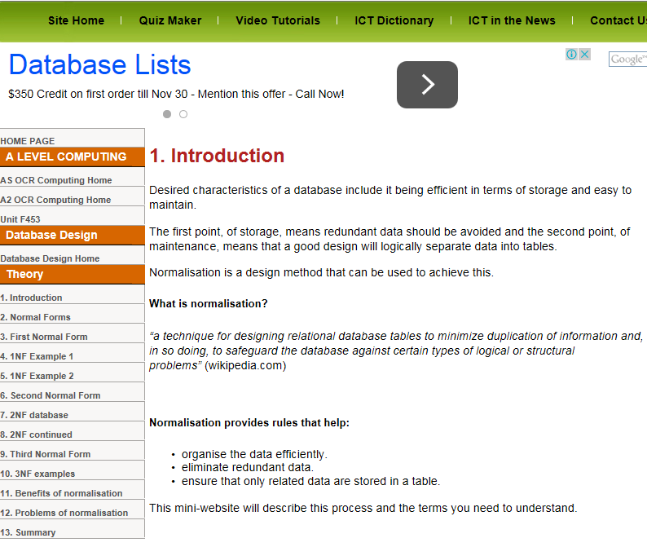
Acknowledgement
This presentation was made
with the help of the following website, which I encourage you to use in preparing yourself to better understand “Normalisation”
http://www.teach-ict.com/as_as_computing/ocr/H447/F453/3_3_9/normalisation/miniweb/index.htm
Information from various Edulists Powerpoints has also been included

