Slide 1

DATA
Informatics

Slide 2
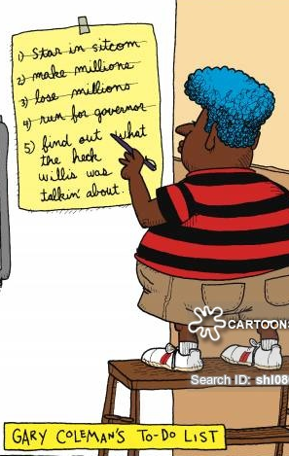
Lesson Objectives
Data Versus Information
What is Primary Data?
What is Secondary Data?
What is Qualitative Data?
What is Quantitative Data?
Data Sources
Case Study – Ready Set Go Gym

Slide 3

Data Versus Information
Raw Data has not yet been filtered
or processed by interpretation or
evaluation. It is raw without meaning.
It is in a pure unassembled form of just facts and figures.
It can be data that you have collected directly (by Interviews, Observations, or Surveys), or large data sets downloaded from the Internet, or a set of measurements you have taken.
Data can also include sounds, images and video, not just text, numbers, dates, and measurements.
Often data is gathered to answer a specific question or to support or refute a Hypothesis.

Slide 4

Information
Once a computer has been used to help process data it is then called Information. Information can be defined as processed, organised and value-added data.
WHAT DOES VALUE ADDED DATA MEAN?
Critical to using computer to solve information problems is an understanding of how data can be input to a computer and then manipulated to create meaningful information.
Input Data = Names, Books, Dates
Output Information = Library Overdue Books List

Slide 5
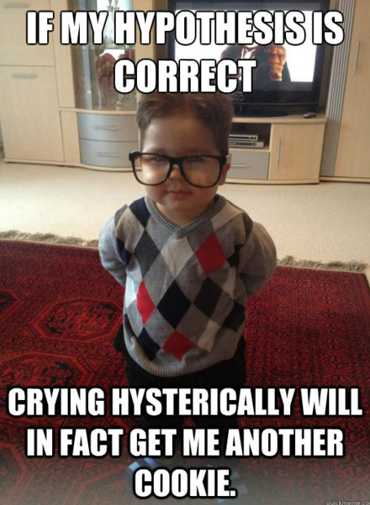
Hypothesis
A Hypothesis is an educated guess or prediction that tries to explain a set of observations and/or patterns.
The way to TEST a Hypothesis is to gather
plenty of Data and analyse it.
A Hypothesis can never be Proven with Data!
It can only ever be:
“Supported” if the data agrees or matches up with it
OR
“Refuted” (shown to be false) if the data does not agree or does not match up with the original prediction or situation.

Slide 6
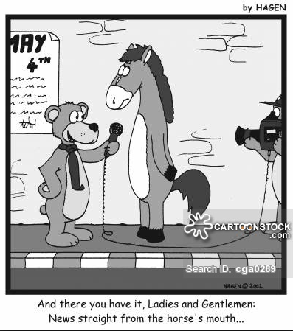
Primary versus Secondary Data
Primary Sources: - Are those that
provide original and uninterpreted
data, facts and figures.
This is information that has not been analysed
or processed in any way.
  Examples: - Original Un-edited Interviews
  - Downloaded XLS of Census Figures
  - Measurements and Observations you have made
  Surveys and Questionaires
Secondary Sources:- Are those that give information that has been processed, interpreted or analysed in some way.
  Examples: - Newspaper Article or TV News
  - YouTube Videos, TV Interviews
  Information taken from a Web Page

Slide 7
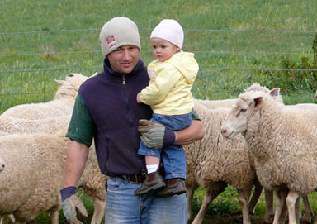
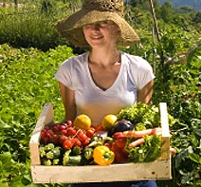
Types of Primary Data
Authentic Journal Articles
Questionnaires or Surveys
Raw datasets downloaded from the Internet
Diaries and Letters
Speeches
Audio / Video recordings (unedited)
(usually of Interviews, or for Observations)
“Primary” Produce

Slide 8

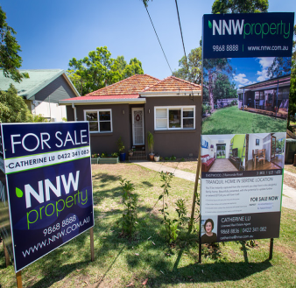
Sources for Internet Datasets
There are many Government and Non-Government public sources of Data on the Internet.
(You just have to Google for them)
Australian Bureau of Statistics Census Data:
http://www.abs.gov.au/websitedbs/censushome.nsf/home/data
Road Accident Data:
https://www.vicroads.vic.gov.au/safety-and-road-rules/safety-statistics/crash-statistics
Wages Data:
http://www.tradingeconomics.com/australia/wages
Looking at Data is a great way to come up with a Hypothesis:
Eg. Many people aged 18-30 cannot afford to buy a property
with the wage they are earning, because wages have not kept
up with Property Price increases, and the cost of living is also a
lot more than it was when their parents were young adults.

Slide 9
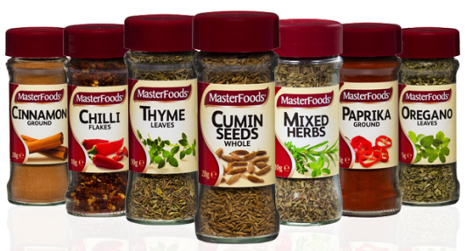
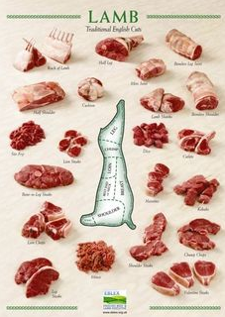
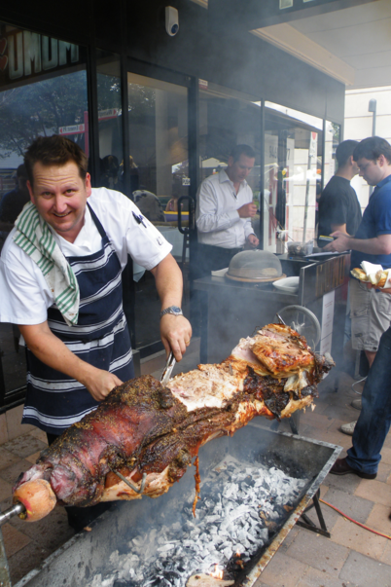
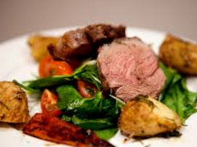
Secondary Data
It is collected and often already interpreted
and processed by someone other than yourself.
Secondary data is usually collected from:
Encyclopaedias
Books
Polls and Surveys (not your own)
Newspapers
Magazines
Web Pages
Like uncooked meat, Secondary Data is often only partially processed, and is not fully digestable information.
U401
U302

Slide 10


Primary and Secondary – Pros and Cons
Primary |  | Secondary
No mysteries about the source Know exactly where it came from and how reliable it is |  | Potentially inaccurate, biased, unrepresentative, or even false
Time and labour intensive to collect (Surveys, Interviews, etc) |  | Quick and Easy to Collect
No original data has been lost and so you can analyse the data in detail |  | Can be gathered from many locations and cover a long span of time
Expensive to Collect (Time & $) (eg. Making a Video Interview) |  | Secondary sources are the only way to gather Historical Data
You know where follow up data can be found if you find you need some extra data |  | Could have been edited too much and is distorted as a result (Eg. Edited Interview = Angry Person bits only after sledging)
Use this data gathered directly to support secondary data you got from the Internet |  | Very helpful for looking at when making a Hypothesis
See pages 82 and 83 for full lists

Slide 11
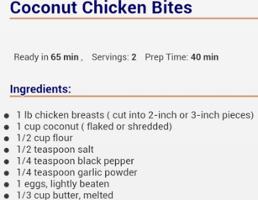
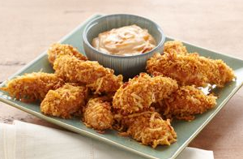
Quantitative versus Qualitative
Quantitative data is concerned
with numbers and measurement.
Think of the “n” in Quantitative as being the “n” for number
Eg. Income, Height, Weight, Lifespan, Cost, Score, Time are all numbers.

Slide 12
Quantitative versus Qualitative
Qualitative data is concerned
with feelings, views, and opinions.
Think of the “Qualit” in Qualitative as being Quality
Eg. How good did those Coconut Bites look, smell, and taste. How did you feel about them: delicious, okay, bland and
flavourless, rubbery and overcooked, etc etc expressed in words not numbers

Slide 13
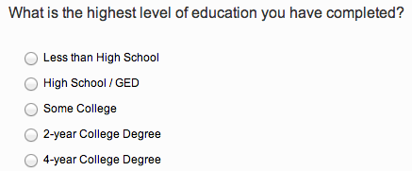
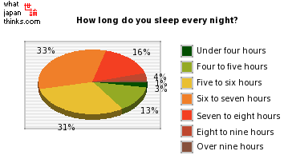
Quantitative Data
Quantitative data is concerned
with numbers and measurement.
“How many hours did people
sleep each night”?
It uses closed questions and
can be easily scored.
(Closed = a Number value, Yes/No, or Multiple Choice, etc only limited options apply and the results can usually be graphed)

Slide 14

Qualitative Data
Qualitative data is expressed in words because it is concerned with your respondent’s feelings, views, experiences and opinions.
It’s more difficult to analyse statistically because it has to
be coded to be scored.

Slide 15
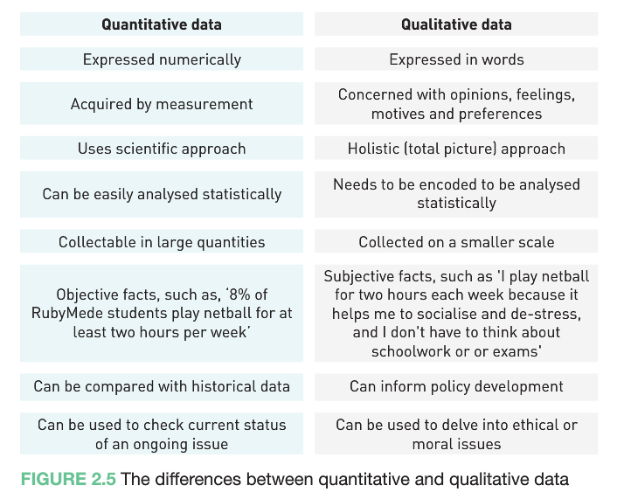
Qualitative vs Quantitative – Page 85

Slide 16
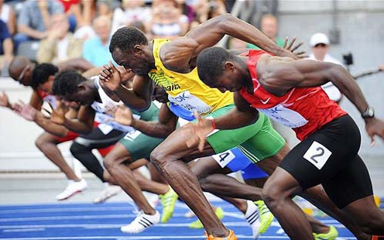
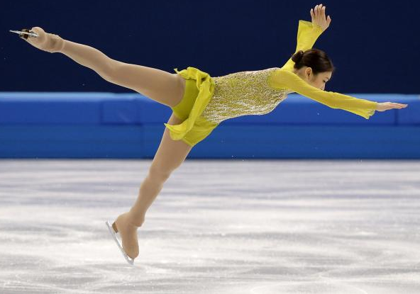
Classwork (5 mins)
Categorise the scoring of these events as either Qualitative or Quantitative and explain the
reason why
Figure Skating
Speed skating
Judo
100m sprint
Team show jumping (Equestrian)

Slide 17
Coding Qualitative Data
Interview transcripts, open ended questions, video, case study, observations, focus groups, social media comments, journals, field notes, etc
Description, appearance, preference, attitude, beliefs
Assign a word, number or symbol to data to enable comparisons
Use codes to summarise text
Eg ‘I use passwords and an avatar to protect my identity and data’ could be summarised as ‘Uses Security’.
Electronic (NVivo)
http://www.digipubs.vic.edu.au/vcaa/vce-computing/vce-computing-units-3-and-4-informatics-unit-3-intro

Slide 18
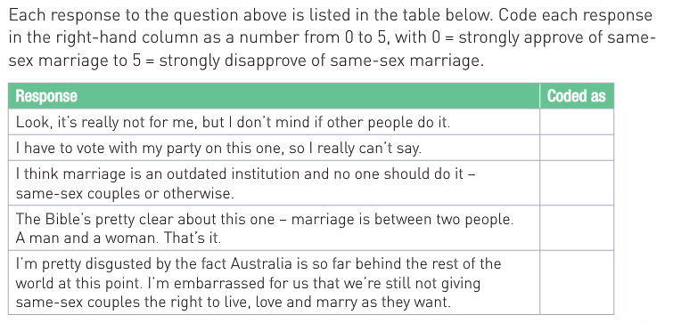
Coding Qualitative Data Exercise (5 mins)
Consider this question and the responses:
What are your views on same-sex marriage?

Slide 19
Same Sex Marriage Response Coding
Each response to the question above is listed in the table. Code each response in the right-hand column as a number from 0 – 5 with 0 = strongly approved
What criteria did you use to turn a thought into a single number?
The detail and nuance in the responses are stripped back by coding each response as a number. There are other ways of coding qualitative data, such as categorising and labelling. How might you have coded the responses to better represent their content?

Slide 20
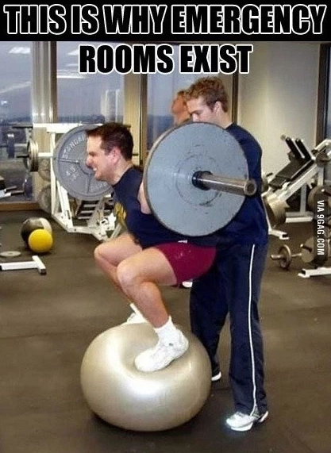
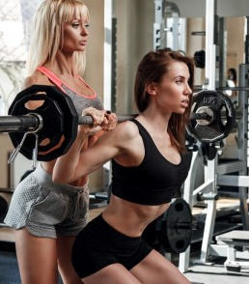

Ready Set Go Gym - Case Study
Pages 87 to 90 give a case Study where a Gym is losing Members and the owner wants to find out two things:
1) Why are they leaving?
2) How could she convince them to stay?
She decides to do half hour interviews with members who are not renewing memberships.
The Data she obtains is Qualitative Data and so she needs to work through putting the responses into Categories and then working out Priorities.
She finds out the key things all interviewees mention, and counts how many people mention the same thing.
She then looks for trends and decides anything related to SAFETY is the highest priority.

Slide 21
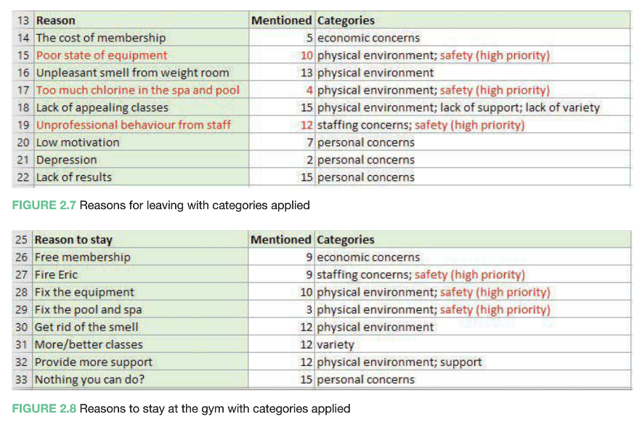
Ready Set Go Gym - Case Study
@@

Slide 22
Qualitative Data and Coding
Descriptive Coding involves reducing down original wordy sentences
to summary terms.
Eg. “She cares about my learning and so I trust her” -> Trustworthy
Analytic Coding or Theoretical Coding replaces ideas with summary
number values, codes or labels.
Eg. An excellent Photoshopped Magazine Cover Mock Up for Multimedia
is assigned a 10 from 1 to 10 grading, as well as a label of “Excellent”
and “Fully Satisfies the Design Brief”
Encoding Qualitative Data allows responses to be grouped,
averaged, totalled, and compared.
(It is kind of like turning Qualitative sentences into Codes and
Numbers that can then be processed a lot like Quantitative Data.
Processing Qualitative Data can be challenging.

Slide 23
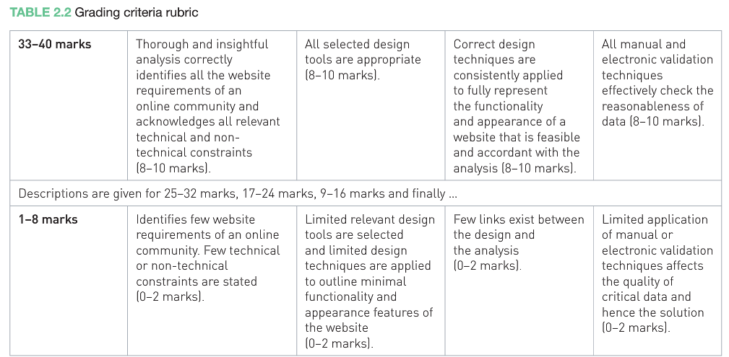
Qualitative Data and Rubrics
These are basically a set of criteria used to place assignments and work into “A”, “B”, “C” etc categories
Hmm…. In the first boxes 4 x 8 = 32 marks not 33
and in the bottom box 4 x 0 would be Zero not 1

Slide 24
Data and the U302 SAT
Organise
Manipulate
Secure
Data and information

Slide 25

Criterion 3: Collect, Organise, Manipulate and Secure
COLLECTING DATA IS ONLY THE FIRST PART OF THE SAT DATA PROCESS
We then have to:
Organise and Manipulate
Use software tools to manipulate data
Qualitative data must be codified and evidence must be present
Non digital data must be digitalised
Students must show evidence of the information generated from their data, manipulated using appropriate software.
File Management and Security
Evidence must be provided of file management
eg a folder map, a listing of files, etc
Evidence of how these files are secured and meet legal requirements
SD p. 15, 30, 31, 38; Administrative information p. 2

Slide 26
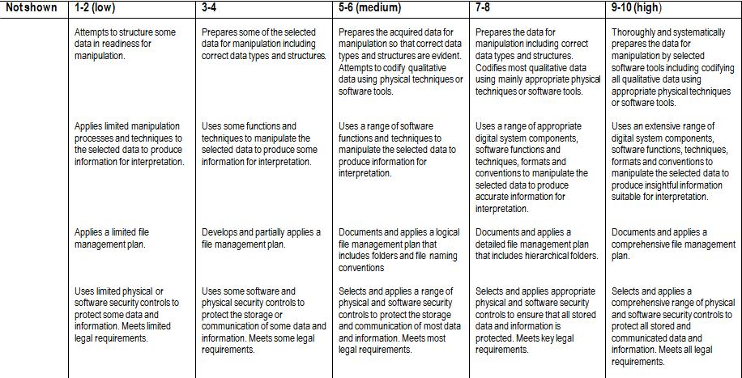
Criterion 3: Skills in organising, manipulating and securing data and information

Slide 27

Classwork / Homework
Read fully through the case study – “Ready Set Go!” pages 87 to 90
Learn the Essential Glossary Terms on page 124
TYK Questions 1 to 8
test your knowledge on page 126

