Slide 1
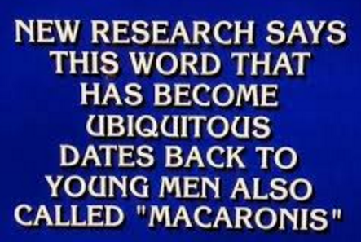




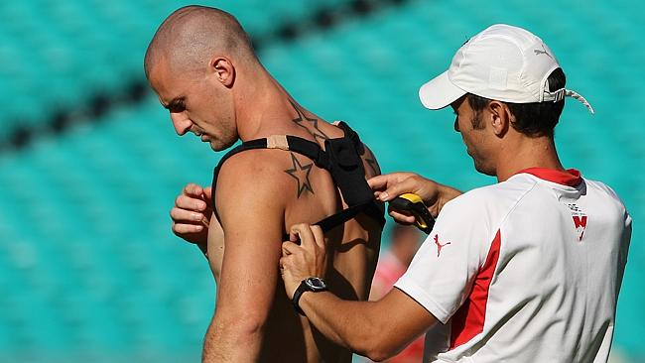
SAT Introduction – U302 and U401

Slide 2
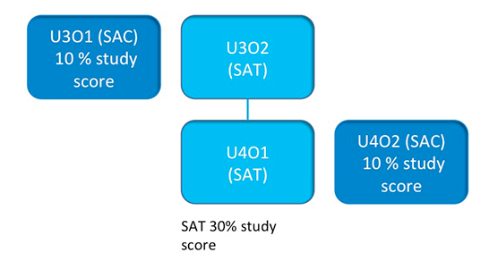
Informatics SAT – U302 and U401
RDBMS and User Flow Diagram
Major Investigation
Data Analytics: complex data, confirm or refute HYPOTHESIS, project plan
Online Presentation
Data Analytics: present findings through Multimodal Online Solution (Website with Infographs and Video etc) plus Evaluation Report
30% study score
Compare Information Management Strategies of two Organisations
End of Year VCAA Exam on Units 3 and 4 Theory: 50% of Study Score

Slide 3

Why are we doing this SAT ???
Data Analytics involving “big data” is a rapidly growing area of Information Technology with growing employment opportunities ☺
Incredible amounts of data are being captured and used by Organisations and Governments to gain insights and plan strategies. We need to know this.
Read the following two short articles:
Five Retail Uses of Big Data
http://www.crmsearch.com/retail-big-data.php
Intelligent Targeting of Customers, including using GPS via a Phone App:
http://www.ibmbigdatahub.com/presentation/big-data-retail-examples-action

Slide 4
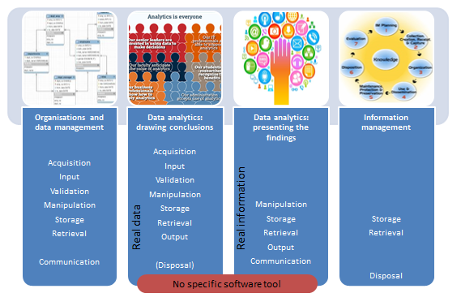
Informatics – 50% School Assessed
10% DB U301 SAC 30% for SAT 10% Theory Test SAC

Slide 5

The SAT in 100 Words or Less
Perhaps I love Basketball, so I form a “Hypothesis” that what makes a Top Performing Team best is their ability to get 3 pointers, because this is the difference that makes the difference.
I make a Project Plan estimating how long each part of U302 will take.
I go and get lots of relevant basketball stats off the Internet, store them in an organised folders setup, put them into MS Excel Spreadsheets, do Mean, Median, Mode, Sorting, Filtering, Max, Min, Graphs etc etc and come up with some Summary Results.
I also interview some local basketball coaches, and get their opinions and answers, I take Video of the Interviews, and also get YouTube or my own snippets of Basketball. I observe some games and record stats, focussing on 3 pointers.
All these findings either prove my hypothesis or show that I was wrong. (I do not lose marks for being wrong!) I write up a Final Report.
U302 is then finished by early June .
In U401 I make a fancy MultiModal Website about my Project, and have to follow a Project Plan Gannt Chart while doing this, and make another Final Report.
I complete my U401 multimodal website by early October.
Most of the work for my SAT is done in classes in between learning book theory for the Exam. I will have to do a small portion of work (like Interviews) outside of class. (Unless I am lazy or ineffective in class, and then I will have to do lots at home ☹)
My teacher checks and grades each of the 8 criterion tasks as they are completed and fills out a form to send to VCAA with my scores for each of the 8 tasks on it.

Slide 6
Problem-solving Methodology
Evaluation
Project Management
C4. Project Management concepts and processes
Assess effectiveness of project plan in managing project progress
Entertainment, Sport, Business, Education
Science, Medicine,
Evaluate effectiveness of solution (MMOS) to communicate conclusions
Existing or emerging trend
Frame a hypothesis: logical variables, prediction, testable
Use software to prepare a Gantt chart
Uses own evaluation criteria
Use software tools to manipulate data to produce MMOS.
C8. Evaluate Solution & Project Plans
Topic/ Research Question
Specific constraints on hypothesis and scope
Perform validation and testing on MMOS
C1. Hypothesis formation and
conclusion
Substantiate a conclusion that confirms or refutes the hypothesis
C7. Develop MMOS
Analysis
Monitor and record progress
Secure files
Units 3 & 4 Informatics SAT
Development
Acquire multiple complex data sets; different types , qualities and structures
Concepts: milestones, dependencies
MMOS confirms or refutes hypothesis
C6. Present and communicate information in MMOS
C2. Acquire, validate, and reference data
MMOS, educational world-wide audience
C5. Design MMOS
Range of collection methods
C3. Organise, manipulate and secure data & information
Reference all data sources
Use formats, conventions, design principles
Validate data; to ensure integrity
Processes:
tasks, sequence, resources, time allocation
Detailed design; functionality & appearance
Prepare data for manipulation
Prepares and uses own evaluation design criteria
Use hardware and software to manipulate data to produce information
Prepare 2 – 3 design ideas
File management plan
Security controls
Maintain project journal; Record adjustments
Unit 4 Outcome 1: SAT Part 2
Design
Unit 3 Outcome 2: SAT Part 1

Slide 7

SAT Software Tools and Functions
Unit 3 Outcome 2: Capturing Hypothesis Data and Analysing It
Gannt Chart tool for documenting project plans (Eg. MS Excel like in Year 11)
Software tools to capture, store, prepare and manipulate data (Probably Excel, but perhaps also MS-Access Databases, and other software. )
Unit 4 Outcome 1: MultiModal Presentation (Text, Graphic, Video, Sound Website)
Software tools to manipulate data for creating a multimodal online solution
Eg. Video Editor, Free Online Infographics Makers, Audio Editor, etc
Website Maker: Dreamweaver, Muse, Wix, Weebly, Wordpress, Blogger, etc
Gannt Chart Tools for documenting Project Plan (Eg. MS Excel like in Year 11)
Unit 4: Results Presenation in a Multimodal Online Solution (MMOS)
Apply functions that provide the ability to:
Import/enter, edit and format content
Structure screen layout
Create links
Provide navigation
Create buttons
Create tags (alt tags)
Incorporate images (still/moving), text and sound, Infographics
http://www.vcaa.vic.edu.au/Pages/vce/studies/computing/informatics.aspx

Slide 8
SAT Assessment Criteria
Unit 3 Outcome 2
1. Depth of understanding of formation of a hypothesis and coherence of a conclusion
3. Skills in organising, manipulating and securing data and information
4. Depth of understanding of project management concepts and processes
2. Skills in acquiring, validating and referencing data
Unit 4 Outcome 1
5. Skills in generating design ideas and designing preferred solutions
7. Skills in technically developing a multimodal online solution that confirms or refutes a hypothesis
8. Understanding of strategies for evaluating the effectiveness of a multimodal solution and assessing the effectiveness of the project plan in monitoring progress
6. Skills in communicating information to educate a world-wide audience through a multimodal online solution
http://www.vcaa.vic.edu.au/Documents/vce/computing/Informatics_SBA.pdf (Page 12)

Slide 9
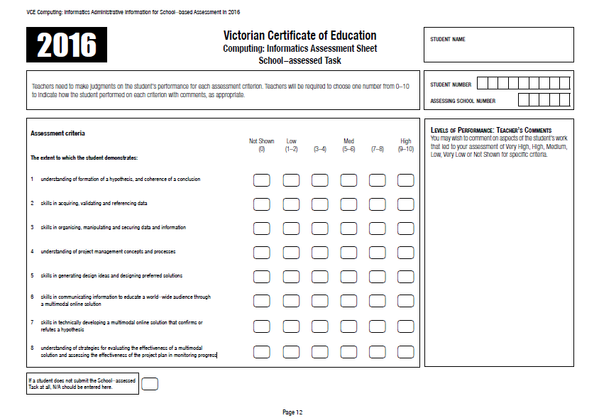
U
3
0
2
SIAR 1
15th June
U
4
0
1
SIAR 3
10th October
There are 8 Assessment Items for the SAT and a Rubric derived score from 0 to 10 is given for each – Eg. How well was each of the tasks done according to VCAA Rubric Criteria.

Slide 10
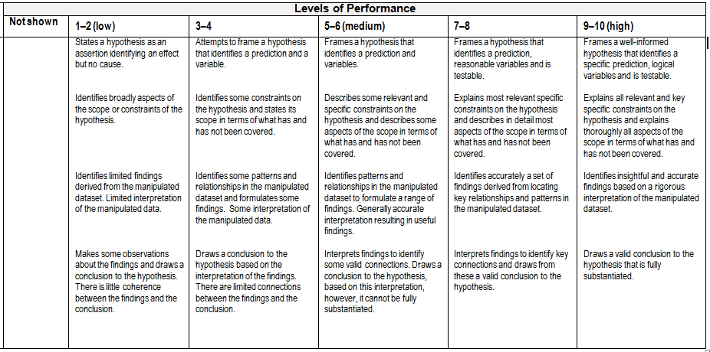
What are the Rubric Criteria?
H
Y
P
O
T
H
E
S
I
S
C
O
N
C
L
U
S
I
O
N
Eg. The first two rows are for how well you formulate your Hypothesis.
SAT Task 1 is split over the start and very end = Assessment of Your Starting Hypothesis and your Final Conclusion at the end of U302. (Really should be 2 x 5 points Tasks) ☹
All other Criteria/Tasks eg. Nbrs 2 to 8 are not split like this. ☺

Slide 11
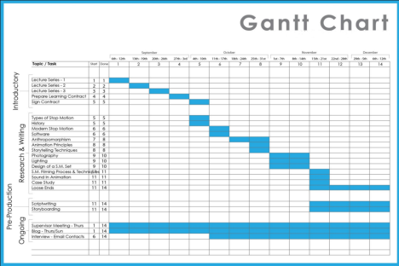
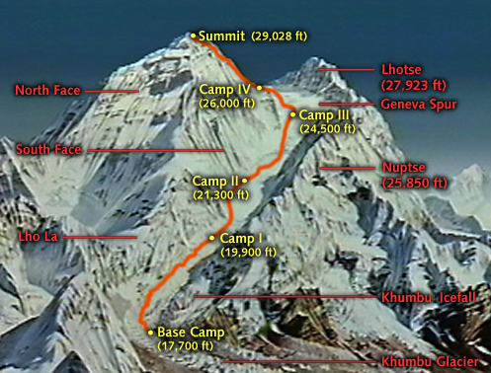
Project Management
Gannt CHART
Processing divided into Tasks and Estimating How Long they will take
MILESTONES
where we reach key objectives
(like reaching Mt Everest Base Camps during
our ascent)
We will fully cover Project Planning in a Separate Presentation another time. ☺

Slide 12
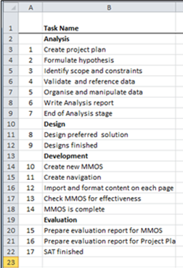
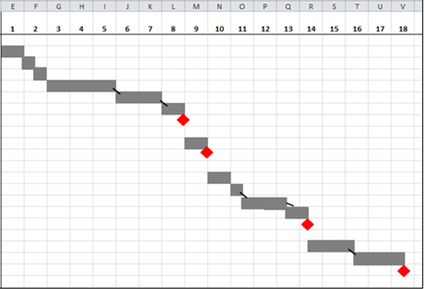
SAT – Project Management
Note this is not the 10/10 Answer for the SAT !
It is just a rough outline of the some of the things that will be required on the Gannt Chart

Slide 13
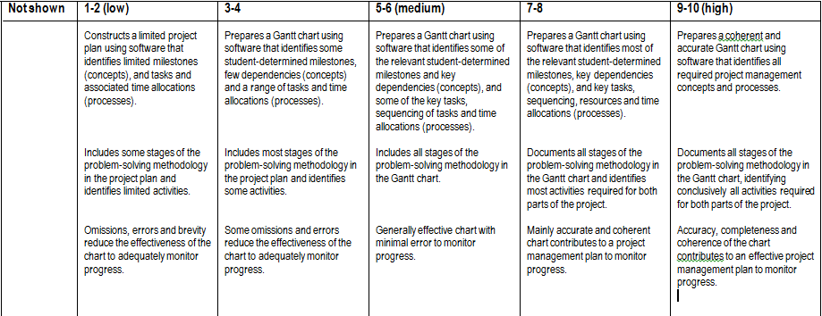
SAT Criterion 4: Understanding of Project Management Concepts and Processes
As for all of the 8 “Base Camps” in the SAT, there is a set of VCAA Criteria in a Rubric that your Teacher uses to give you a Score out of 10 on Project Management.
We will cover Project Management in detail in another presentation.

Slide 14

Informatics SAT – U302 and U401
The First SAT Task
It needs to be something you are interested in and formulated in the correct formal structure and be testable

Slide 15

SAT Hypothesis
Hypothesis: (Three key things)
Prediction
Containing Logical Variables
and is Testable
The Hypothesis Report also needs to discuss
Scope
and Constraints of the Project.
One big problem with a Hypothesis is that you might have a great idea, but not be able to find variables for it, or gather sufficient data to test it properly

Slide 16


HYPOTHESIS
Rule 1:
Hypothesis must NOT be written as a Question !
Will a Basketball Team be top of their League
if they are the top team at scoring 3 Pointers?
When a good Basketball Team is a top team at scoring 3 pointers, they will be in the Top Three in their League because 3 pointers add to the Total
Score in close games to produce the winning edge.

Slide 17


HYPOTHESIS
Rule 2:
A Hypothesis must pass the standard formula test:
More/Less of “X” will lead to more/less of “Y”
because of “Z”
Scoring more 3 pointers, will lead to more points for the Total Score because 3 pointers are far more valuable and harder to get than 2 pointers.

Slide 18
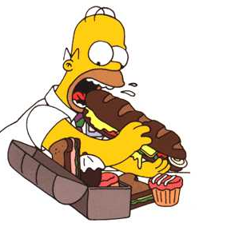
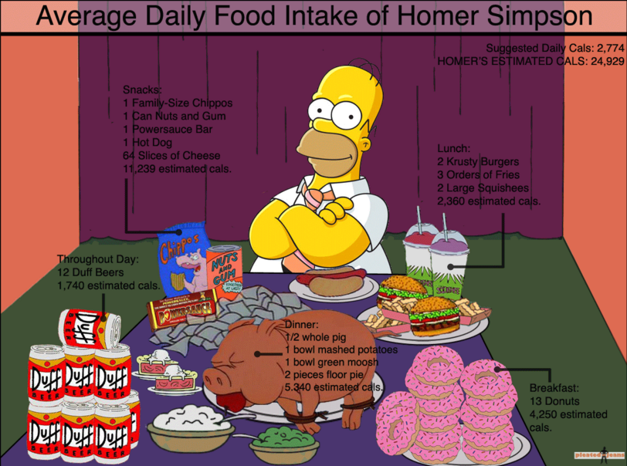

Rule 3 – Is it Testable?
Rule 2:
Homer eating too much food will lead to more fatness and obesity for him, because he is continually massively exceeding the daily colorie/kilojoule allowance for his age and exercise habits.
However, Rule 3 – Is this Testable???
NO
He is a cartoon person!
Notes:
Homer eating too much food will lead to more fatness and obesity for him because he is massively exceeding the daily colorie/kilojoule allowance for his age and exercise habits.

Slide 19


HYPOTHESIS
Rule 3:
A Hypothesis must be Testable
If we cannot gather data from the Internet, do surveys and interviews, look for trends, and so some stats and graphs, we are not going to be able to rigorously Test our Hypothesis.
For our “3 Pointer” Hypothesis we can gather NBA Stats from the web, go and observe Basketball Games, Survey Players, and Interview some basketball coaches.
We will be able to Test this Hypothesis ☺

Slide 20
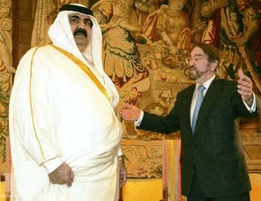

Hypothesis – Example 1
Is this a satisfactory SAT Hypothesis:
Why do some Arab Countries have excessively high rates of obesity?
Notes:
A number of Arab countries are oil and gas wealthy and many of their population love to eat out at restaurants regularly consuming calorie laden meals and desserts

Slide 21


Hypothesis – Example 1
Why do some Arab Countries have excessively high rates of obesity?
Fails Rule 1 – It is a Question!
When an Arabian Country has lots of wealthy people it has high rates of Obesity because people cannot go out and exercise in the extremely high temperatures and their main social activity is eating, particularly at American Fast Food and other Restaurants in air conditioned shopping malls that they drive to in Cars.
We can get GDP, Population, Climate Data, Car Ownership Rates, Obesity Rates, etc data and interview some people
of Arabian background to TEST this hypothesis.
Notes:
Sporting a GDP of $181.7 billion and a population of close to two million, Qatar, in terms of per capita income*, is the richest nation in the world. It also has the third-largest reserves of natural gas. However, with its booming economy and privileged lifestyle, Qatar is also becoming the world’s fattest country.
Read more at Middle East Voices: http://middleeastvoices.voanews.com/2012/06/qatar-why-is-the-worlds-richest-country-so-fat-40379/#ixzz418RFU2eb

Slide 22




Hypothesis – Example 2
Is this a satisfactory SAT Hypothesis:
The population of a city or town can be estimated from the number of American Fast Food outlets it has.
Notes:
It has More of X Population leads to more of Y fast food outlets BUT does not have the “because of Z” part, and so it fails Rule 2 !

Slide 23

Hypothesis – Example 2
The population of a city or town can
be estimated from the number of
American Fast Food outlets it has.
Hypothesis has More of X Population leads to
more of Y fast food outlets BUT does not have the “because of Z” part, and so it fails Rule 2 !
The Hypothesis needs to have the standard “because” (or “due to”) text added onto the end of it as shown
on the next slide.
Notes:
It has More of X Population leads to more of Y fast food outlets BUT does not have the “because of Z” part, and so it fails Rule 2 !

Slide 24


Hypothesis – Example 2
The population of a city or town can
be estimated from the number of American Fast Food outlets it has, because bigger towns have enough people to sustain a larger number of outlets.
The Hypothesis is Testable, because we should be able to get Population figures, and the number of outlets from Phone Directories and Store Locators on the Web, as well as interviewing Store Managers.

Slide 25


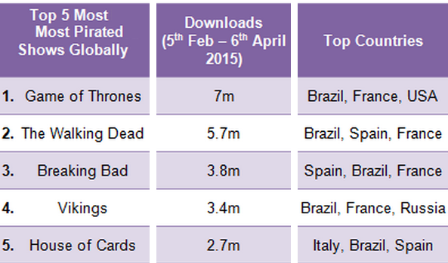
Hypothesis – Example 3
Is this a satisfactory SAT Hypothesis:
Piracy involving illegal digital downloading continues to be popular, because most people think it is not an example of criminal behaviour - lots of people download illegally and hardly anybody ever gets caught.

Slide 26

Hypothesis – Example 3
Piracy involving illegal digital downloading continues to be popular, because most people think it is not an example of criminal behaviour - lots of people download illegally and hardly anybody ever gets caught.
It is close to being okay, but it needs rewording:
Piracy continues increasing at a higher rate
than court prosecutions, because lots of people
continue to download illegally and do not think
they will get in much trouble or ever be caught.

Slide 27

Hypothesis – Example 3
Piracy continues increasing at a higher rate
than court prosecutions, because lots of
people continue to download illegally and
do not think they will get in much trouble
or ever be caught.
We now have two variables to compare: Download Volume vs Number of Prosecutions and their changes over recent times.
The Hypothesis is Testable, because we should be able to get Download figures, find out the number of court prosecutions, etc and create a Survey that we could get family and friends to undertake ANONOMOUSLY. There are serious ethical and legal issues if we were to promote Piracy or identify or capture by name violators of the law…. We would need to be very careful !
Notes:
Due to the Legal Issues with testing this Hypothesis (eg. gaining first hand knowledge of criminal activities) might be a bit risky for this topic. Drug topics have a similiar problem.

Slide 28

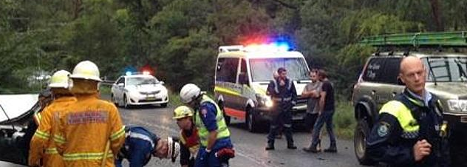
Hypothesis – Example 4
Is this a satisfactory SAT Hypothesis:
You are far more likely to have a fatal accident on a rural road outside of the city where you are travelling at much higher speed than in the city, because you are probably driving on your own for a considerably long distance on this rural journey and higher speed leads to more vehicle damage and more injuries.

Slide 29

Hypothesis – Example 4
Is this a satisfactory SAT Hypothesis:
You are far more likely to have a fatal accident on a rural road outside of the city where you are travelling at much higher speed than in the city, because you are
probably driving on your own for a considerably
long distance on this rural journey and higher speed
leads to more vehicle damage and more injuries.
We will be able to Test this Hypothesis by gathering data on Road Accidents, Rural Speed Limits, Average City Speeds versus Rural Speeds, Average City trip length versus Rural Trip Length, data about Australia’s most dangerous highways, etc. We can also take observations of rural accident prone highway areas and make video and take pictures, interview emergency service workers, etc

Slide 30

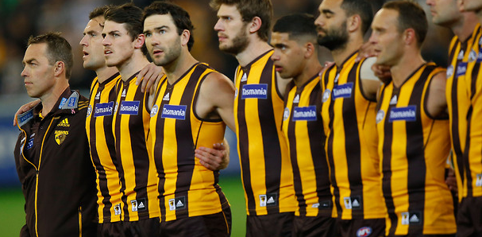
Hypothesis – Example 5
Is this a satisfactory SAT Hypothesis:
AFL teams that finished in the finals over the past five years owe their success to the fact that they are financially sound due to their membership size and that they play more teams below them during the season, rather than above them.

Slide 31
Hypothesis – Example 5
AFL teams that finished in the finals over the past five years owe their success to the fact that they are financially sound due to their membership size
and that they play more teams below them
during the season, rather than above them.
We will be able to Test this Hypothesis by gathering data on all the Teams in the Finals for the last 5 years, their Membership figures, Financial Reports, and the last 5 years fixtures. We can also capture some good video snippets off the Internet to use for U401.
Notes:
In Rule 2 “because of Z’” can also be written as “due to Z” because and due to both mean the same thing which is “for these reasons”

Slide 32
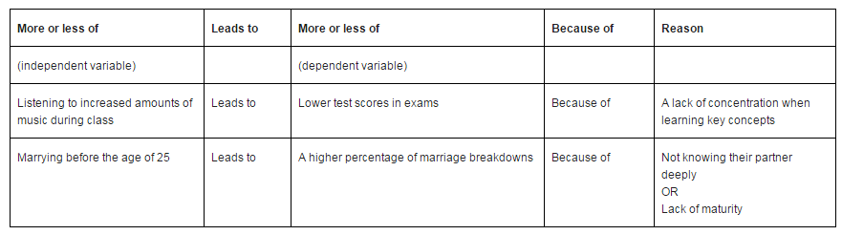
Hypothesis – Summary
Once you have a Hypothesis that fits that standard format, it needs to be seen if enough data can be found for it, whether a Survey can be done, whether people can be interviewed, are there useful Videos on YouTube.
This is called assessing the FEASABILITY of the Hypothesis.
Notes:
In Rule 2 “because of Z’” can also be written as “due to Z” because and due to both mean the same thing which is “for these reasons”

Slide 33
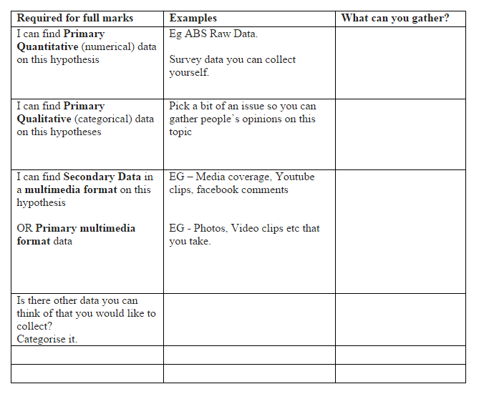
Hypothesis – Feasability Checking

Slide 34

Hypothesis – Feasability Checking
All Year 12 VCE Subjects total 100 hours work.
The estimated time that should be spent on
U302 is 11 hours total time to complete U302:
( the equivalent of 3 weeks of full time classes).
Before submitting your Hypothesis it is recommended that you at least check the Internet for availability of relevant data and check with prospective Interview people for their willingness to participate.
You do not have time to restart with a new Hypothesis later on!
You also then need to work out the “Scope” of your Hypothesis (you may not have enough time for a worldwide investigation!) as well as the “Constraints” there will be, such as the roughly 11 hour total work time.
Scope and Constraints are covered in the slides that follow.

Slide 35


Constraints
Limitation or restriction you are working under
Economic (cost and time) – the 11 hours of Project Time
Technical (speed of processing, capacity, availability of equipment, compatibility, security, video editing skills etc)
Social (will people agree to do Interviews and Surveys)
Legal (ownership, privacy of data requirement. Asking about a criminal act eg. asking about drugs and illegal downloading)
Useability (usefulness, ease of use, can the raw data be made sense of)
SAT Examples: might not be able to get permission for an Interview, the need to de-identify all survey respondents, running out of time, may not be able to get the video footage you wanted, might not get enough useful data or might get way too much data to ever be able to analyse during the work time available on the SAT. (All things you need to think about!)
Think about your Hypothesis and formulate a list of Constraints

Slide 36




Scope
The “Scope” of something is what it can do
and what it cannot do. What’s In and What’s Out.
Eg. The Scope of the function of a Camera is that it captures a digital image of what it is pointed at and focussed on. The camera cannot work out how to best frame the image, or when to click the button to capture the exact perfect moment.
Digital Capture is in Scope, working out the perfect picture content is Out of Scope.

Slide 37
Scope
The Scope states the boundaries or parameters
Explains what will and what will not be covered
For Example:
If you were investigating “Basketball 3 Pointers” you might refine your scope to last year’s NBA Stats for the top 5 teams, and investigate one or two local basketball teams.
If you were investigating the number of medical centres in the City of Casey, you might look at Cranbourne only.
Notes:
You can have a big hypothesis, but it will need to be specified that you are Scoping it down so that the investigation work will be a manageable amount; an amount that can be achieved in the 11 hours of Project work time.

Slide 38
Hypothesis Scope
Your U302 Project Hypothesis needs to have enough Scope to justify 11 hours of concentrated work time spent on it, while satisfying the VCAA Task Rubrics.
Eg. You cannot just narrow the Scope down to asking your local Under 18’s footy coach 3 questions in a 5 minute video interview, and analysing his team players game stats for the last three games. On the other hand you will probably not have time to analyse the last 10 years of AFL football game stats! That Scope is too big. In your Scope document you need to specify what you are doing, and what you are not going to be able to do.
Many of you may also need to limit your investigation due to some of the Constraints you have identified as existing for the SAT Project.
Eg. If you do not have a video camera, good editing skills, and a network connection who can get you a 30 minute interview with an AFL Coach, then definitely list this as out of scope for your project.

Slide 39
The Rest of the SAT
In this Presentation we have covered a broad overview of the SAT, which is made up of the U302 Hypothesis, Data Collection, and Analysis, as well as the U401 Multimodal Presentation of your results. (Both outcomes also include Project Management.)
We have then focussed in on the first task “The Hypothesis”, as well as its Constraints and Scope. This is the task that gets the whole SAT Project started.
We will cover the other Seven SAT Tasks in other Presentations as we move forward with our SAT.
You now need to come up with a Hypothesis for your SAT.
(You do not have to pick one of the 5 in this presentation).
Check its data acquisition feasability, and detail its Scope and Constraints.
This can then all be put into a document that is submitted to your Teacher.

Slide 40
References
Several Slides in this presentation are taken from the awesome Informatics Presentation at the VCAA Centre in February 2016
by Judy Zuccon.
Thanks Judy for your great presentation. ☺
Material has also been used from various Edulists emails from Lucas Garth, Heath Matheson, Jordyn Croft, and others.

