Slide 1
mBot
Ultrasonic Sensor

Slide 2
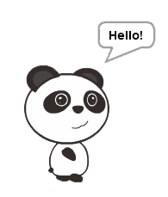
TASK 1
Starter Task
Get your Panda to have a conversation.
Must Say 10 things
Hint: No mBot Needed

Slide 3
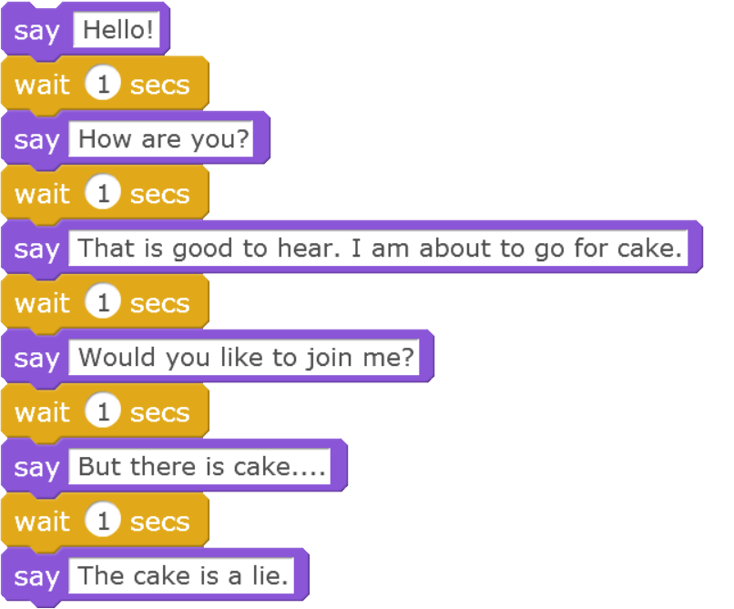
Say Block Solution.

Slide 4
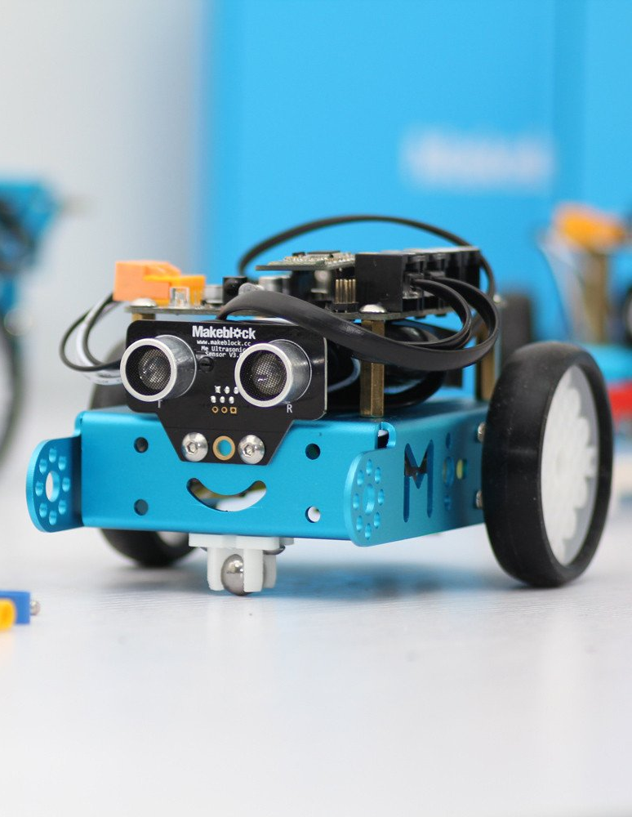
Ultrasonic Sensor?
Can determine the distance to an object
Location?
Right Here
Notes:
What is mBot Video: https://www.youtube.com/watch?v=pmsSipper3Y

Slide 5
How does it work?
Distance to Object
Transmitter
OBJECT
Ultrasonic Sensor
Receiver

Slide 6
Distance
Is a number.
Q: What does the Ultrasonic Sensor give us?
A
NUMBER

Slide 7
How to find out Distance
SAY BLOCK
U.S. Sensor
Distance
(cm)

Slide 8
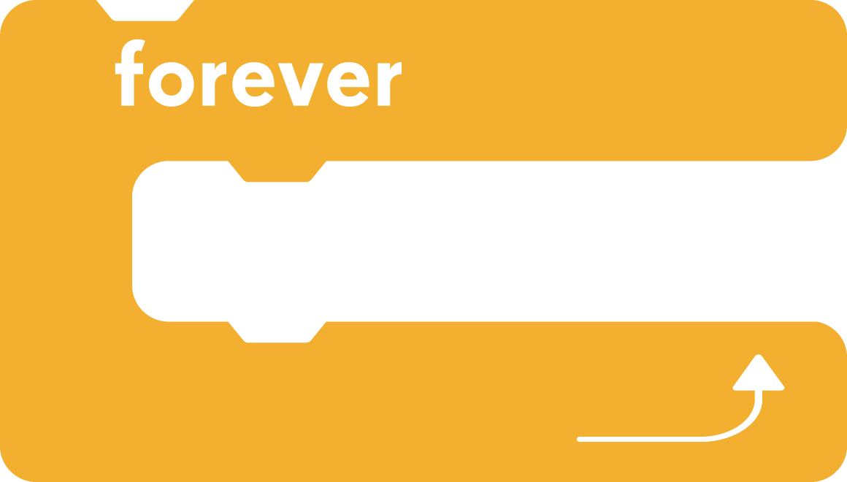
TASK 2
Ultrasonic Task
Get your Panda to tell you the distance between your mBot and the wall.
HINT: Move Bot by hand.

Slide 9
Ultrasonic Sensor Distance Updater

Slide 10
What Happened?
Collected Data
Presented Data

Slide 11
TIME TO ASK QUESTIONS
The power of the “If” statement.

Slide 12
‘If’ Statement - Question
Asks a question
If the answer is TRUE then it does action inside
If FALSE, then it continues without actioning.
For example;
bell rings
Go to Class
Notes:
Emphasis on TRUE/FALSE possibilities

Slide 13
More examples
Shoe untied
Tie shoelaces
Close to wall
Stop Moving towards it

Slide 14
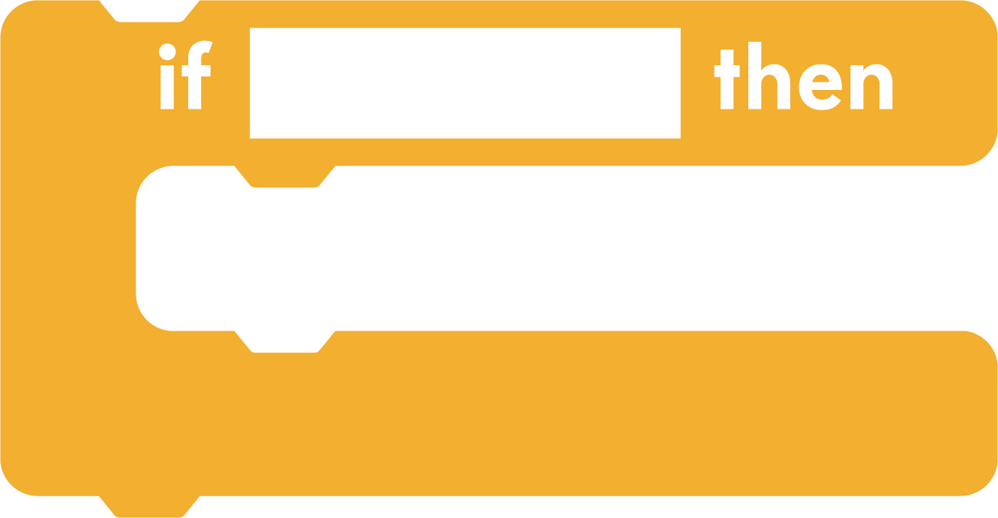
Does this question make sense?
Distance What?
Is greater than?
Is equal to?
Is less than?
Distance
> 20

Slide 15
Ask a question that makes sense
OPERATOR Less Than
Using Math operators we can ask a proper question
IF
DISTANCE
< 20
THEN
STOP MOVING
Don’t forget that the distance is actually the Ultrasonic sensor

Slide 16
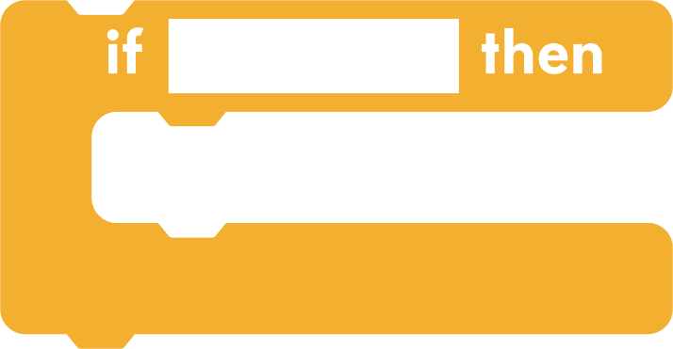
TASK 3
IF Statement Task
Get your lights to turn red when the mBot gets close to the wall.

Slide 17
IF Statement Solution

Slide 18
MORE CONTROL
IF Statement
If-Else Statement

Slide 19
IF-ELSE Statements
Just like before, we can ask a question
TURN LIGHTS RED
TURN LIGHTS GREEN

Slide 20
TASK 4
IF-ELSE Statement Task
Turn LEDs Red when close to the wall
AND
Turn LEDs Green when not close to the wall

Slide 21
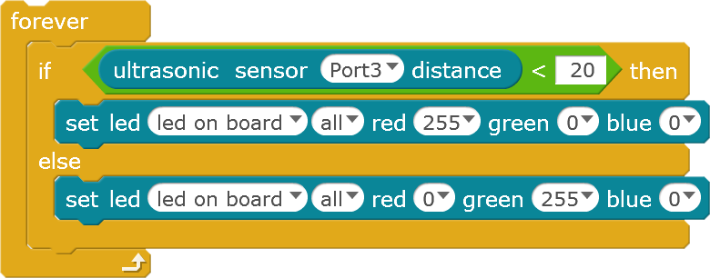
IF-ELSE Statement Solution

Slide 22
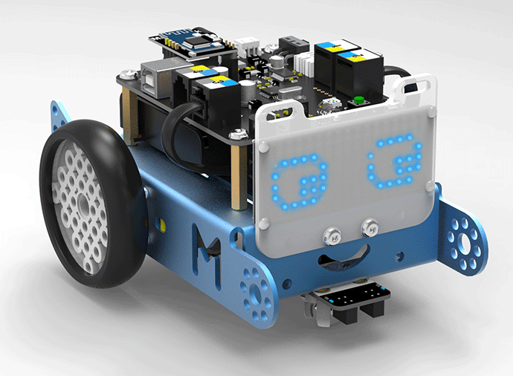
TASK 5
Final Task
Using Task 4, get your mBot to stop when it gets close to the wall.
AND
To Drive Forward when not close to the wall.
*Picture Unrelated

Slide 23
Any Questions

