Slide 1
mBot
An Introduction to programming

Slide 2
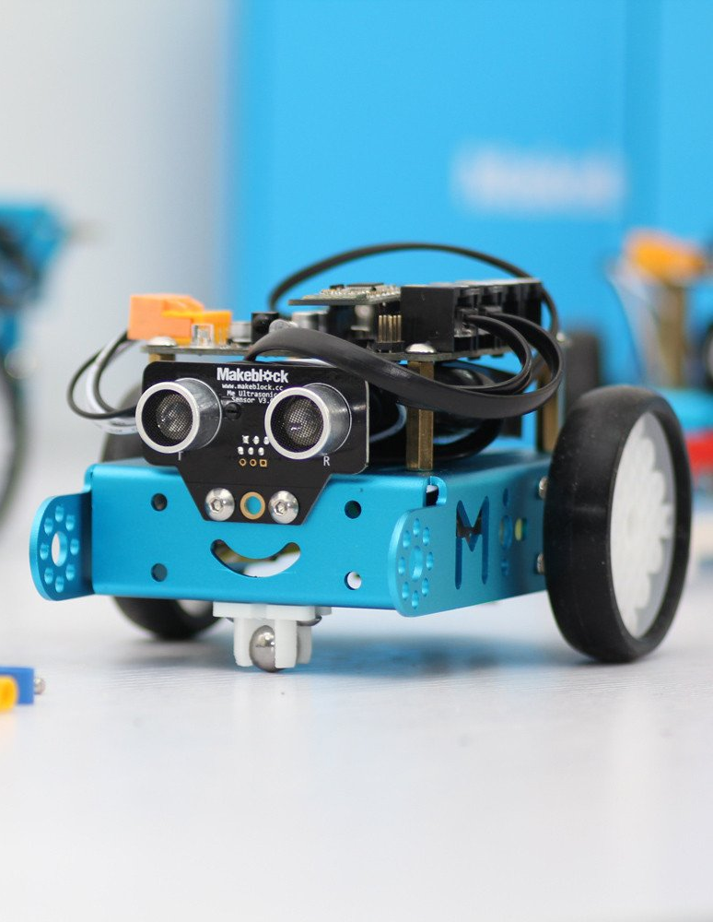
What is the mBot?
Robot
What can it do?
Move
Light Up
See the world around it
So much more…
Notes:
What is mBot Video: https://www.youtube.com/watch?v=pmsSipper3Y

Slide 3
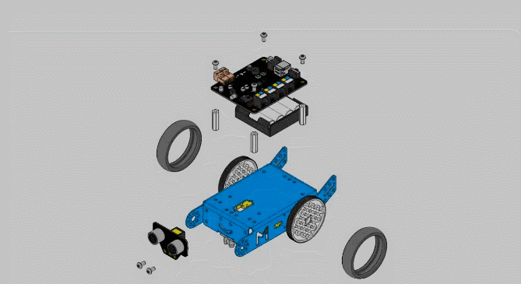
Assembly
Many pieces are used
Always check to make sure nothing is loose.

Slide 4
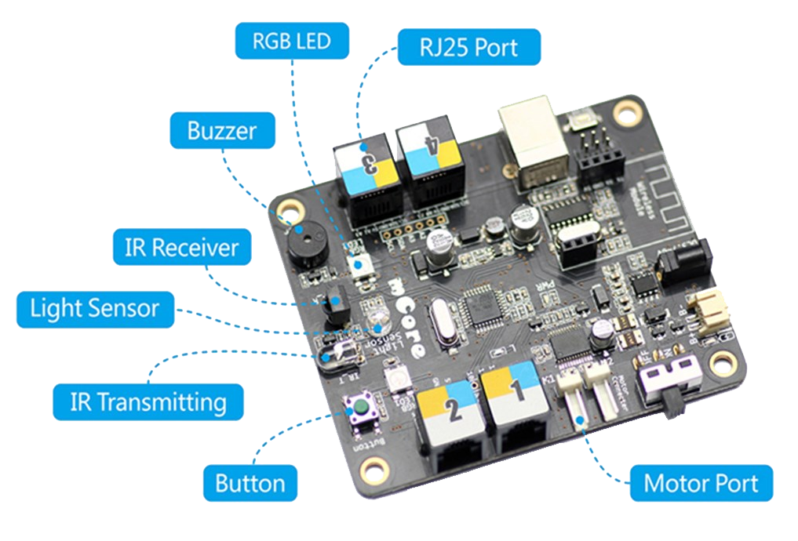
What is that computer looking thing?
This is called a Micro Controller
It controls the mBot electronics

Slide 5
Getting Ready
PREPARE
CONNECT
Get mBot
Open mBlock
Connect Menu
Check all parts
Plug in USB
Select 2.4G
CHECK
Use Light
Restart if no Light
GO
Complete Task

Slide 6
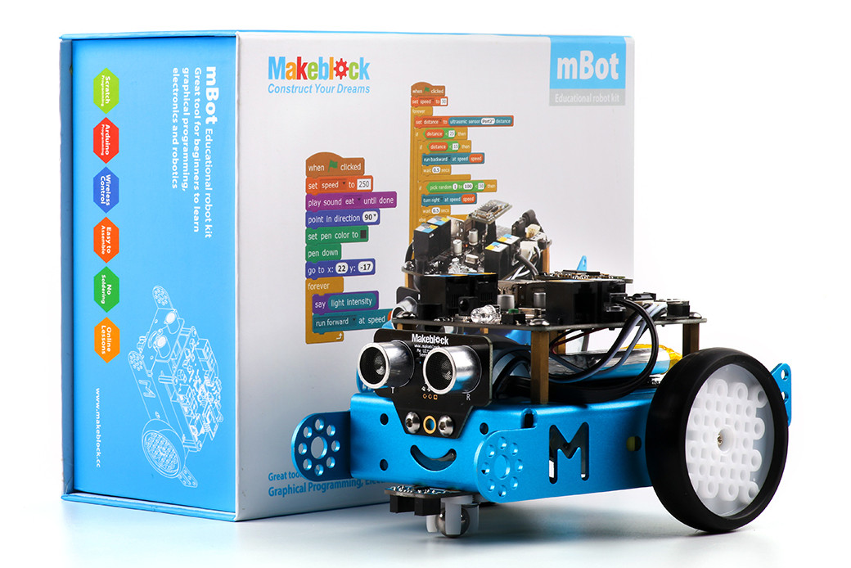
PREPARE
Get mBot
Check all parts
Plug in USB
Notes:
Students should have an assembled mBot and a 2.4Ghz USB

Slide 7
Getting Ready
PREPARE
CONNECT
Get mBot
Open mBlock
Connect Menu
Check all parts
Plug in USB
Select 2.4G
CHECK
Use Light
Restart if no Light
GO
Complete Task

Slide 8
CONNECT
Open mBlock
Connect Menu
Select 2.4G Serial

Slide 9
Getting Ready
PREPARE
CONNECT
Get mBot
Open mBlock
Connect Menu
Check all parts
Plug in USB
Select 2.4G
CHECK
Use Light
Restart if no Light
GO
Complete Task

Slide 10
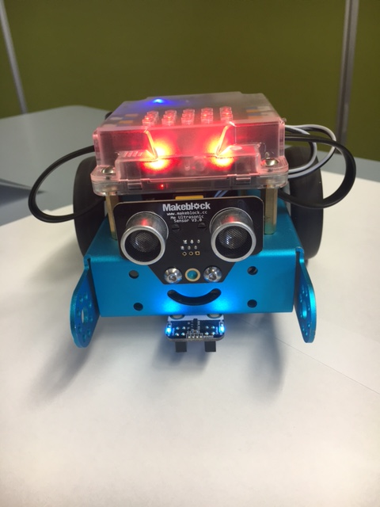
CHECK CONNECTION
20
Use Light
Restart if needed
Change Number
Notes:
Drag out the Set LED (LED ON BOARD) tag.
Pick a colour, Then double click block.

Slide 11
Getting Ready
PREPARE
CONNECT
Get mBot
Open mBlock
Connect Menu
Check all parts
Plug in USB
Select 2.4G
CHECK
Use Light
Restart if no Light
GO
Complete Task

Slide 12
GO
Ready to go.
Complete this every time you use the mBot
Try to complete each task
Notes:
Drag out the Set LED (LED ON BOARD) tag.
Pick a colour, Then double click block.

Slide 13
TASK 1
BLOCKS NEEDED:
Control your robot with the arrow keys.

Slide 14
Any Questions
Next Slide has Solution to Task 1: Arrow Key Controls

Slide 15
Arrow Keys controlling mBot Movement

