Slide 1
DATA

Slide 2
BRAINSTORM
What do you think data is?
How would you get data?
Notes:
Recommend using Padlet or equivalent to encourage everybody to have a go at answering.
High chance not many students would know, nor be confident at year 7 in their first few lessons to speak up.

Slide 3
Data comes in all shapes and forms…
Observations
Interviews
Surveys
Online (Skype, Hangout, etc.)
In person
Paper Based
Internet
Books
Online Survey
Video/Audio Recording
Data Repositories
Google Survey
Survey Monkey

Slide 4
Visualising DATA

Slide 5
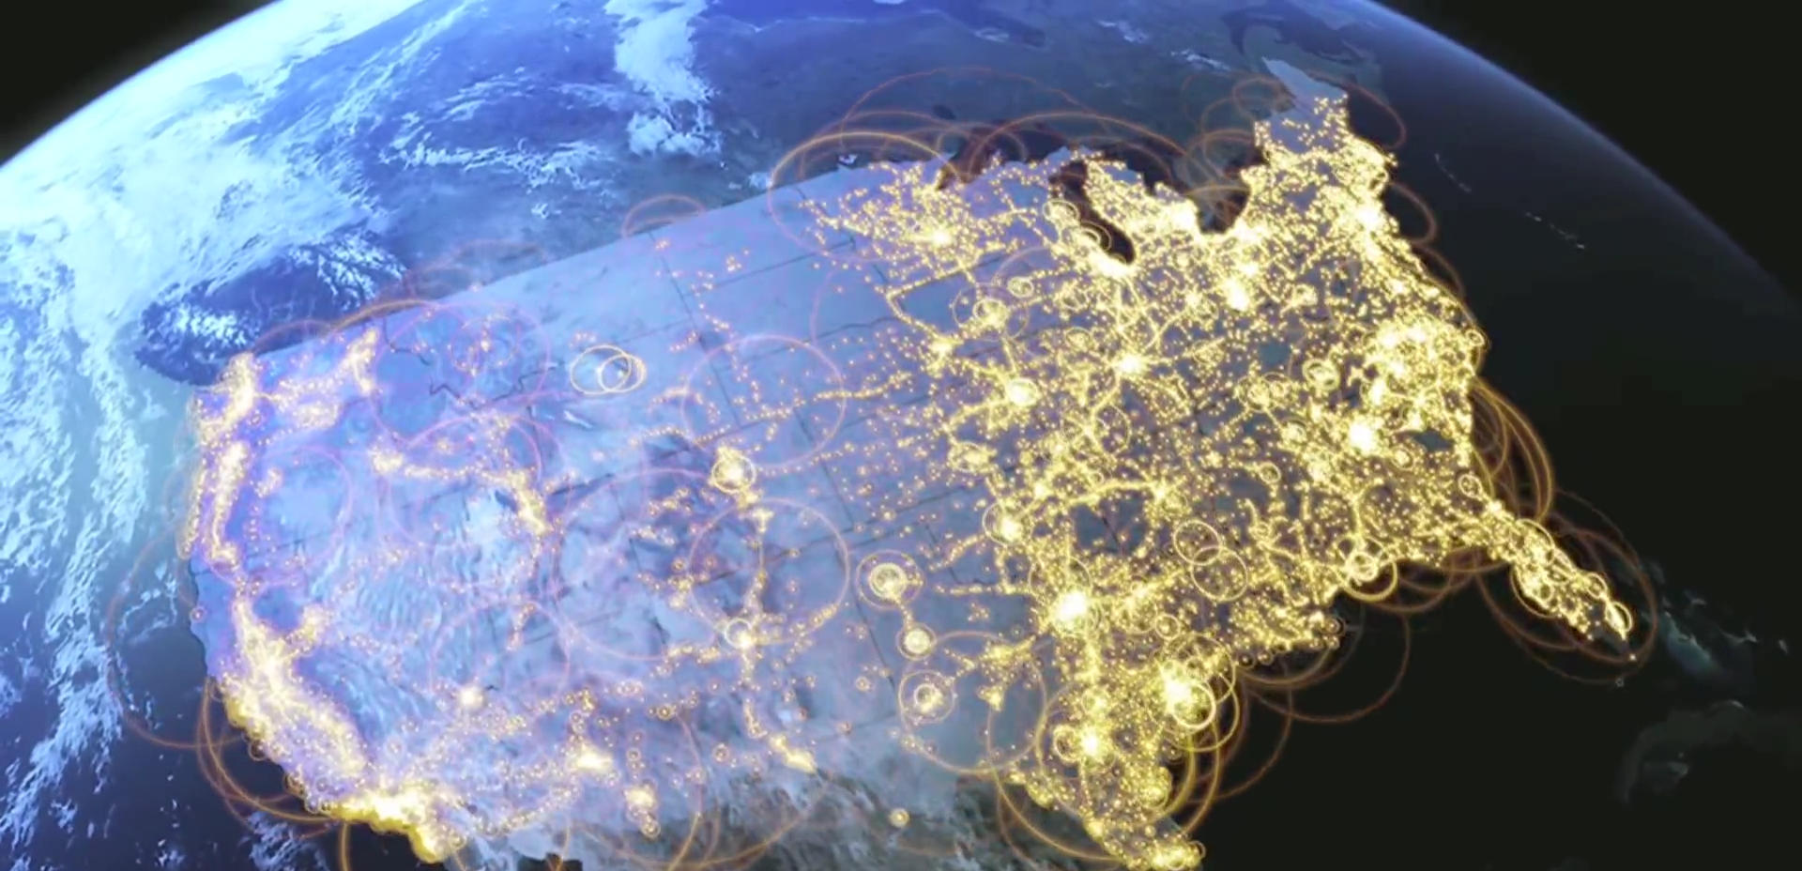
https://www.youtube.com/watch?v=rJC7B-9ZfhE

Slide 6
Or more simply..
More on this later…

Slide 7
Lets Practice
Collecting Data

Slide 8
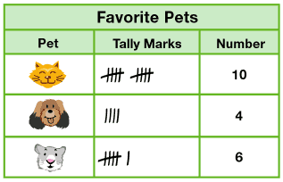
Collecting Data
Create a survey for the class on Paper
Some examples are;
Favourite Food
Favourite Sport
Favourite Colour
Survey your class!
Keep your results safe.

Slide 9
Spreadsheets
Spreadsheets can
• Store Data
• Organise Data
• Analyse Data
Many different types of spreadsheet programs exist.
Lets enter our data into Microsoft Excel

Slide 10
Result
You should now have a table of data
FAVOURITE FOOD
Type of Food | Frequency
Pizza | 7
Chips | 4
Salad | 11
Other | 3

Slide 11
Review Time
What other the three main ways to collect data?
Surveys
Interviews
Observations
These three categories accommodate for all different types of data collection techniques

Slide 12
Review Time
How could we collect data for SURVEYS?
Paper Survey
Online Survey
Google Forms
Survey Monkey
Excel Survey
Tablet / iPad @ Lunchtime

Slide 13
Review Time
How could we collect data for INTERVIEWS?
Online
Face to Face
Can record these by
Audio
Video
Scripts
Statements

Slide 14
Review Time
How could we collect data for OBSERVATIONS?
Research
Observation

