Slide 1
Data Visualisations in Adobe Illustrator

Slide 2
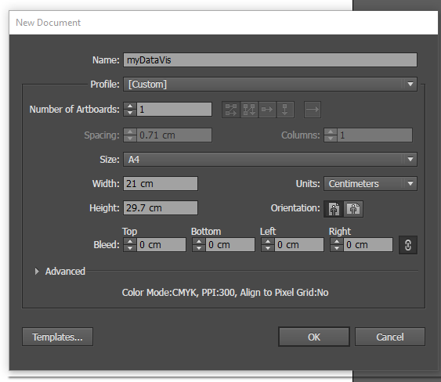
Starting
Wait for the program to load …
File → New
Give it a name
Size A4
Units Centimeters (US spelling)

Slide 3
Data – the Illicit Drug Report (consumer arrests)
NSW | 21013
Vic | 16466
Qld | 28389
SA | 7250
WA | 13414
Tas | 1027
NT | 927
ACT | 492

Slide 4
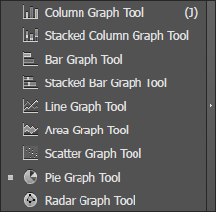
Drawing a graph
Hold the mouse down on the Graph tool.
Select Pie Graph Tool
Draw a “graph” in the document.

Slide 5
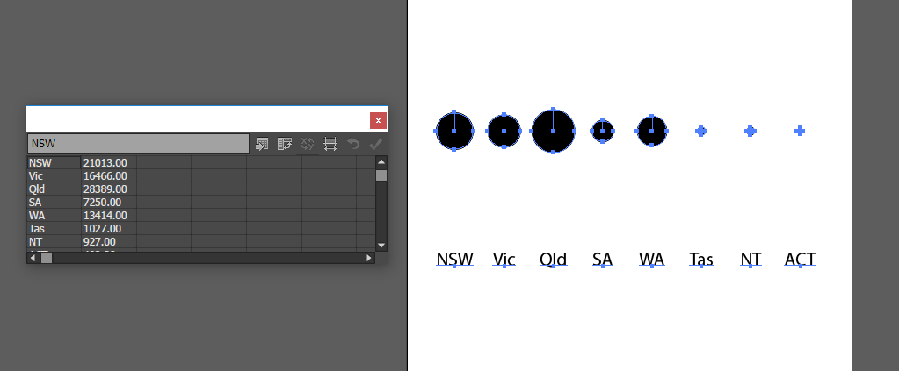
Bubble charts – paste the numbers in column

Slide 6
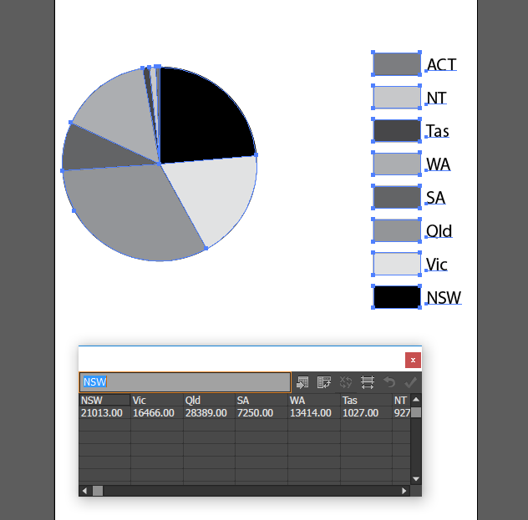
Pie chart – paste the numbers in row

Slide 7
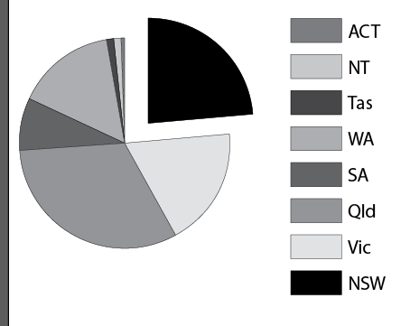
Direct selection
Left arrow is select, will select entire graph.
Right arrow is direct select, can select parts of the graph.
Direct selection allows you to move only parts of the graph (e.g. pull out pieces of a pie chart)

Slide 8
Colours
Click on Color tab, click on down arrow. Change to CMYK or RGB.
Note: if you only have one part selected, it will change colour mode while the rest will stay grayscale!
Note: I assume everyone knows what CMYK, RGB, grayscale etc. are …

Slide 9
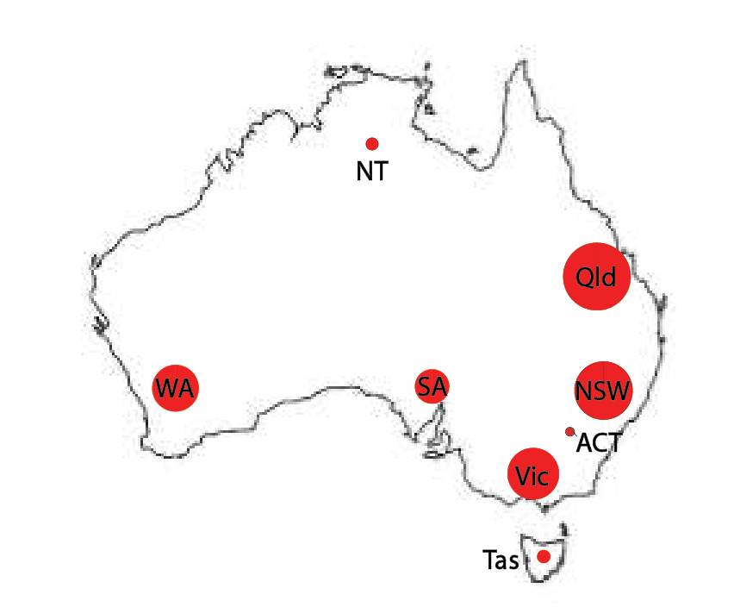
Try and make this …
Save a vector map from Google, drag into the document
Make sure you change the colours of the bubbles (both fill and stroke … check if there’s any grayscale left!)
Ctrl + and ctrl – to zoom in and out
Use direct selection to put the bubbles over the states
Be aware of grayscale!

Slide 10
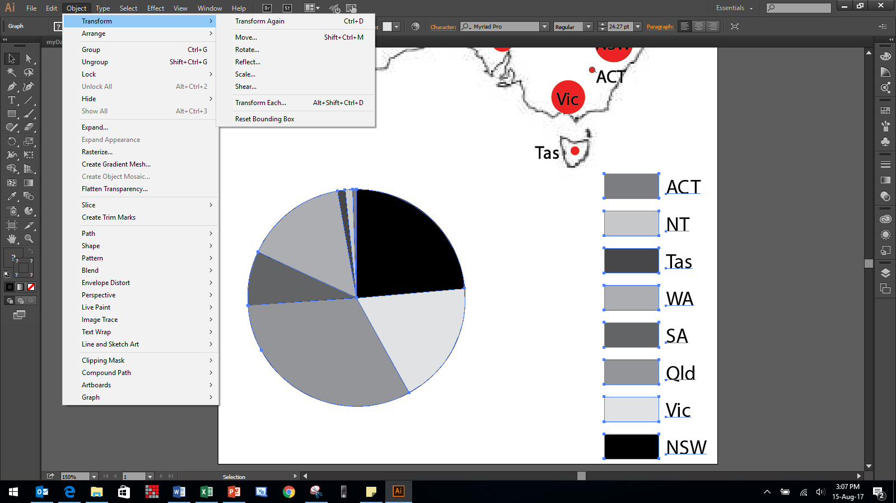
Transform to change sizes

Slide 11
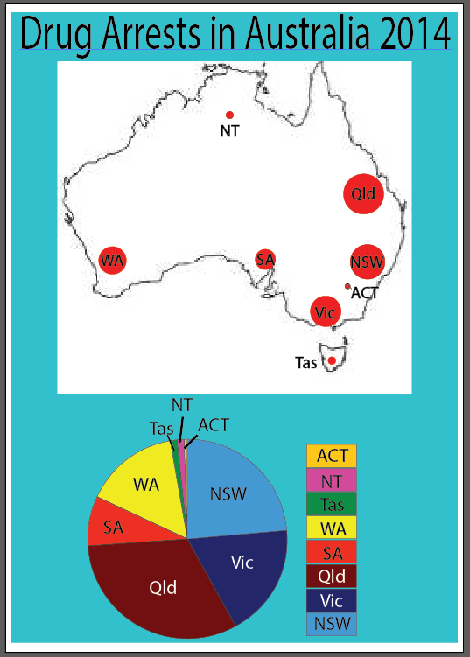
Make it fancier
Direct select the pie slice AND the label colour using the Shift key, so that they’re the same colour.
Use arrow keys to give fine movement.
Make sure your colours are substantially different in a pie chart … a bubble chart can have the same colours for the bubbles.
Tools like text labels, rectangles, etc. are same as any other problem.
Be aware of grayscale!

Slide 12
Play!
Try some different stuff … if you work out how to do something cool, write it up (Word doc, PowerPoint, etc).
Send to me, I’ll send to everyone in the class.

Slide 13
References
http://wiki.bk.tudelft.nl/toi-pedia/Data_visualization_using_Illustrator
http://wiki.bk.tudelft.nl/toi-pedia/Illustrator_Basics

