Slide 1
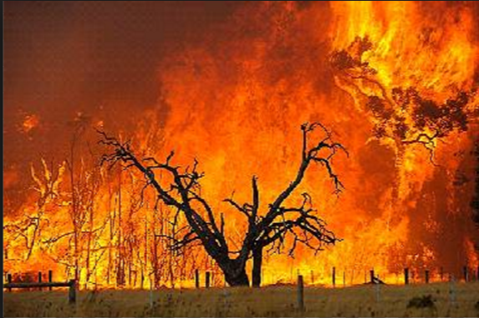
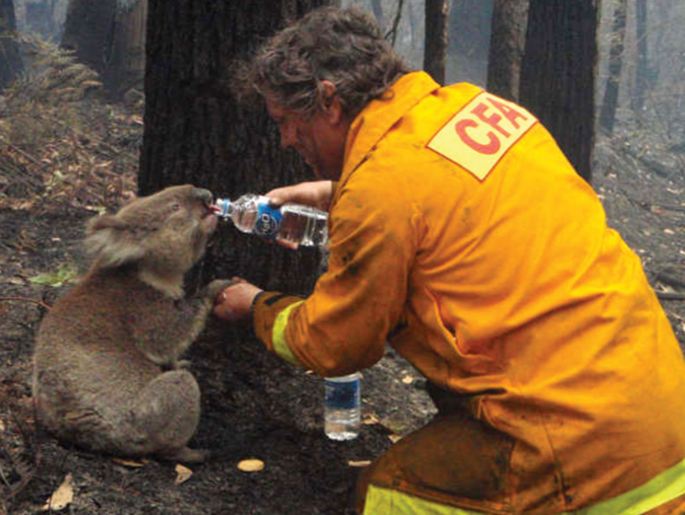
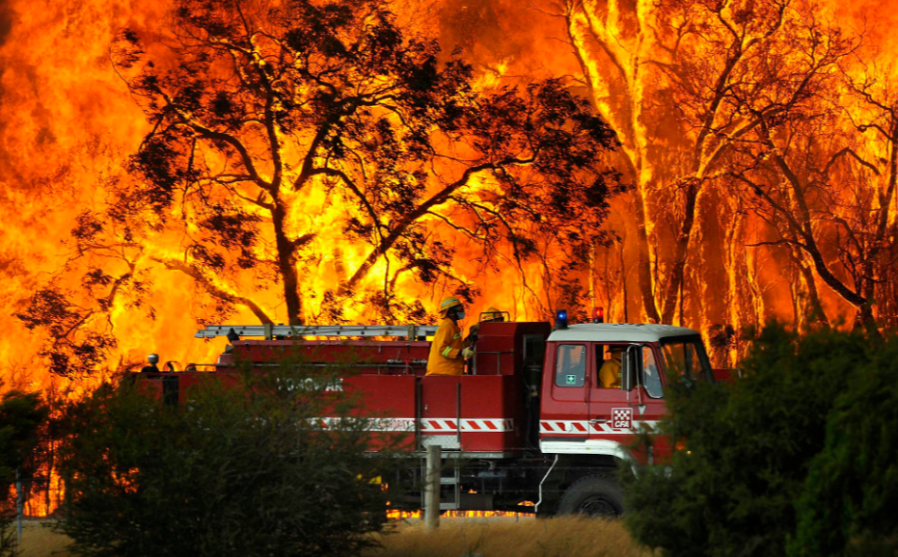
Over the past 240 years carbon emissions
have drastically increased.
Australian populations increases dramatically
The rise in Sydney temperatures as a result of increases of population and massive global increase in carbon emissions.
Causing Temperatures to rise!

