Slide 1
THE MEANING OF COLOURS
(anyone who does a background like this will be failed out of spite)

Slide 2
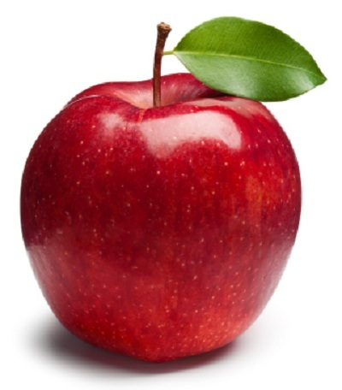
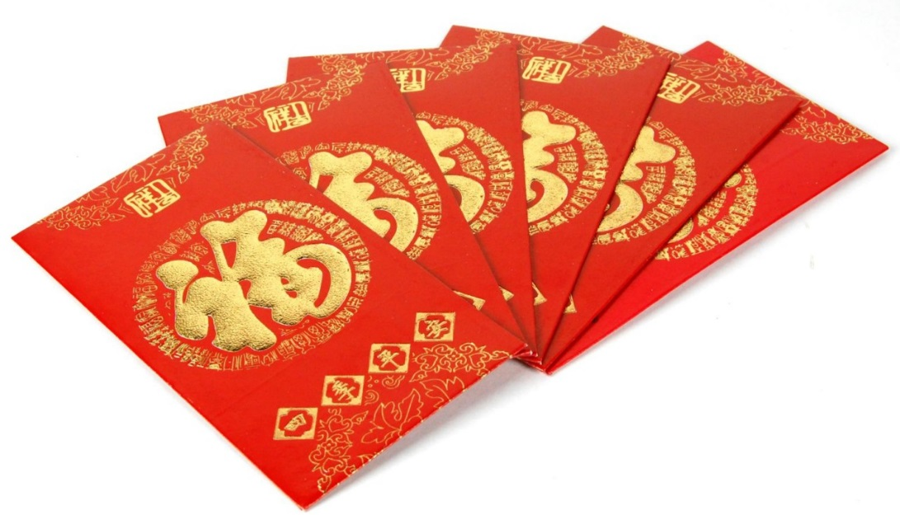
RED
Fire
Blood
Danger
Energy
War
Courage
Appetite
Luck (Chinese)
Communism
“the enemy”

Slide 3
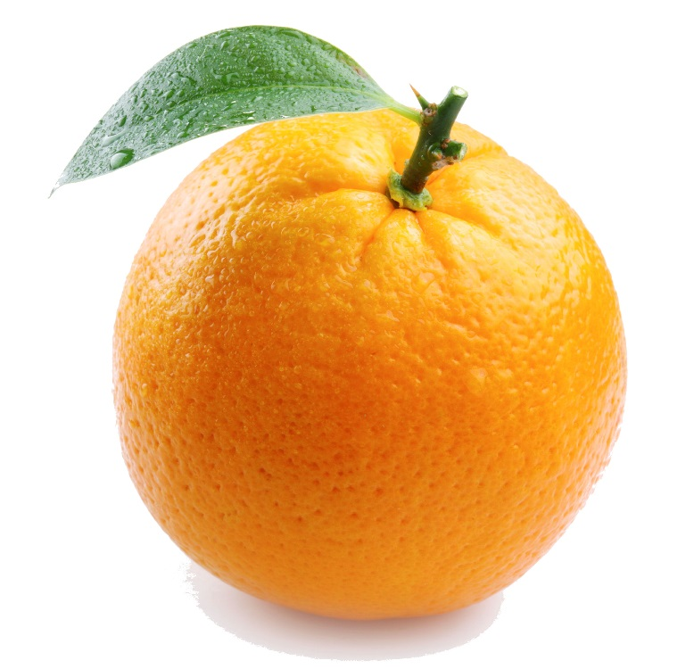
ORANGE
Energy
Joy
Heat
Invigoration
Visibility

Slide 4
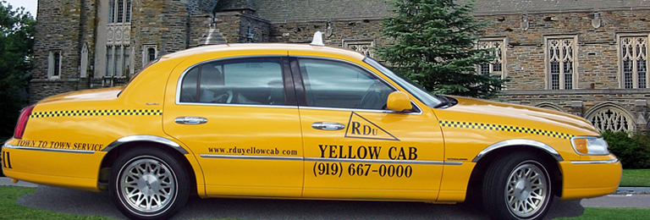
YELLOW
Sunshine
Happiness
Warmth
The most visible colour against black
Used in warning signs
“kiddish” – not a common adult colour

Slide 5
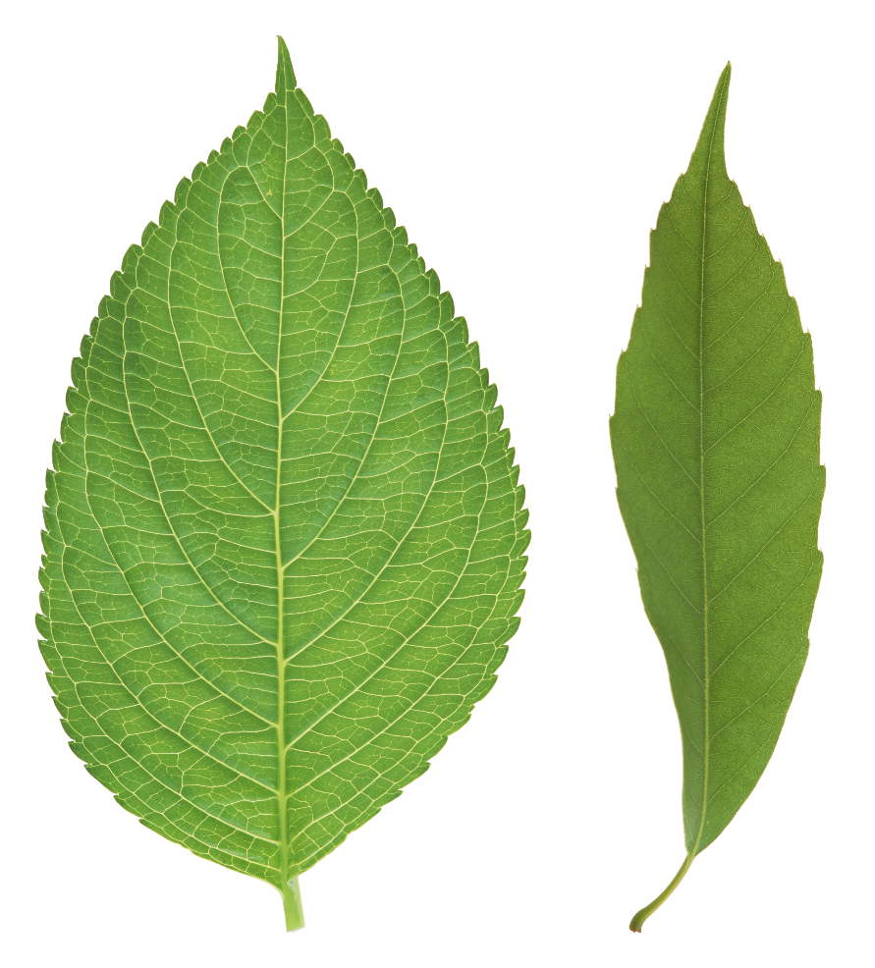
GREEN
Nature
Safety
Money
Healing
“newness”, lack of experience
Jealousy
Most sensitive colour to the human eye
Environmentalism

Slide 6
BLUE
Sky
Sea
Stability and maturity
Masculinity
Suppresses appetite
Power/experience (dark)
Cold

Slide 7
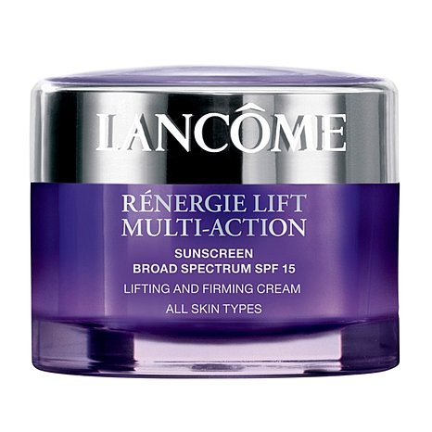
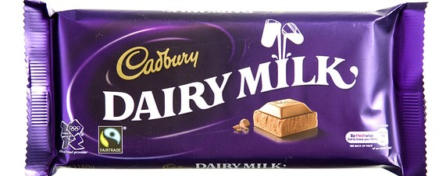
PURPLE
Red and blue – energy and stability
Power
Royalty
Wealth/luxury products
Soothing
Artificial

Slide 8
PINK
Feminine/”girly”
Romance
Passiveness
Suppresses appetite

Slide 9
GREY
Neutrality
Old age
Stability/stone/rock

Slide 10
BROWN
Nature
Stability
Masculinity
Old/autumn
Comfort

Slide 11
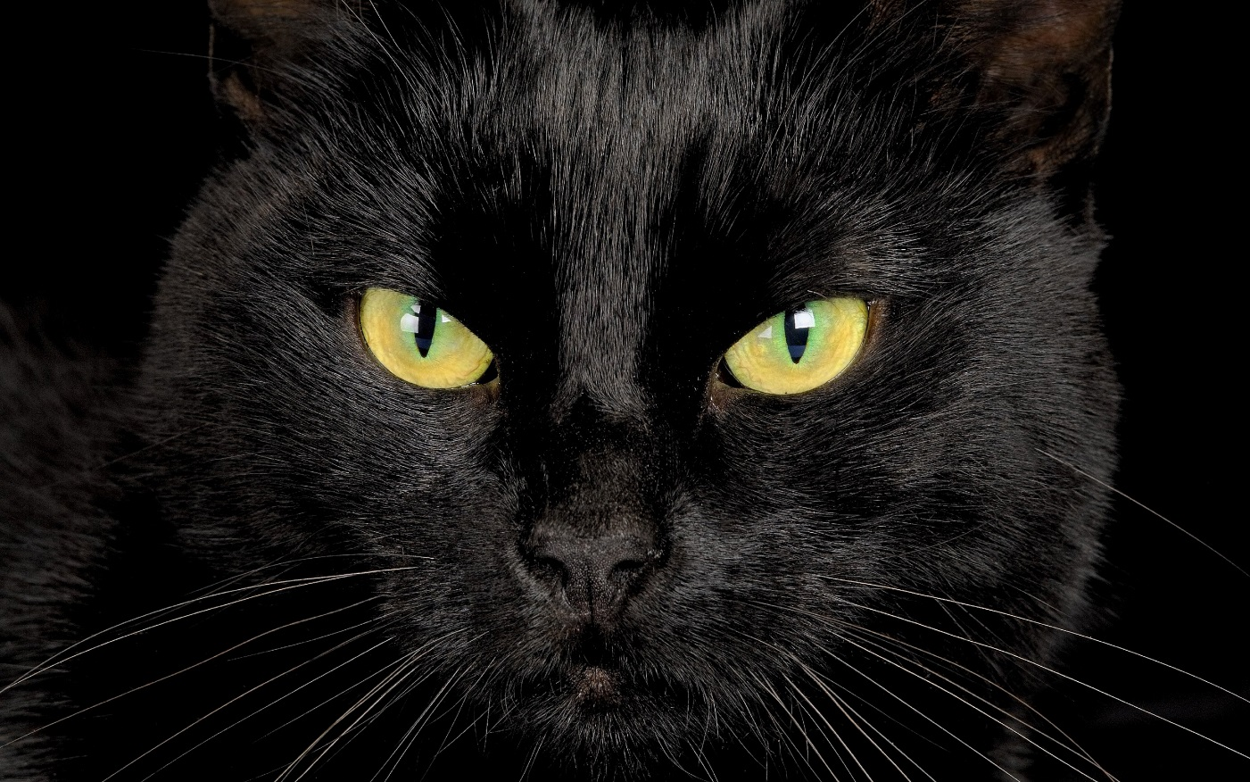
BLACK
Death
Negativity
Power
Emo/goth
Fear and the unknown
Night
Grief
Contrast (with yellow, orange, etc.)

Slide 12
WHITE
Light
Goodness
Purity/cleanliness/sterility
Simplicity
Charity, medicines

Slide 13
http://cdn.ebaumsworld.com/mediaFiles/picture/1548104/85038843.png

