Slide 1
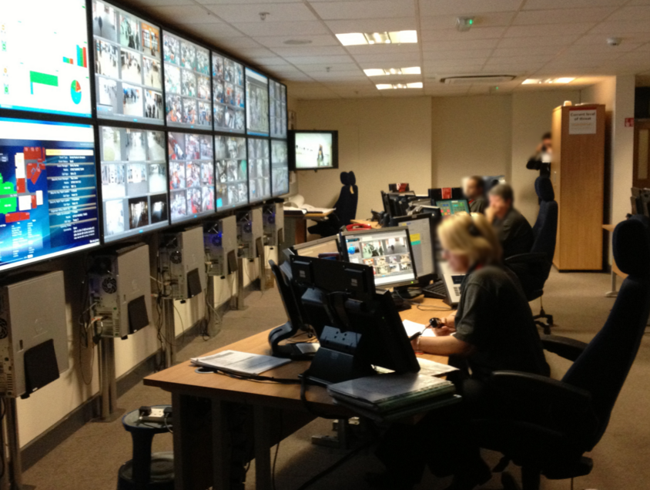
CCTV Networks

Slide 2
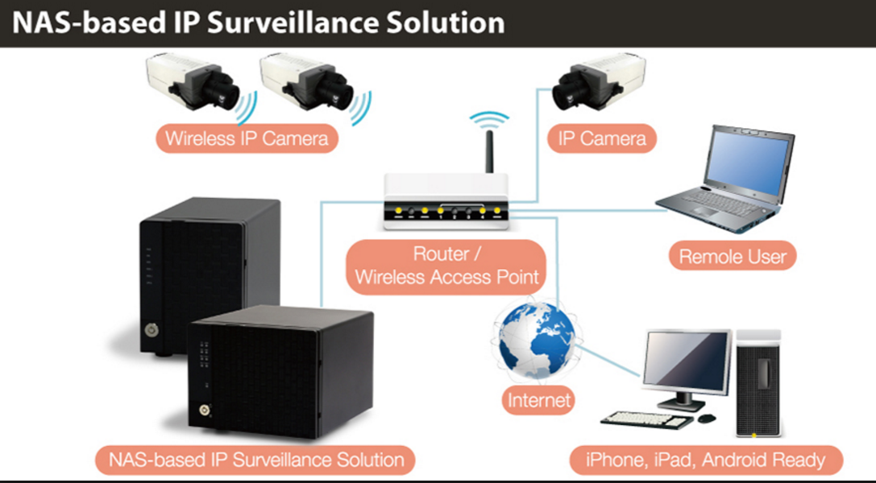
CCTV Networks
The video files recorded are huge and so NAS storage is needed, 16TB per NAS Box.

Slide 3
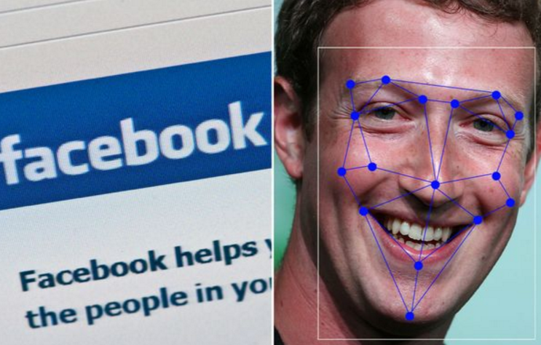
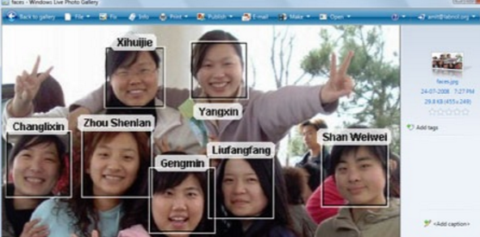
CCTV Networks Find People Automatically
Facial Recognition technology is now very well established with 99% accuracy.
Places like Crown Casino, Nightclubs, and big stores like Coles, Kmart, Myer, etc can store images of banned people or known shoplifters and the CCTV network technology automatically identifies them and sounds an ALARM !!!!!!!!

Slide 4
CCTV Networks
What if I have an identical twin,
And they are on all the bad person
Banned Lists?????
So what if I cover my face, then the CCTV cannot get me.....
WRONG
They could pattern match your walking with CCTV from another location where your face is visible.
- See next slide

Slide 5
CCTV Networks – Your “Gait”
http://www.ibtimes.co.uk/japanese-cctv-system-identifies-criminals-by-way-they-walk-1433150

