Slide 1
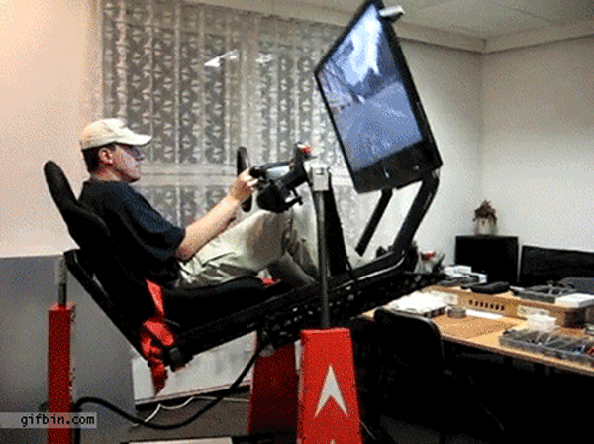
Computer Gaming Survey Infographics
Y11 VCE Computing

Slide 2
Bond University
Every two years Bond University in Queensland conducts an Australia wide research study into Computer Gaming and publishes a Report containing many Infographics.
(Google on “Bond University Gaming”)
In this PPT we look at some of the results, and figure out what Survey Questions we would
write to get the data we need to make these Infographics.

Slide 3
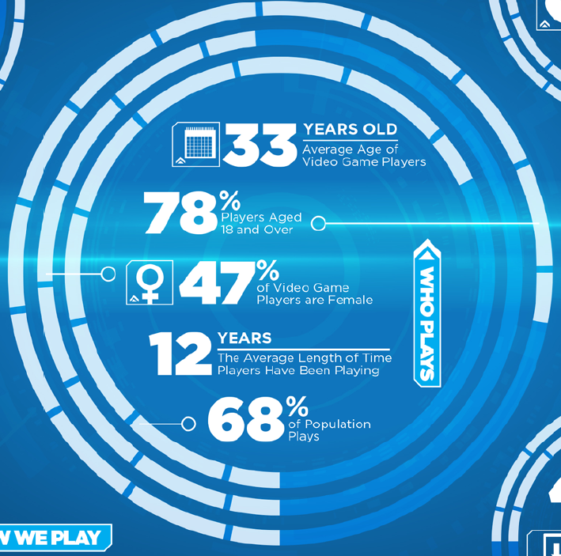
Who Plays Games ?
What Questions
would we need to ask in a Survey to collect data to make a summary like this?
Notes:
Always start a Survey with Q1. Sex M or F ? And Q2. Please tick your age group: 4-12, 13-18, etc then need a question that asks if they play any video games.
Also ask how many years have you been playing computer games.

Slide 4
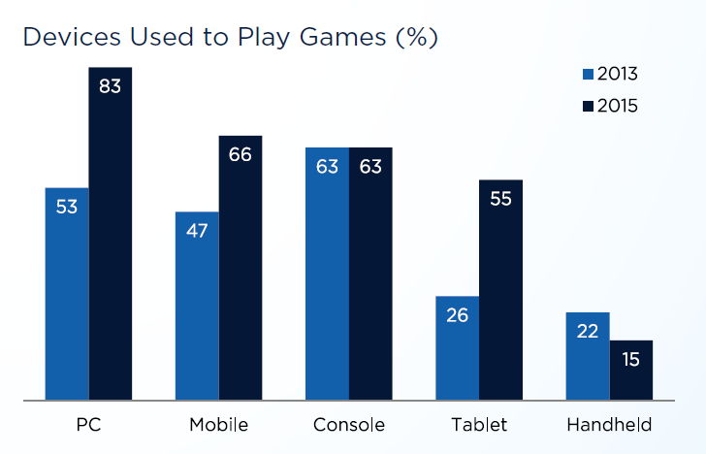
Devices Used to Play Games
Notes:
Ignoring getting two separate years of data, the Survey Question we would ask to get a breakdown by Device might be something like:
What device do you spend the most time playing games on:
Options: PC, Console, Tablet, Mobile, Hand Held, Other, or I do not play games at all

Slide 5
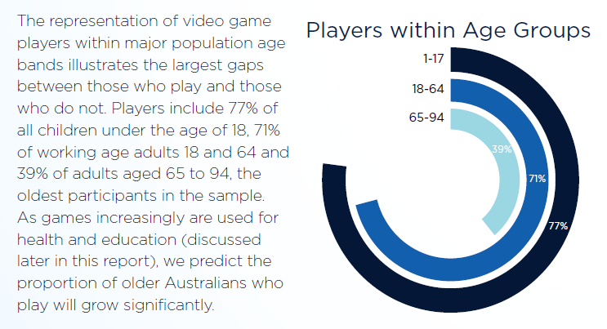
How Many Play in each Age Group?
If a survey asks if People play games, and also asks for their Age Group, then we can obtain data to make an Infographic like this one.

Slide 6
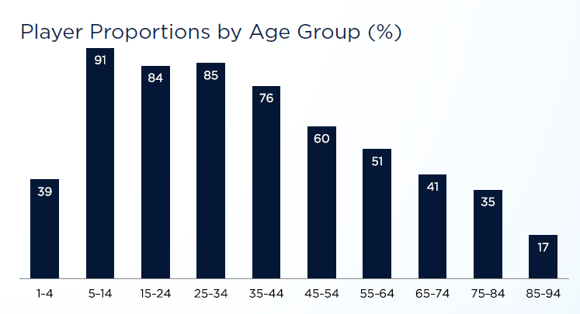
People that Do Play Games by Age Group
If a survey asks if People play games, and also asks for their Age Group, then we can obtain data to make an Infographic like this one.

Slide 7
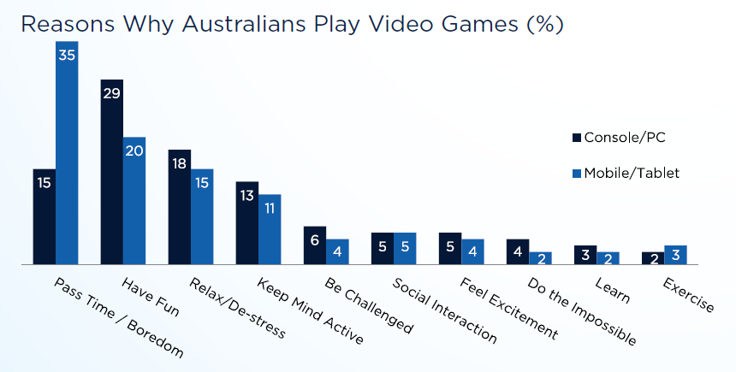
Why People Play Games
@@to
In our Survey we need to ask what is the main reason people play games and give them the categories in the above graph as selectable options.

Slide 8
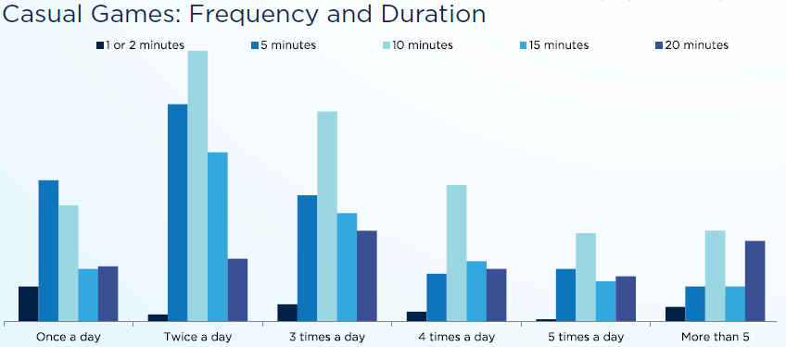
Casual Gaming
Casual games are usually played between two and three times a day, on a mobile device usually for ten minutes each time.
We need to ask in our survey how long people usually play a casual game for, and how many times a day they do this.

Slide 9
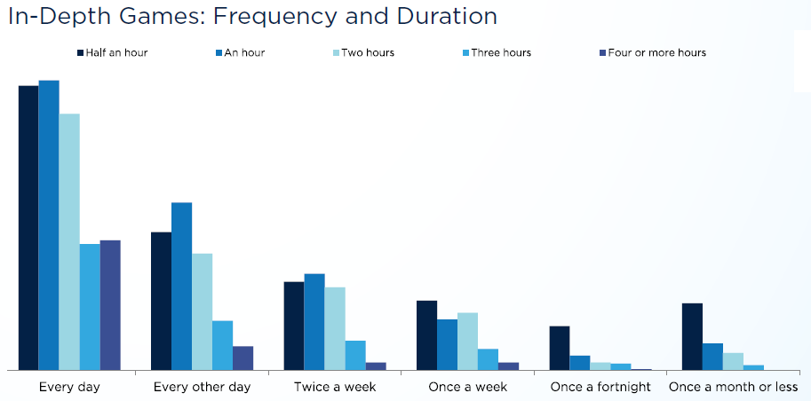
In Depth Gaming
In-depth games are typically played daily for between half an hour and two hours on a console or PC.
We need to ask in our survey how long people usually play an In-Depth game for, and how many times a day they do this.

Slide 10
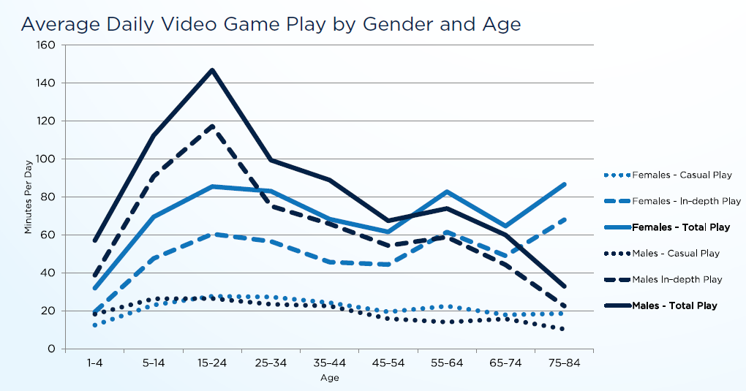
Average Daily Game Play
By combining our previous survey question responses, we should be able to work out this final summary graph.

