Slide 1
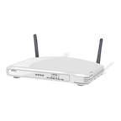

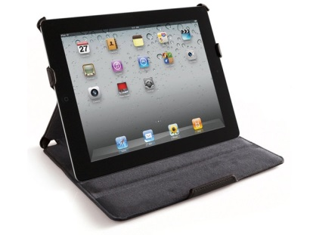

switch
Use these images to create the networks described on the separate slides.
Explain basically how the network would function and who would use this type of a network.
internet
WAP

Slide 2
Peer to Peer/Home or Office
All Computers use the same printer
Nodes on this network can share all files & information & devices
Switch/Router
Used for : file sharing, home office, small businesses. one printer is used for sharing of hardware. Internet connection is also used by all on this network.
internet

Slide 3
Client server
WAP
internet
switch
All Activity must be authenticated by the main file server. Username & password is needed for security. NOS performs this task.
Use: Large organisations to share software, hardware, internet access, & communications.

Slide 4
Internet peer to peer (P2P)
All computers behave like servers.
Mesh or Web Structure
Satellite connections are used around the world
WAP
WAP
WAP
WAP
WAP
Use: All LANS, business, home users, while on the internet use this network type.
Mesh of connections with LANS.

Slide 5
Bus Network
Create a diagram here.
Explain how the nodes work.
Explain the main use for this type of network.

Slide 6
Star network
Create a diagram here.
Explain how the nodes work.
Explain the main use for this type of network.

Slide 7
Hybrid
Explain how the nodes work.
Explain the main use for this type of network.

Slide 8
LAN
Explain how the nodes work.
Explain the main use for this type of network.

Slide 9
WAN
Explain how the nodes work.
Explain the main use for this type of network.

