Slide 1
VCE Software Development Unit 3
Programming Practice – Data and information
File input and output part 2

Slide 2
From The Study Design
Key knowledge - Data and information
formatting and structural characteristics of input and output, including XML file formats
types of data structures, including one-dimensional arrays (single data type, integer index) and records (varying data types, field index)
Key knowledge - Approaches to problem solving
processing features of a programming language, including instructions, procedures, methods, functions and control structure
Source: http://vb.net-informations.com/xml/how-to-xml-in-vb.net.htm

Slide 3
You should have …
A program that can:
Create a node using a createNode subprocedure.
Make an XML file with some records.
Read an XML file into an array of records.
Display the records.
If you haven’t finished the Headstart stuff, do that FIRST.

Slide 4
Editing and saving changes
In order to save any changes to data, you want to put a Save changes button on your form.
This button should only be active when there are changes in the text boxes.

Slide 5
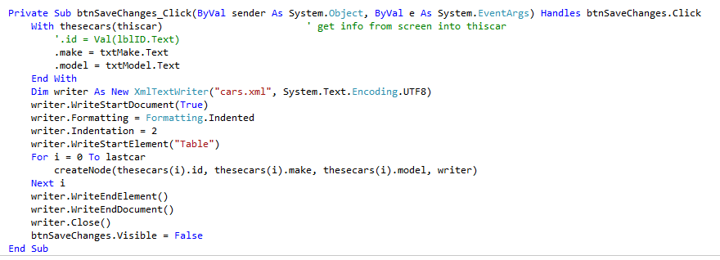
Editing and saving changes part 2
When the button is clicked, the following should happen:
the data on screen is written into the array copy. This is done using the with statement.
The file is reopened, and the array is written to the file, replacing all of the existing data.
Change the array
Write to the file

Slide 6
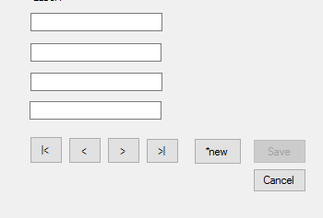
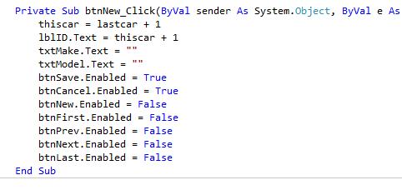
Adding a new record
We should have thiscar and lastcar that tell us which number car we are looking at, and which car is the last in the last. To add a new record, we want to increase thiscar by 1 and make a blank record. We also want to disable navigation and make the user Save or Cancel.

Slide 7
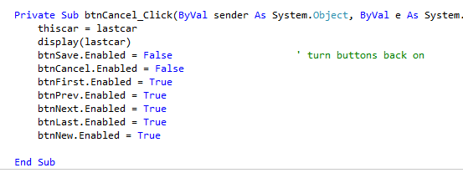
Cancelling a new record
Cancel is the easier option … just forget that we’ve got a blank record at the end and turn the nav buttons back on.

Slide 8
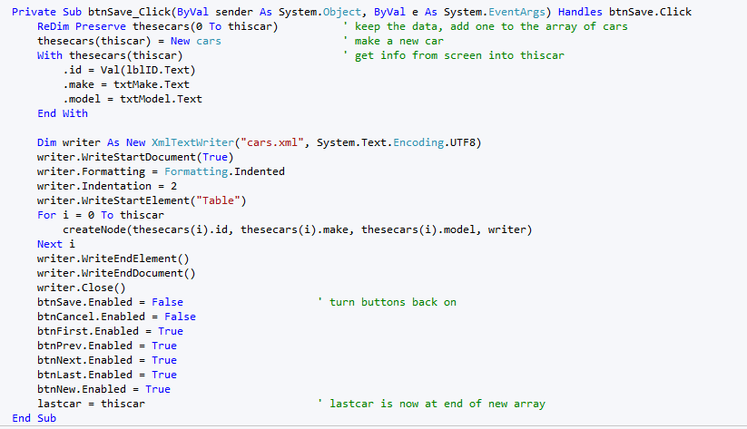
Saving a new record
Save is the harder option … we need to make the array one item bigger (redim) while keeping the data (preserve). Make a new record and write the screen contents into it. Then, we open the file and write the array to it.

Slide 9
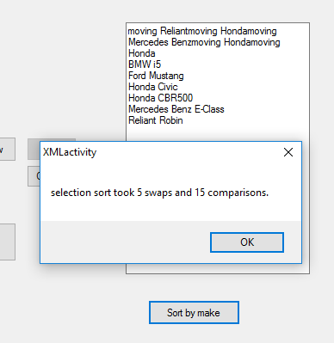
Sorting vehicles
We can also sort the vehicles by their make. You will need somewhere to dump the sorted list … a multiline text box will work fine.

Slide 10
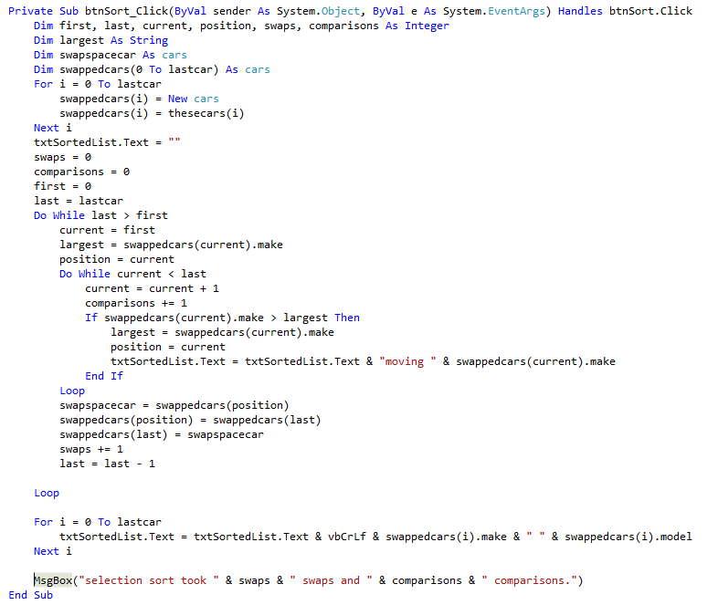
Sorting vehicles
What type of sort is this?

