Slide 1


VCE Software Development
Unit 3
Programming Practice – Data and information
File input and output

Slide 2
From The Study Design
Key knowledge - Data and information
formatting and structural characteristics of input and output, including XML file formats
types of data structures, including one-dimensional arrays (single data type, integer index) and records (varying data types, field index)
Key knowledge - Approaches to problem solving
processing features of a programming language, including instructions, procedures, methods, functions and control structure
Source: http://vb.net-informations.com/xml/how-to-xml-in-vb.net.htm

Slide 3
Files
In order to save data for longer than the runtime of the program, it must be saved to a file on disc.
The Study Design mandates XML files, so that’s what we’re going to use.

Slide 4
XML
XML is a general purpose tag based language and very easy to transfer and store data across applications. Like HTML , XML is a subset of SGML - Standard Generalized Markup Language. XML is a platform independent language, so the information formatted in XML can be used in any other platforms (Operating Systems). XML is a self describing language and it gives the data as well as the rules to identify what information it contains.
XML files are made up of tags that contains data. Generally a start tag and end tag to hold the data. For example, if you want to create an XML tag name "Header", the start tag is like < Header > and the end tag is like < /Header > . We can fill our information between these tags.

Slide 5
An example
<?xml version="1.0" encoding="utf-8" standalone="yes"?>
<Table>
<Cars>
<Car_ID>1</Car_ID>
<Car_Make>Ford</Car_Make>
<Car_Model>Mustang</Car_Model>
</Cars>
<Cars>
<Car_ID>2</Car_ID>
<Car_Make>Reliant</Car_Make>
<Car_Model>Robin</Car_Model>
</Cars>
</Table>
For our XML file, I’ve cut down the definition of a car to just ID, make and model to save a bit of space. I’ve also cut down to two cars.

Slide 6
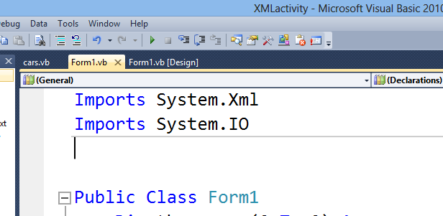
Imports statements
If you are using XML, you must use some imports statements – these tell VB how to handle XML files.

Slide 7
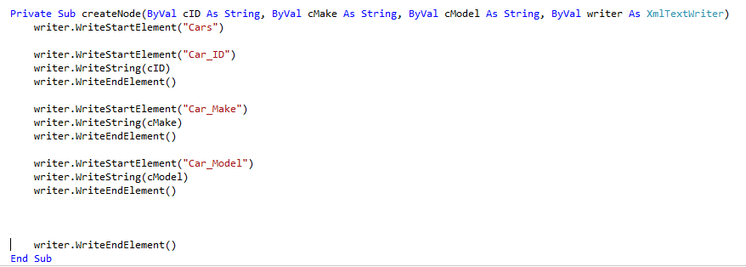
Writing a new XML file from a program
First up you need a subprocedure called createNode
This will write Car_ID, Car_Make and Car_Model to an element.
Note that you start with a WriteStartElement and end with a WriteEndElement

Slide 8
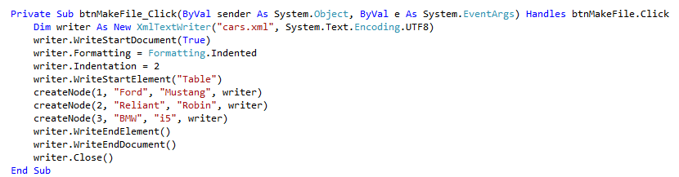
Writing part 2
Once you have createNode, you can create XML entries. I have linked these to a button. The XML file created is called cars.xml .

Slide 9
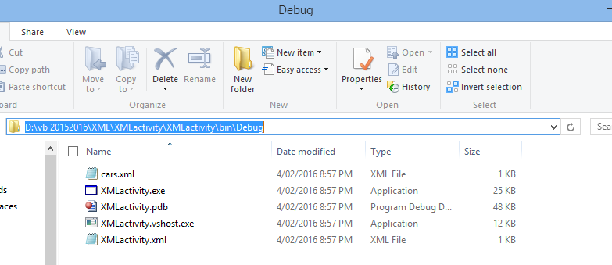
Writing part 3
The XML file cars.xml is in your program’s \bin\Debug folder.

Slide 10
Writing part 3
The XML file cars.xml is in your program’s \bin\Debug folder.
You should be able to double-click and read the file in Notepad.

Slide 11
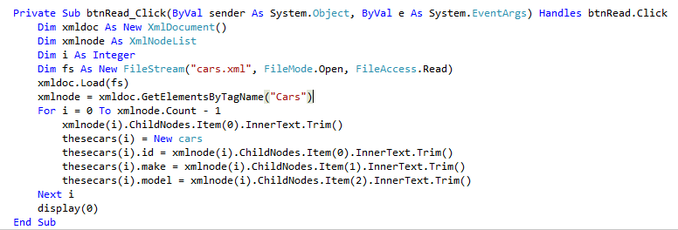
Reading part 1
This code will read a document into an array of objects (note that you’ll need to make the class as per last lesson).
Display is the same as last time too.

Slide 12
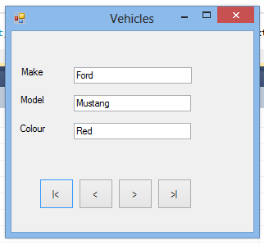
Time to go do something …
It’s probably a good idea to make this a separate form at least, if not a completely new program.
Get an XML file to read into a program as per the PowerPoint.
Have a go at writing to an XML file. I’ll be playing with this myself.

