Slide 1
Area of Study 2:
Interactions and Impact
Analyse and explain the dependencies between two information systems and evaluate the controls in place in one information system to protect the integrity of its source data.

Slide 2
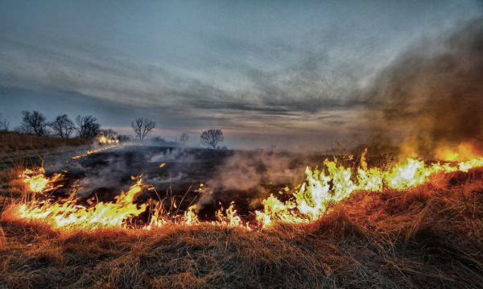


Case Study One
Bureau of Meteorology and the CFA

Slide 3
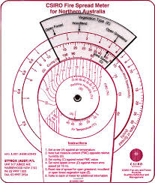
Data from the BOM
Wind, temperature, humidity and rainfall are weather elements that affect the behaviour of bushfires.
In Australia there is a system of assessing these in conjunction with the state of the available fuels to determine a measure of "fire danger" or the difficulty of putting out any fires which may occur.
The Bureau provides fire agencies with weather forecasts based on the McArthur Mk V Forest and modified CSIRO Mk IV grassland fire danger meters to assist them in calculating the Fire Danger Ratings for each State and Territory.

Slide 4
Fire Weather Warnings
The Bureau of Meteorology also issue Fire Weather Warnings when weather conditions are conducive to the spread of dangerous bushfires.
Warnings are generally issued within 24 hours of the potential onset of hazardous conditions. Warnings are also broadcast on radio and television.
Fire agencies determine Fire Danger Ratings.
In Victoria, the CFA will declare fire bans based on a range of criteria including forecast weather provided by the Bureau.

Slide 5
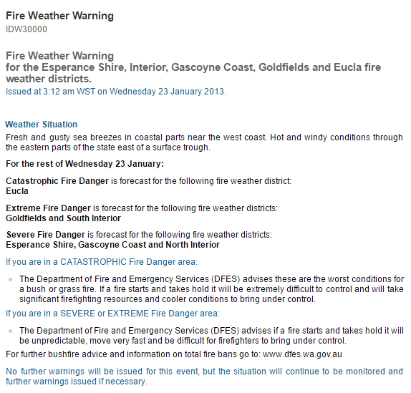

Slide 6
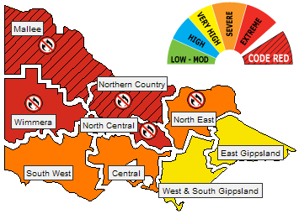
Fire Danger Ratings

Slide 7
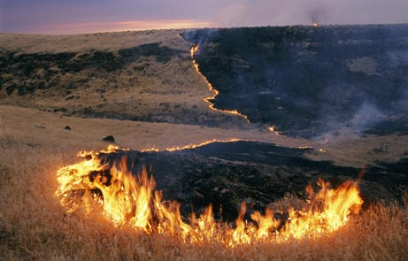
Weather data
Temperature(air)
Wind speed
Relative humidity
Rainfall and no days since last rain
Fuel data
Fuel load
Fuel Curing
Fire Danger Ratings

Slide 8
Fire Danger Ratings
Fire Danger Ratings are distributed through the media, fire agencies and other key emergency service organisations.
Warnings are normally issued in the afternoon for the following day so to be available for evening television and radio news broadcasts.
Based on the weather forecast, the CFA response will then kick in.
Hot day response – crew on stand by.
IMT set up and on stand by.
Local response tables – TFB 5 trucks to any call out.

Slide 9
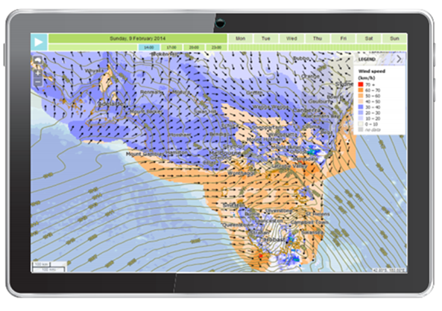
Fire control
Meteorological data is fundamental to predicting fire danger and fire behaviour on timescales from seasonal to very short range.
Accurate fire weather forecasts can make all the difference to a community’s safety and to the overall success and wellbeing of firefighters and fire authorities in preparing for adverse fire weather.
The information is vital to predicting fire movement and growth, which informs safety messaging to the community.

Slide 10
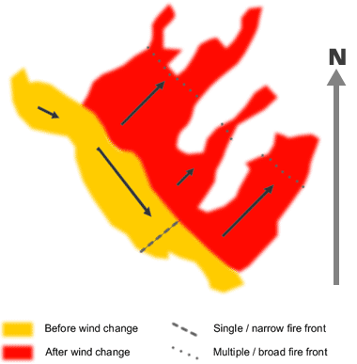
Weather change on the fire ground
Wind change is the killer
‘When the wind was from the north-west, we had these long, thin slivers of fast-moving fire. But with the change, the flank becomes the head... The whole thing goes ballistic.’
That was how it had happened on the state’s previous disaster days:
Black Friday, Ash Wednesday, Black Thursday, Black Saturday
The northerly wind kick-starts the fire, drives it south, then the southerly change
comes sweeping in and whips it into a frenzy.
It will generally move to the north-east, but in those first few moments it is swept up into a vortex that can send its missiles spinning in every direction.
Instead of a five-kilometre front heading south-east, you’ve got an eighty-kilometre front, and it’s rampaging all over the place.
Historically, more than 80 per cent of the destruction wrought by bushfires occurs after the cold front hits.

Slide 11
For these systems to work together
The CFA information systems receive input from the BOM system
This data must have
    integrity
    accuracy
    timeliness
    reasonableness
    authenticity
    correctness

Slide 12
Questions
What is the Organisational Goal of the CFA?
What might the goal of their information system be?
List three possible objectives of the CFA information system
What is the Organisational Goal of the BOM?
What might the goal of their information system be?
List three possible objectives of the BOM information system
List five examples of data that the CFA needs from the BOM system

Slide 13
Questions
Explain the meaning of these terms from a CFA point of view to deliver quality Fire Danger Ratings:
          integrity
          accuracy
          timeliness
          reasonableness
          authenticity
          correctness

Slide 14
Some other systems…
bom, cfa & emergency services

Slide 15

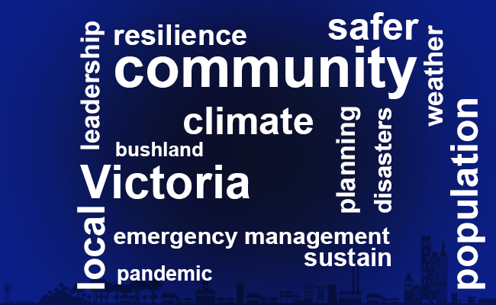
Emergency Management Victoria - Goals
https://www.emv.vic.gov.au/about-us/our-vision-goals-and-values

Slide 16
If systems are to share data they must have a standard file format
How can this data be made available for multiple systems?

Slide 17
EMV - Fire Danger Ratings real time data
Brief description
These Fire Danger Ratings are important as they provide a trigger for people to make decisions, including leaving early on days of extreme fire danger. It helps you to know when conditions are dangerous enough to put your bushfire survival plan in to action. Ratings are forecast using Bureau of Meteorology data for up to four days in advance, based on weather and other environmental conditions such as fuel load.
This data has only been published (temporarily) for the intent and use by Govhack 2016 participants. More info http://emergency.vic.gov.au/about-this-site/introduction

Slide 18
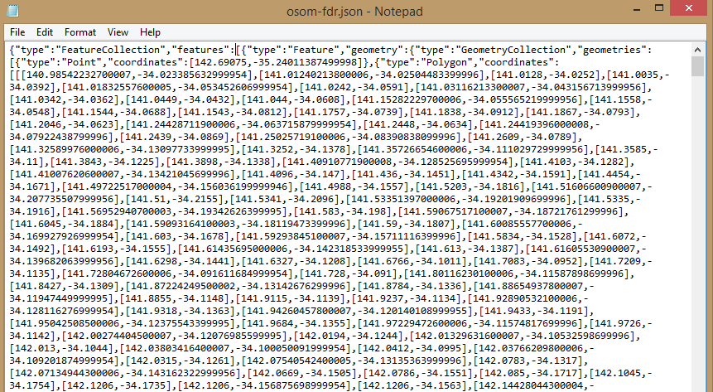
Json file format

Slide 19
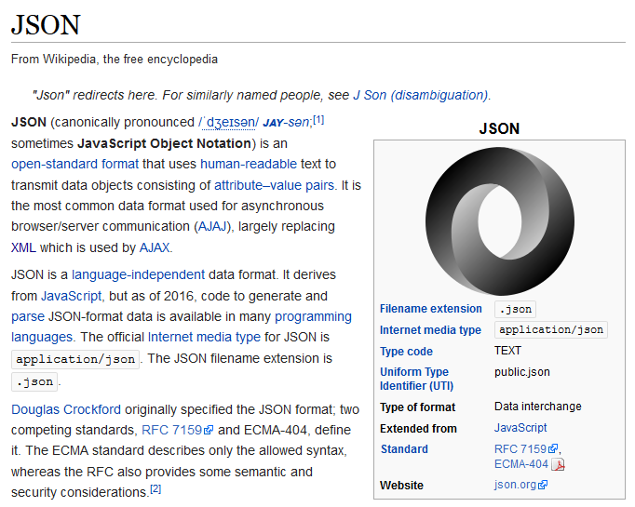

Slide 20
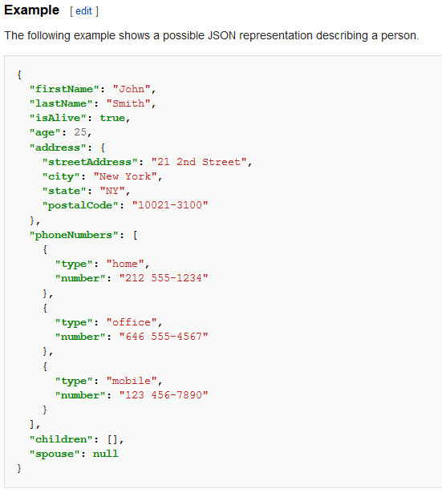
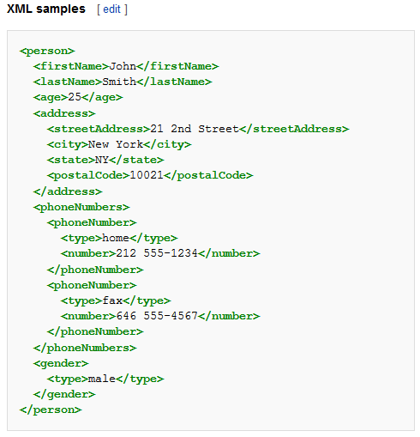
JSON is promoted as a low-overhead alternative to XML as both of these formats have widespread support for creation, reading and decoding in the real-world situations where they are commonly used. Apart from XML, examples could include OGDL, YAML and CSV. Also, Google Protocol Buffers can fill this role, although it is not a data interchange language.

Slide 21
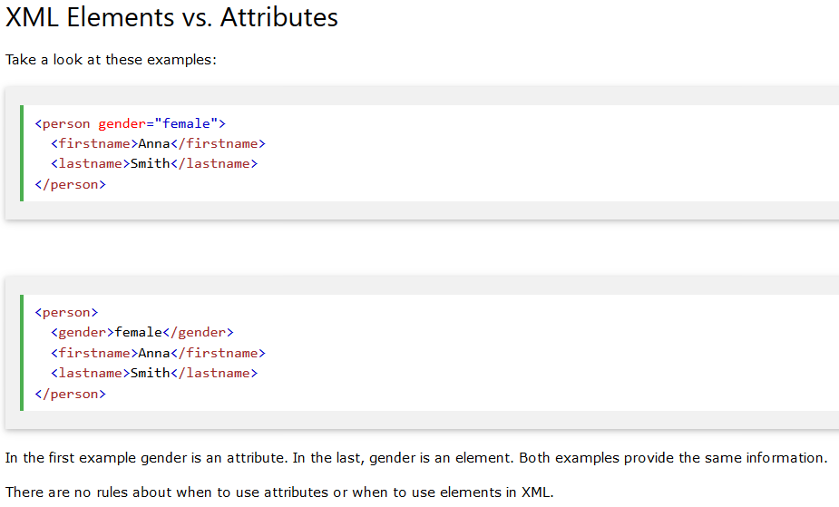
Elements vs Attributes

Slide 22
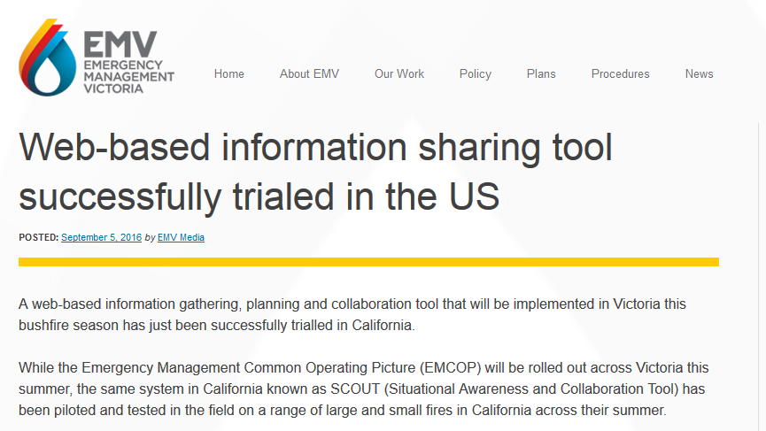
https://www.emv.vic.gov.au/latest-news/web-based-information-sharing-tool-successfully-trialed-in-the-us/

Slide 23
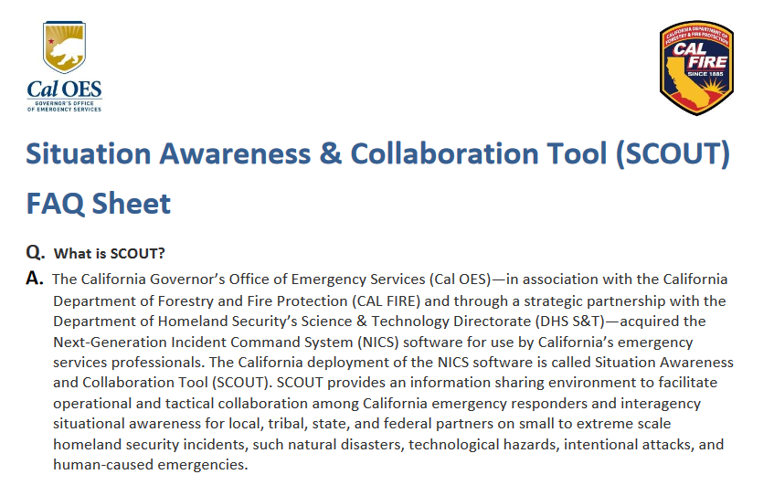
http://www.caloes.ca.gov/RegionalOperationsSite/Documents/2016_03_21%20SCOUT%20FAQ%20Sheet.pdf

Slide 24
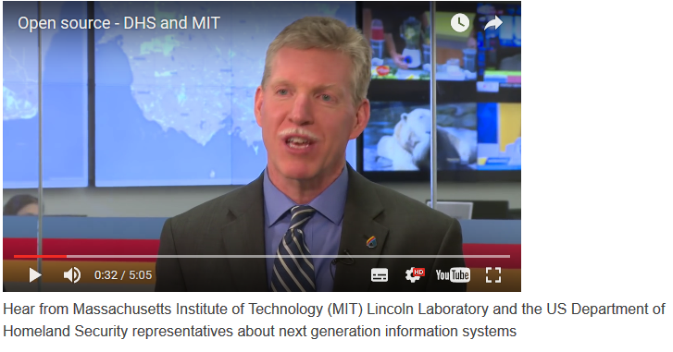
Hear about the SCOUT system:
https://youtu.be/wUHWo0Hy2k0

Slide 25
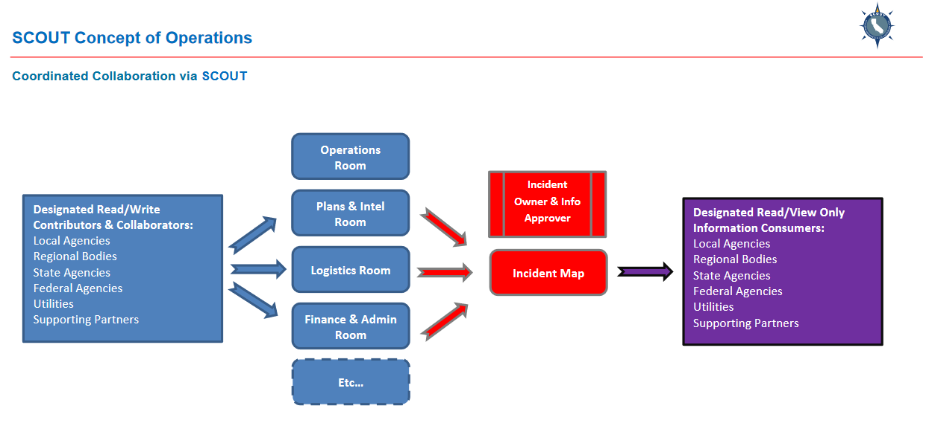
http://www.caloes.ca.gov/RegionalOperationsSite/Documents/2016_04_25%20SCOUT%20Concept%20of%20Operations.pdf

Slide 26
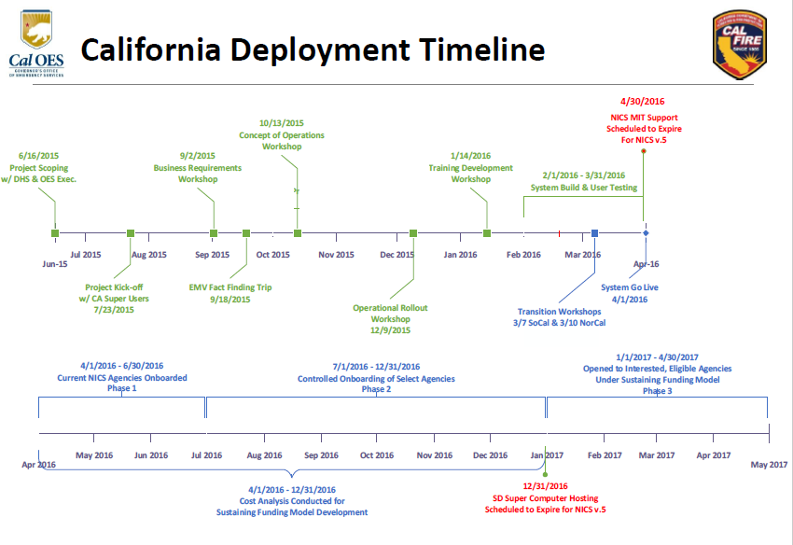
www.caloes.ca.gov/RegionalOperationsSite/Documents/2016_03%20SCOUT%20Transition%20Workshop%20Brief_for%20distribution.pdf

Slide 27
Questions
What is EMV? Who are their stakeholders?
What are the Organisational Goals and Objectives of EMV?
What is Scout?
Who are the stakeholders in SCOUT?
How would SCOUT help the EMV achieve their Goals and Objectives?
How do users access the information provided by SCOUT?
How is it possible to share the data between these information systems?
What could happen if the integrity of the data is compromised?

