Slide 1
SAT 2B
TESTING AND EVALUATION

Slide 2
Test your code
Create
Test Data
Run Tests
Document
Create a set of data to test the program meets the FRs from your SRS.
List the data and expected results in a trace table.
Enter the test data into the program to see if the actually results are as expected.
Take screen shots as evidence that your program works as expected and meets all FRs

Slide 3
Trace Table
Feature tested | Test Data | Expected | Actual | Evidence
Calculation without membership | adult =2 child =2 MEMBER =NO member no = na | $40.00 + $20.00 +$6.00 GST= $66.00 | $66.00 | See screen dump1 - as expected.
Calculation with membership | adult =2 child =0 MEMBER =Yes member no = 14356 | $40.00+$4.00 GST less 5%= $41.80 | $41.80 | See Screen dump 2- as expected
other tests - eg 5 examples of testing, where you test all your validation rules and buttons

Slide 4
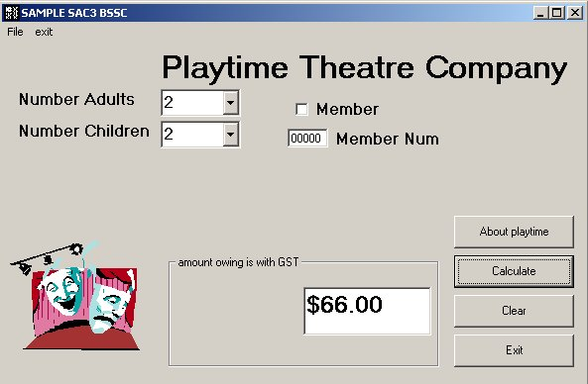
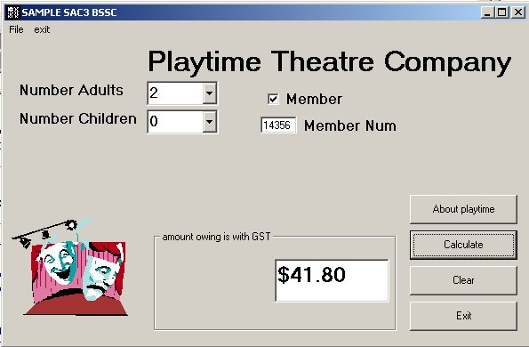
Evidence
Screen shot 1
Screen shot 2

Slide 5
Evaluate the Usability of your Solution
Design
Tests
Gain
Permission
Document
Results
List
Changes
List the dates, participants, questions to ask, steps to follow, etc.
Fill in a permission document and ask each participant to sign it.
Conduct the tests.
Record the results.
Recommend any changes that should be made to your program.

Slide 6
Design Tests
To test your prototype you will need to get your participants to do some specific tasks (not the whole program). These tasks should reflect the core functional requirements of your design. The way the tasks are worded is critical to the success of your evaluation.
Make sure that your tasks:
Give the user something concrete to do
Have clear completion criteria (i.e., book appointment for 13/04/2015 at 11:30)
Do not give instructions (or hints) about how to use the interface

Slide 7
Design Tests – tasks and questions
Which example is best suited for usability testing?

Slide 9
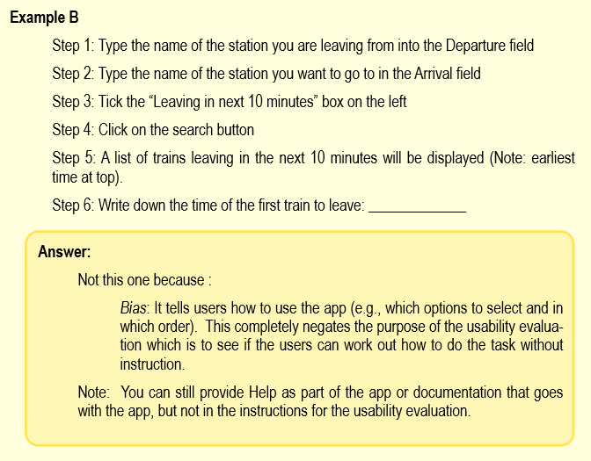

Slide 11
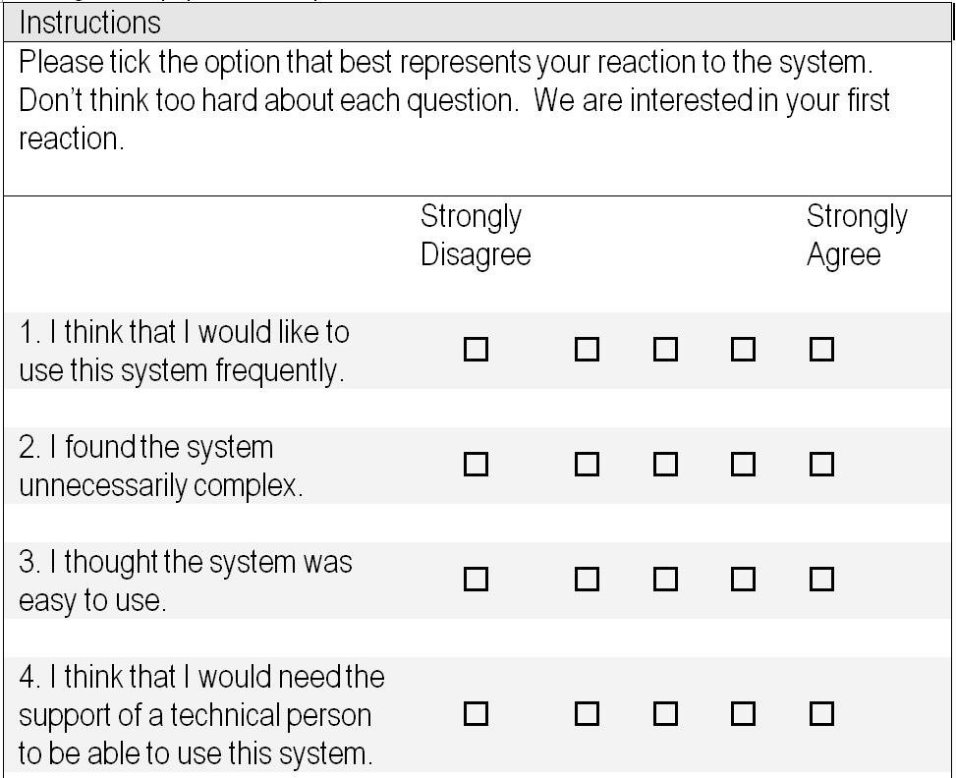
Design Tests – constructing questions
Examples of closed questions:

Slide 12
Design Tests – constructing questions
Examples of open questions:
Please answer the following questions about your experience:
What did you like most about the prototype?
What did you like least about the prototype?
Would you recommend this prototype to a friend (please tick)?
☐ Yes
☐ No
This is very general example, write your own instructions and questions.

Slide 13
Templates for you to download:
The following templates are on Compass for you to download and complete and hand to your users:
Informed Consent
Task Description
Satisfaction Questionnaire

Slide 14
Templates for you to download:
And…
A Usability Test Report template (for you to complete to document your test design and results)

Slide 15
Thank you

