Slide 2
DeBono’s 6 thinking hats

Slide 3
Goals and objectives (U4O2)
why individuals and organisations use information systems
Organisations goals p. 2
High-level business purpose
information systems goals p. 3
High-level system purpose

Slide 4
Elevator pitch
Envato excursion

Slide 5
Efficiency vs Effectiveness
Efficiency is a measure of how much time, cost and effort is applied to achieve intended results. Measures of efficiency in a solution could include the speed of processing, its functionality and the cost of file manipulation. Measures of efficiency in a network include its productivity, processing time, operational costs and level of automation.
Effectiveness is a measure of how well a solution, an information management strategy or a network work and whether each achieves its intended results. Measures of effectiveness in a solution include completeness, readability, attractiveness, clarity, accuracy, accessibility, timeliness, communication of message, relevance and useability. Measures of effectiveness of an information management strategy include integrity of data, security, ease of retrieval and currency of files. Measures of effective networks include reliability and maintainability.

Slide 6
Glossary – design brief
A design brief is a statement that contains an outline of a situation, context, problem, need or an opportunity, and constraints or conditions under which a solution must be developed.
It is sometimes important to create a solution that not only meets the current needs but has the capacity to meet future or changing needs.
It provides a basis from which students can apply some or all of the stages of the problem-solving methodology when creating digital solutions.

Slide 7
Activity
Holiday homework – SAT

Slide 8
Collecting data
determine needs and requirements
interviews
surveys
Observation
Focus groups
Workshops
Document review

Slide 9
Stakeholders
Envato excursion

Slide 10
Activity
Brainstorm all the potential sources of data and information for your SAT
Who (stakeholders)
Name, position
Where
Offices, sites, countries
What
Annual reports, observing people at work, materials

Slide 11
Activity
Meet with your SAT stakeholders, using the kick-off agenda
Introductions
Goal of your SAT
Goals of the proposed system
Who to talk to
Requirements
Outline of timeframes (project plan)
Take notes

Slide 12
Functional and non-functional requirements
Functional – what the system does, its features
Non-functional – characteristics of the system as a whole
https://www.outsystems.com/blog/2013/03/the-truth-about-non-functional-requirements-nfrs.html

Slide 13
Functional requirements
Document these using Use Cases
Must be prioritised
1 critical
2 high priority
3 medium priority
4 low priority
Break into phases
Minimum feature set (any less than this and the system isn’t useful)
Phase 1 (your SAT goal delivery)
Phase 2 (later)
http://leadinganswers.typepad.com/leading_answers/estimating/

Slide 14
Functional Requirements matrix
Requirement | Priority | Phase
A | Critical | Minimum
B | Critical | Minimum
C | High | Minimum
D | High | Phase 1
E | High | Phase 1
F | Medium | Phase 1
G | Medium | Phase 2
H | Low | Phase 2

Slide 15
Non-functional requirements
Usability
Affordability
Security
Interoperability
Marketability
Reliability
Portability
Robustness
Maintainability
Availability
Performance
Scalability
Flexibility
Auditability
Documentation
Factors influencing the design of solutions
Not an exhaustive list

Slide 16
10 non-functional requirements
https://www.outsystems.com/blog/2013/03/the-truth-about-non-functional-requirements-nfrs.html

Slide 17
Example Documentation NFRs
Install instructions
Readme.txt
User guide
Support & maintenance guide
FAQs
Etcetera.
https://www.outsystems.com/blog/2013/03/the-truth-about-non-functional-requirements-nfrs.html

Slide 18
Activity
Functional and non-functional requirements test
Read Requirements specification company.com, sample document
Develop the SRS template v4
Read the SRS Fact sheet

Slide 19
Constraints
These things will limit the final solution (product) and what you can do when you are delivering it (project)
Economic
Available budget, resources
Legal
Copyright, privacy, intellectual property
Social
Context of use (corporate, not-for-profit), requirements for accessibility or multiple languages
Technical
Hardware, software, networks, security
Usability
See Non-functional Requirements

Slide 20
Activity
As a class, brainstorm all the constraints that exist on VCE Software Development U3&4
Brainstorm all the current, known constraints on your SAT project (you will learn more), add to your SRS

Slide 21
Security considerations
including data protection and authentication
Security is special as can be
functional requirement
non-functional requirements and/or
constraint

Slide 22
Security examples
Functional
User login
Ability to manage users, roles and permissions
Integrate with payment gateway with SSL
Data validation to ensure quality, no special characters
User registration with bot protection features
Non-functional
Exist on business network with access via VPN
Application logging
All users must login
Constraint
Utilise existing single sign-on (SSO) infrastructure or hosted environment with firewalls

Slide 23
Scope
What is IN | What is OUT
What needs to be decided

Slide 24
Scope – online ordering system
What is IN | What is OUT
User management Product catalog Online ordering Phase 1 features | Reporting Phase 2 features Staff training Hosting
What needs to be decided Analytics User guide

Slide 25
Scope
What is OUT is almost as important as what is IN
Do not repeat all your functional requirements, but include key, general categories
This is everything your project will deliver
Working software
Documentation
Source code
Other services

Slide 26
Out of scope items could be …
Some types of documentation
On-site installation
Post-deployment maintenance
Phone support
Features in future phases, i.e. “phase 2”

Slide 27
Level of detail
Purpose
Scope – IN, OUT
Functional requirements
Use case diagram
Use case detail
Designs
Context diagram
Data flow diagram

Slide 28
Project trade-offs

Slide 29
Search your feelings
Use your hunches and intuition
Listen to your client’s ‘gut feelings’

Slide 30
Software Requirements Specifications (SRS)
Output of planning and analysis, p. 31
See Template and Fact Sheet SRS
Activity
Develop SRS for SAT project
Show this to your customer regularly

Slide 31
Glossary – SRS
Software requirements specification is a comprehensive description of the intended purpose and environment for purpose-designed software solutions. It documents the key activities associated with the analysing stage of the problem-solving methodology.
Software requirements specifications (SRS) fulfil the purposes of breaking down a problem into component parts, providing input to the design stage and serving as a reference point for further stages of the problem-solving methodology.

Slide 32
Activity
Preparing an SRS
Analysis questions
Practice SACs
Gifts online
Ocean Breeze
Shagadelic Carpets
Jackson’s Pond Emporium
U3O1 Revision Notes

Slide 33
Projects change
Needs change
New ideas emerge
Manage the changes
Iterate

Slide 35
Projects have:
Purpose, goal or outcome
Finite
Comprised of many activities or parts
Unique
Risk
Notes:
Ask which of these is a project? Answer - all
New product or service
Change in structure, staffing or style of an organisation
New transportation vehicle
New or modified information system
Constructing a building or facility
Building a water system for a community in a developing country
Running a campaign for political office
Implementing a new business procedure or process

Slide 36
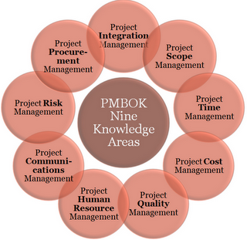
Project management
Notes:
Project management is a process
Scope - project contains all the work required, and only the work required, to complete the project
Time - ensure timely delivery of the project
Budget - ensure the project is completed within the approved budget
Risk - identifying, analysing and responding to project risk
Quality - ensure the project meets the needs for which it was undertaken
Communications - ensure timely and appropriate generation, collection, dissemination, storage and ultimately disposal of project information
Human resources - make the most effective use of the people on the project
Procurement - acquire goods and services from outside the performing organisation

Slide 37
Blue hat – planning and control

Slide 38
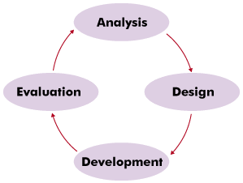
Problem solving methodology
Project managers make sure the steps in the PSM take place
Flow goes both ways between stages
Project management
Notes:
Project management wraps around your methodology
Even if you do a bit of the total lifecycle you still treat it like a project and manage it

Slide 39
Project management – Time
milestones
dependencies
task identification
sequencing
time allocation
resources
Gantt charts

Slide 40
Gantt chart tips
Start with the PSM
each phase should be a roll-up task
each activity will likely have lower-level tasks
Enter in external milestones then project milestones
Be careful with Duration vs Elapsed time – it may take a 1w of elapsed time to do a 1hr task
Set-up a BMG Calendar to identify term from non-term time

Slide 41
The problem with Gantt charts …
Task identification
Effort estimation
Getting out of date
https://www.youtube.com/watch?v=GiPe1OiKQuk Donald Rumsfeld’s “Known unknowns”
Activity – Agile poker

Slide 42
Baselines
http://redragon77.blogspot.com.au/2010/11/tracking-gantt-chart-control-chart.html

Slide 43
Project plan
Submit for U3O2 – baseline
Submit for U401 – actual with annotations

Slide 44
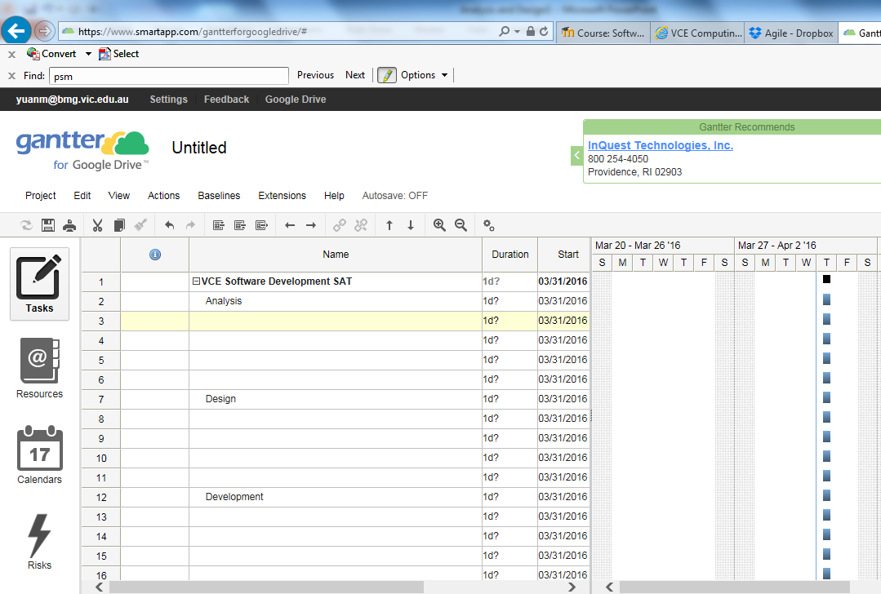
MS Project recommended so you can track Actual start/ end and % complete

Slide 45
Activity
Project management worksheet
Project management garage exercise
https://www.smartapp.com/gantterforgoogledrive/
Develop SAT project plan
Gantt chart
Annotations (text doco)

Slide 46
Criteria 4 – performance 9-10
Prepares a Gantt chart using software that identifies all relevant project management concepts and processes.
Documents all stages of the problem-solving methodology in the chart, identifying conclusively all activities required for both parts of the project.
The accuracy, completeness and coherence of the chart contribute to an effective project management plan to monitor progress.
Criteria 8 is also project management, includes the annotations

Slide 47
Staying organised
To Do list
Project plan
Use version naming
Use Google Drive for documents (you will need these at school, home and at your client’s)
Document version | Signifies
V0.1 | Initial release
V0.2 | Minor release
V1.0 | Major release
V1.1 | Minor release

Slide 48
Managing risks
Risk | Likely? | Impact | Action
Not managing deadlines | 80% | High | Review in class Tues and Fri
Leaving until the last minute | 70% | High | Need to show evidence in class
Not enough client contact | 70% | High | Schedule weekly / bi-weekly meeting for term 2 and term 3
All as above |  |  | Must ‘demo’ software

Slide 49
Contingency plans

Slide 50
Class stand-up
What did you do yesterday (last week)?
What are you doing today (this week)?
Do you have any road blocks?

Slide 51
Waterfall vs Agile

Slide 52
Agile development
What’s missing?

Slide 53
Agile design
http://agilemodeling.com/essays/agileDesign.htm

Slide 54
“Demo”
Periodic demonstration of working software
Given by the team to the customer
Do this during Development phase, U4O1

