Slide 1
VCE Software Development Unit 3
Programming Practice – Data and information
Objects and classes

Slide 2
From The Study Design
Key knowledge - Data and information
characteristics of data types
types of data structures, including one-dimensional arrays (single data type, integer index) and records (varying data types, field index)
Key knowledge - Approaches to problem solving
methods of representing designs, including data dictionaries, object descriptions, mock-ups and pseudocode
processing features of a programming language, including instructions, procedures, methods, functions and control structures

Slide 3
By now we have done …
Making variables
Sequence, selection and repetition
Doing some processing
Creating an array
Making random numbers
Linear and binary searching of an array
Sorting an array by selection sort

Slide 4
Object-oriented programming
Up until now, we have used variables and arrays of variables. This was the backbone of procedural programming, but it became painful when programmers wanted to hold multiple pieces of data about a single entity. This is especially true in database style programming.

Slide 5
Objects and classes
In Visual Basic terms:
A class is an abstract representation of something. Think of it like being a list of the interesting features of something. A class can have properties and fields (the data kept) and methods (the actions the thing can do).
An object is a usable example of the thing the class represents.
BUT, the Study Design says you need to know records (varying data types, field index) and object descriptions. Sometimes the different languages use different terminology.

Slide 6
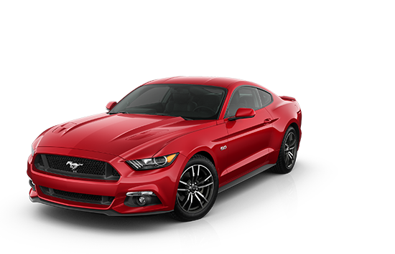
Class (object description) and object
Object: Vehicle
Properties:
Property | Data Type | Description
Make | String | The maker of the vehicle
Model | String | The model of the vehicle
Colour | String | The colour of the vehicle
Wheels | Integer | Number of wheels on the vehicle
Towbar | Boolean | Does the vehicle have a towbar?
Methods:
StartEngine |  | Start the engine
Drive |  | Drive the vehicle
Make = “Ford”
Model = “Mustang”
Colour = “Red”
Wheels = 4
Towbar = false

Slide 7
Defining a class
Go to Project → Add Class …

Slide 8
Let’s add some properties

Slide 9
Declaring some vehicles

Slide 10
Time to go do something …
Using the vehicles example in this PowerPoint, create five vehicles.
Put in some navigation buttons (traditional First/Previous/Next/Last) to navigate through the five vehicles.

