Slide 1

What is a network?
A network consists of two or more computers that are linked in order to:
  share resources (such as printers and CD-ROMs),
  exchange files, or
  allow electronic communications
Introduction to Networking – John Bellavance

Slide 2
The two basic types of networks include:
Local Area Networks (LAN)
Wide Area Networks (WAN)
LAN
WAN

Slide 3
LANs – Operate in a limited geographical area.
Allow many users to access high-bandwidth media
Provide full-time connectivity to local services.
Connect physically adjacent devices
WANs (Wide Area Networks)
WANs interconnect LANs. They make it possible for businesses to communicate across great distances. WANs create a new class of workers called Telecommuters – never leave home to go to work.
Operate over large geographically separate areas.
Provide full-time remote resources connected to local services.
Provide e-mail, WWW, file transfer and e-commerce services.
Ex: Modems, ISDN, DSL, Frame Relay, T or E carrier.

Slide 4
The internet consists of multiple interconnected networks, both large and small.
The 3 components of a connection to the internet
Physical connection- using a NIC, a modem.
Logical connection- Using standards called protocols. Protocols are formal descriptions of a set of rules and conventions that govern how devices on a network
Applications- are used to display and interpret the data- a web browser displays HTML as a web page or FTP to download files.

Slide 5
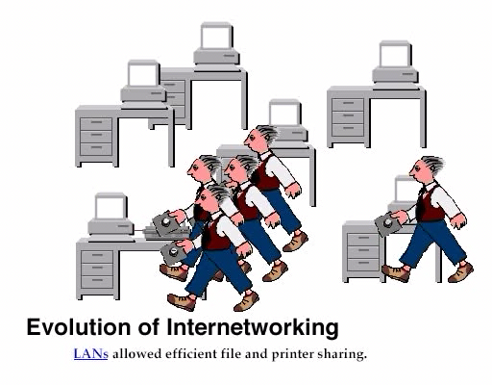
Data Networks
Developed because companies wanted to exchange info over long distances. At first they used sneakernet, but sharing data using floppy disks was not efficient.
The solution was to network the resources (printers,servers) to increase productivity and save money.
Companies in the 80s created a variety of network software and hardware, with their own standards. As a result they were incompatible with each other.

Slide 6
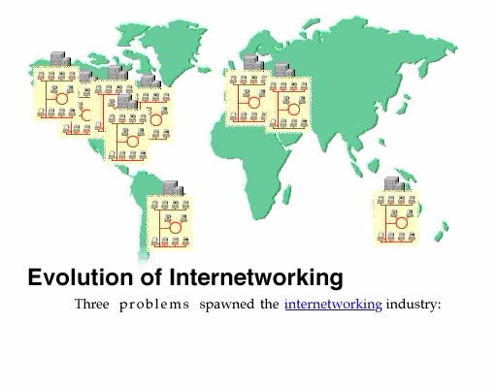
Internetworking History
One solution was to create LAN (Local Area Network) standards which provided guidelines for creating hardware and software..

Slide 7
Intranets- Intranet server are different than public web servers, in that the public does not have access to the organizations intranet.
Extranets- is and intranet that is partially accessible to authorized outsiders with a password and username.

Slide 8
Information
Flow

Slide 9

Know about computers the easier it is to understand networks.
Many networking devices are special computers.

Slide 10
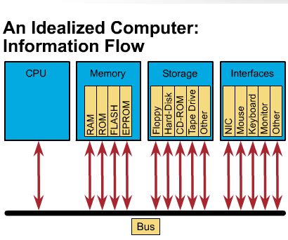
Information Flow within a PC

Slide 11
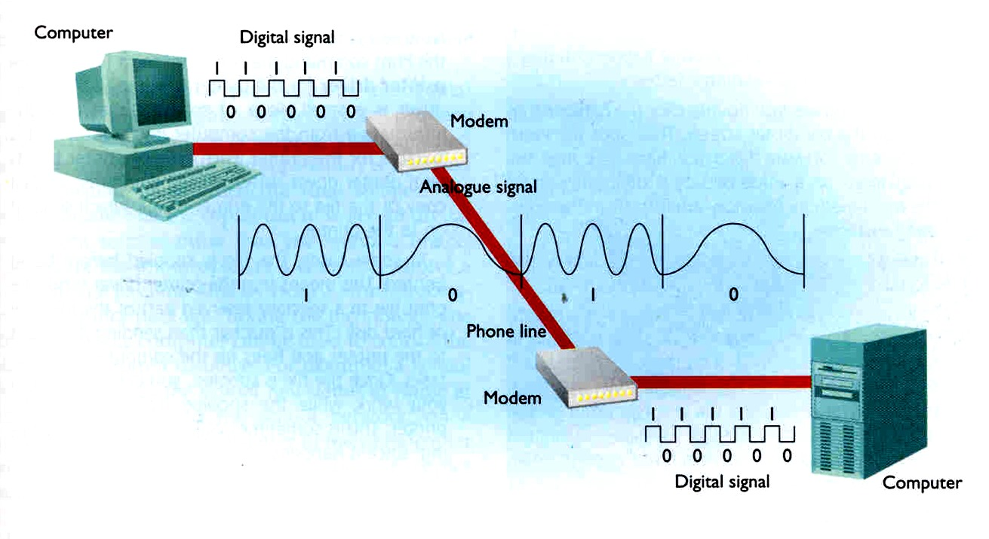
Modems allow data transfer between computers using the Public Switched Telephone Network (PSTN). They convert digital data to an analogue signal for transmission or use other signalling standards.

Slide 12
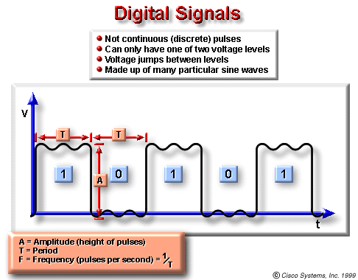
Information Flow - Digital

Slide 13
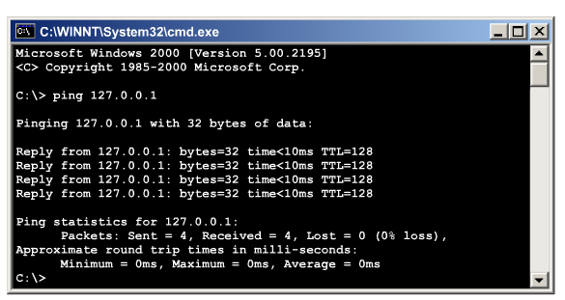
TCP/IP and Testing connectivity
A computer must be running TCP/IP protocol suite to access the internet.
A PC requires an IP address, a subnet mask and a default gateway, this can be done manually or using Dynamic Host Configuration Protocol (DHCP).
Use Ping to:
Verify TCP/IP installation
Works by sending multiple IP packets to a destination. Each packet sent is a request for a reply.
Ping 127.0.0.1- internal loop back
Ping a host IP
Ping a remote destination

Slide 14
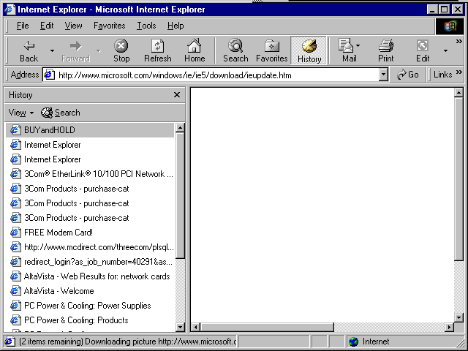
Web Browsers
software that interprets
hypertext markup
language (HTML)
HTML can display graphics, play sounds, movies.

Slide 15



Plug Ins
work in conjunction
with browser to launch
the program required
to view the special, properiety files
Flash/Shockwave

Slide 16
How are they linked?
Computers on a network may be linked through:
  cables,
  telephone lines,
  radio waves, satellites or
  infrared light beams

Slide 17
Digital Bandwidth
is the measure of how much information can flow from one place to another in a given amount of time
Bandwidth is finite-
Bandwidth is not
Bandwidth is key to analyze network performance and designing networks-
Demand for bandwidth is ever-increasing-

Slide 18
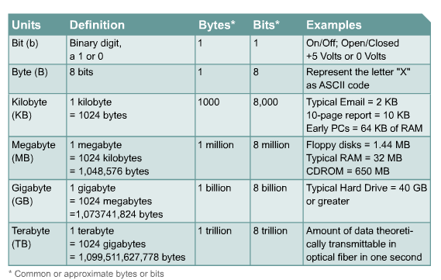

Slide 19
WAN Services and Bandwidths
Type of Service | Typical User | Bandwidth
Modem | Individuals | 56 Kbps
DSL | Ind.,Telecommuter, small business | 12Kbps-6 Mbps
ISDN | Telecommuters and small businesses | 128 Kbps to 2 Mbps
Frame Relay | Small institutions and reliable WANs | 56 Kbps to 44 Mbps
T1 | Larger entities | 1.544 Mbps
T3 | Larger entities | 44.736 Mbps
STS-1 (OC-1) | Phone companies/Backbones | 51.840 Mbps
STS-3 (OC-3) | Phone companies/Backbones | 155.251 Mbps
STS-48 (OC-48) | Phone companies/Backbones | 2.488320 Gbps

Slide 20
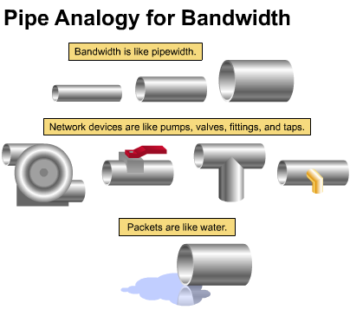
Pipe Analogy for Bandwidth

Slide 21
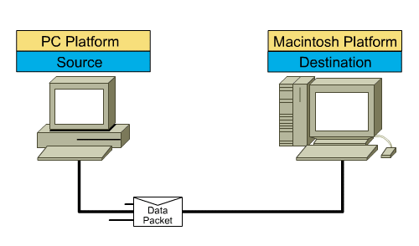
DATA FLOW- PACKETS
Before data can be sent across a network it must first be broken into smaller chunks(Data Packets) before data can be sent in the form of electrical impulses.

Slide 22
The OSI Reference Model
Each layer has a unique function.
7
6
5
4
3
2
1
User interface
Data presentation and encryption
Keeping different applications’ data separate
End-to-end connections
Addresses and best path
Access to media
Binary transmission
Application
Presentation
Session
Transport
Network
Data Link
Physical

Slide 23
Application Layer
Application
Presentation
  Ex:Email, HTTP, FTP, SNMP.
Session
Transport
Network
Data-Link
Physical

Slide 24
Presentation Layer
  Provides data representation, Compression and encryption
  Ex: Ascii, Jpeg, Tiff, sound and movie files.
Application
Presentation
Session
Transport
Network
Data-Link
Physical

Slide 25
Session Layer
Application
Presentation
Session
  Synchronizes dialogue between 2 hosts
Transport
Network
Data-Link
Physical

Slide 26
Application
Presentation
  Reliability and Error Recovery- TCP segments and reassembles the data, adding a header with control information for sequencing and acknowledging packets received.
Session
Transport
Network
Data-Link
Physical

Slide 27
Network Layer
  Connectionless, and Responsible for logically addressing the packet
  Addressing is done through routed protocols such as IP, IPX, AppleTalk
  Path Selection - Routers operate at the Network Layer.
Application
Presentation
Session
Transport
Network
Data-Link
Physical

Slide 28
Data-Link Layer
Application
  Handles error notification, network topology issues, and physically addressing the frame.
  MAC
Presentation
Session
Transport
Network
Data-Link
Physical

Slide 29
Physical Layer
  Provides electrical, mechanical,
  Connectors-Ethernet 802.3 CAT 5 cable, RJ45 jacks.
    Coaxial cable
    Fiber Optics cable
Application
Presentation
Session
Transport
Network
Data-Link
Physical

Slide 30
How Data is Encapsulated
  Build the data.
  Package the data for end-to-end transport.
  Append (add) the network address to the header
  Append (add) the Physical address to the data link header.
  Convert to bits for transmission.

Slide 31
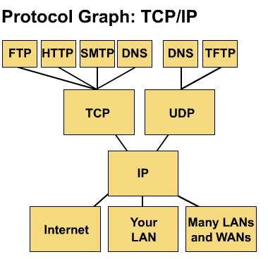
Common TCP/IP Protocols
Application Layer
Transport Layer
Internet Layer
Network Access

Slide 32
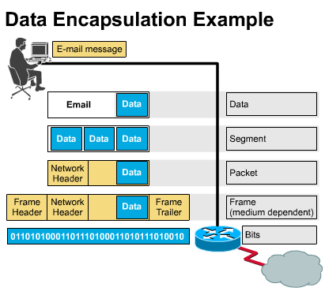
Encapsulation wraps data with necessary protocol information before transit.

Slide 33
Network
Hardware

Slide 34
LANs typically consist of:
Routers
Switches
Hubs
Servers
Workstations
Network peripherals such as Printers

Slide 35
Servers
A very powerful dedicated computer on a network which centralises the processing of particular functions eg
  File server for staff/student access
  Print server
  Email server
  Web server
The use of a server means that all data can be accessed by any computer on the network. So no need for dedicated workstations.

Slide 36
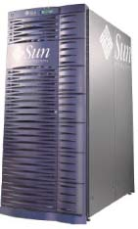
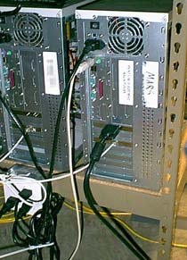
File servers
A very fast computer with a large amount of RAM and storage space along with a fast network interface card
The network operating system software resides on this computer

Slide 37

Workstations
All computers connected to the file server on a network are called workstations

Slide 38
Media
carry information
  bits, bytes
considerations include:
  cable length
  cost
  ease of installation
  total number of computers on the media

Slide 39
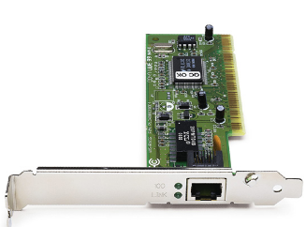
Network Interface Cards
printed circuit board that provides network capability to computers
also called a LAN adapter
  To change a PCs network speed from 10Mbps to 100Mbps, you need to upgrade the NICs.

Slide 40
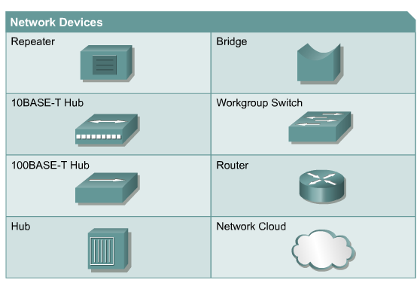

Slide 41

NICs, Repeaters, & Hubs
Repeaters can be used to increase the distance
NIC
NIC
So what can we use if this distance is greater than 100 meters?
What’s the maximum distance for Cat 5 cable?
100 meters

Slide 42
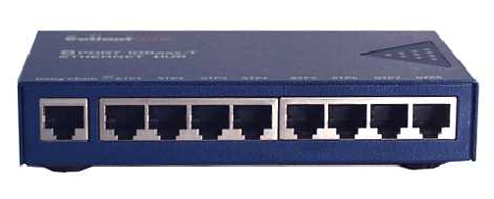



LAYER 1—Hub (multi-port repeater)
The Cloud

Slide 43

Same Broadcast Domain and same Collision Domain
In this picture, all hubs forward all traffic to all devices.

Slide 44

Bridge
To lessen the amount of LAN traffic, businesses began to uses bridges to filter frames based on
MAC addresses = Look at the Local Addresses like the post office.

Slide 45

LAYER 2—Bridge
Connects two LAN segments and pass frames.
Build tables of all Mac addresses on the network.
Keeps traffic local by filtering traffic based on MAC Addresses contained in the layer 2 Frame. Creates more usable bandwidth.the bridge keeps track of MACs on each side of the bridge and filters traffic based on MAC addresses only.
SEGMENTATION = Creates separate or more collision domains.

Slide 46
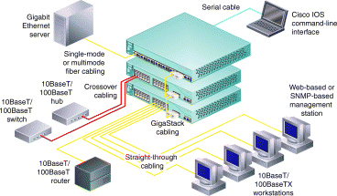


Switch
Another benefit of a switch is that each LAN segment gets dedicated bandwidth.
Combines the connectivity of a hub and the traffic regulation of a bridge They switch frames out only the port connected to the host.
10 Mbps
10 Mbps
The Cloud
10 Mbps
10 Mbps
10 Mbps

Slide 47
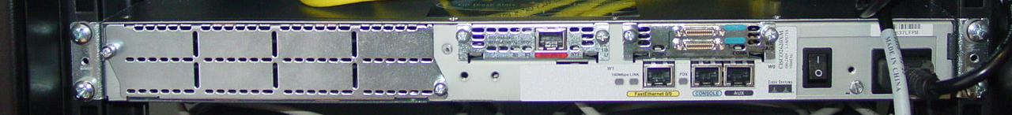
Router
examine incoming packets (piece of data)
choose the best path for them through the network to the packet’s destination
switch them to the proper outgoing port
*most important traffic-regulating devices on large networks
enable virtually any type of computer to communicate with any other computer anywhere in the world
interconnect networks eg between your LAN and the Internet

Slide 48
Router
Layer 3
Routers filter traffic based on IP addresses. The IP address tells the router which LAN segment the ping belongs to.
1
1
16

Slide 49
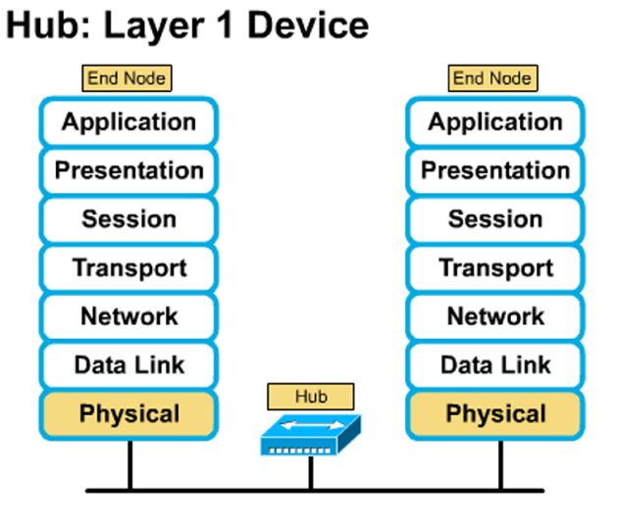

Slide 50
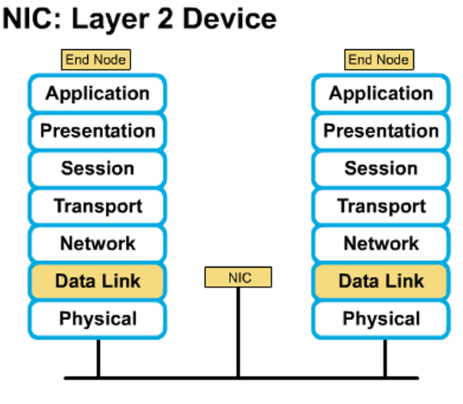

Slide 51
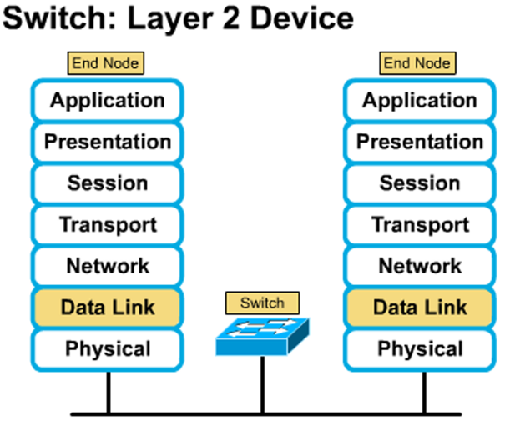

Slide 52
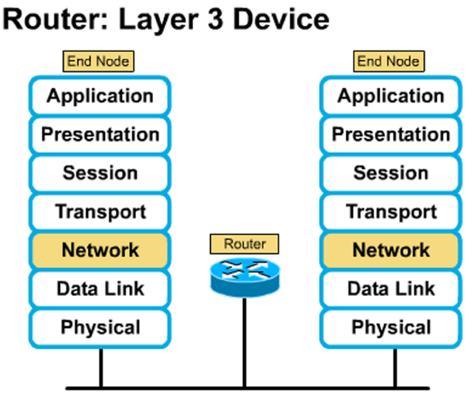

Slide 53
Protocol
A protocol is a set of rules that governs the communications between computers on a network
These rules include guidelines that regulate the method of access, types of cabling and speed of data transfer
PROTOCOL =
SET OF RULES ABOUT COMMUNICATIONS BETWEEN NETWORKS!

Slide 54
Network protocols
Ethernet
  Is a widely used hardware protocol that defines the way data enters a network and travels to its destination
  Used in both Bus and Star networks
  Transmits data at 10Mbps over twisted pair cable

Slide 55
Where does TCP/IP fit into all this???
TCP/IP is the protocol that is used for the transmission of information over the Internet
IP (Internet Protocol) - the main delivery system for information over the Internet
TCP (Transport Control Protocol) - used to break apart and rebuild information that travels over the Internet

Slide 56
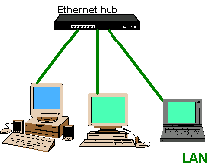
Ethernet
Most widely used
Uses an access method called CSMA/CD (Carrier Sense Multiple Access/Collision Detection

Slide 57
Token Ring
Token ring protocol involves ‘token-passing’.
It is not as popular as Ethernet protocol
A single electronic ‘token’ moves around the ring from one computer to the next. If a computer wishes to transit and receives an empty token, it attaches data to the token which then proceeds around the ring until it comes to the computer the data is meant for.

Slide 58
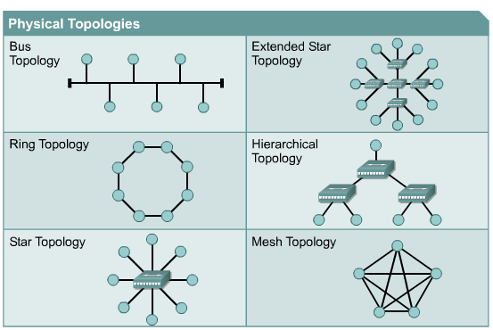





Network Topologies – are defined how computers, printers and other network devices are connected. It defines the physical layout of wires as well as the paths used for data transmission.
Network have both Physical and Logical topologies.
The physical refers the the layout of devices and the media (cables). Logical defines how the media is accessed by the hosts fro sending data.
Bus
Ring
Star
Mesh

Slide 59
Star
A star network is designed with each node (file server, workstation, peripheral) connected directly to a central network hub or server

Slide 60
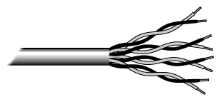
UTP
UTP has four pairs of wires inside the jacket
Each pair is twisted with a different number of twists per inch to help eliminate interference from adjacent pairs

Slide 61

Coaxial cable
Coaxial cable has a single copper conductor at its centre with a plastic layer between the centre conductor and the braided metal shield
Although coaxial cabling is difficult to install, it is highly resistant to signal interference

Slide 62

Fiber Optic Cable
Fiber optic cabling consists of a center glass core surrounded by several layers of protective materials
It transmits light rather than electronic signals
It is the standard for connecting networks between buildings, due to its immunity to the effects of moisture and light

Slide 63
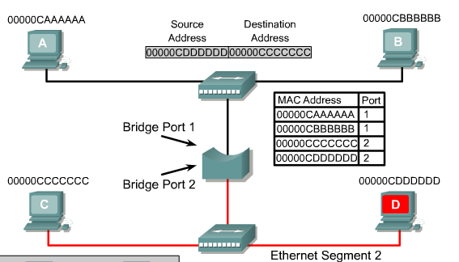
To accomplish this a bridge keeps a table of MAC addresses and the associated ports. The bridge then forwards or discards frames based on the table entries. The following steps illustrate the operation of a bridge:
  The bridge has just been started so the bridge table is empty. The bridge just waits for traffic on the segment. When traffic is detected, it is processed by the bridge.
Host A is pinging Host B. Since the data is transmitted on the entire collision domain segment, both the bridge and Host B process the packet.

Slide 64
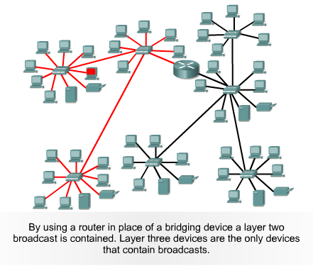
In order for a packet to be forwarded through a router it must use Layer 3 forwarding based on the destination IP address and not the MAC address. For a packet to be forwarded it must contain an IP address and the router must have a destination IP to send the specific packet to in its routing table.

Slide 65
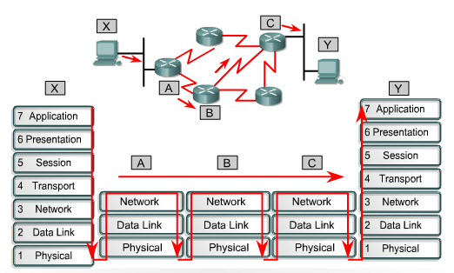
Introduction to data flow
Refers to the movement of data through Layer 1, 2 and 3 devices and how data must be encapsulated to effectively make that journey. Remember that data is encapsulated at the network layer with an IP source and destination address, and at the data-link layer with a MAC source and destination address.

Slide 66
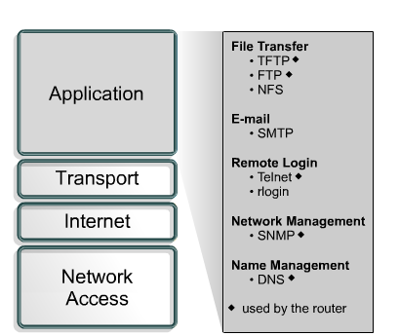
The application layer of the TCP/IP model handles high-level protocols, issues of representation, encoding, and dialog control. The TCP/IP protocol suite combines all application related issues into one layer and assures this data is properly packaged before passing it on to the next layer.

Slide 67
FTP is a reliable, connection-oriented service that uses TCP to transfer files between systems that support FTP. It supports bi-directional binary file and ASCII file transfers.
TFTP is a connectionless service that uses the User Datagram Protocol (UDP). TFTP is used on the router to transfer configuration files and Cisco IOS images
Network File System (NFS) – NFS is a distributed file system protocol suite developed by Sun Microsystems that allows file access to a remote storage device

Slide 68
Simple Mail Transfer Protocol (SMTP) – SMTP administers the transmission of e-mail over computer networks.
Terminal emulation (Telnet) – Telnet provides the capability to remotely access another computer.
Domain Name System (DNS) – DNS is a system used on the Internet for translating names of domains and their publicly advertised network nodes into IP addresses.

Slide 69
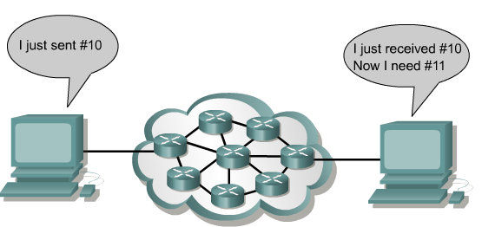
The Internet is often represented by a cloud. The transport layer sends data packets from the sending source to the receiving destination through the cloud. End-to-end control, provided by sliding windows and reliability in sequencing numbers and acknowledgments, is the primary duty of the transport layer when using TCP.

Slide 70
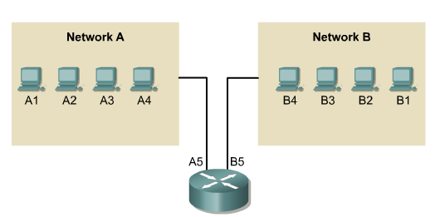
IP addressing
For any two systems to communicate, they must be able to identify and locate each other. While these addresses in this figure are not actual network addresses, they represent and show the concept of address grouping. This uses the A or B to identify the network and the number sequence to identify the individual host.

Slide 71
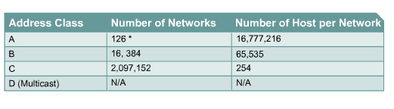
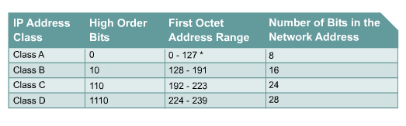
* 127 is reserved

Slide 72
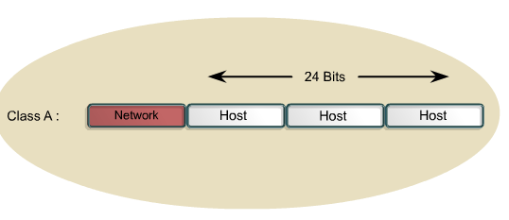
The Class A address was designed to support extremely large networks, with more than 16 million host addresses available. Class A IP addresses use only the first octet to indicate the network address. The remaining three octets provide for host addresses. The first bit of a Class A address is always 0. With that first bit a 0, the lowest number that can be represented is 00000000, decimal 0. The highest number that can be represented is 01111111, decimal 127. The numbers 0 and 127 are reserved and cannot be used as network addresses. Any address that starts with a value between 1 and 126 in the first octet is a Class A address.

Slide 73
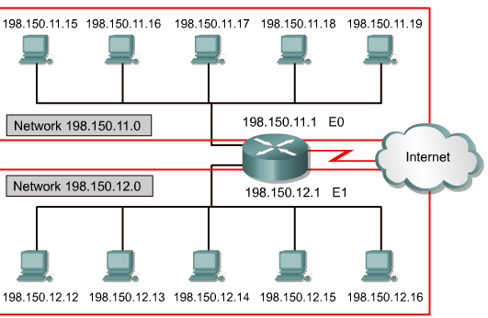
Network address – Used to identify the network itself
In this figure, the section that is identified by the upper box represents the 198.150.11.0 network. Data that is sent to any host on that network (198.150.11.1- 198.150.11.254) will be seen outside of the local area network as 198.159.11.0. The only time that the host numbers matter is when the data is on the local area network. The LAN that is contained in the lower box is treated the same as the upper LAN, except that its network number is 198.150.12.0.

Slide 74
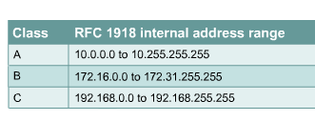
RFC 1918 sets aside three blocks of IP addresses for private, internal use. These three blocks consist of one Class A, a range of Class B addresses, and a range of Class C addresses.
Addresses that fall within these ranges are not routed on the Internet backbone. Internet routers immediately discard private addresses. If addressing a nonpublic intranet, a test lab, or a home network, these private addresses can be used instead of globally unique addresses.
Connecting a network using private addresses to the Internet requires translation of the private addresses to public addresses. This translation process is referred to as Network Address Translation (NAT).

Slide 75
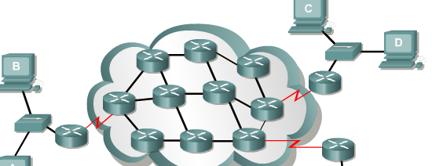
Path determination
Path determination occurs at the network layer. Path determination enables a router to compare the destination address to the available routes in its routing table, and to select the best path. The routers learn of these available routes through static routing or dynamic routing. Routes configured manually by the network administrator are static routes. Routes learned by others routers using a routing protocol are dynamic routes.

Slide 76
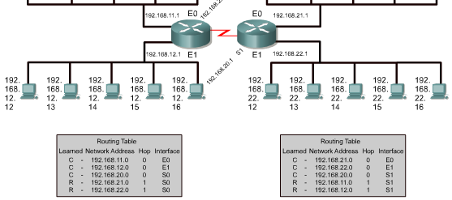
Routing tables
Routers use routing protocols to build and maintain routing tables that contain route information. This aids in the process of path determination. Routing protocols fill routing tables with a variety of route information. This information varies depending on the routing protocol used. Routing tables contain the information necessary to forward data packets across connected networks.

Slide 77
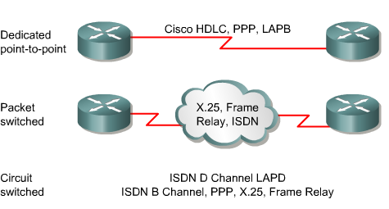
The data link layer protocols define how data is encapsulated for transmission to remote sites, and the mechanisms for transferring the resulting frames.

Slide 78
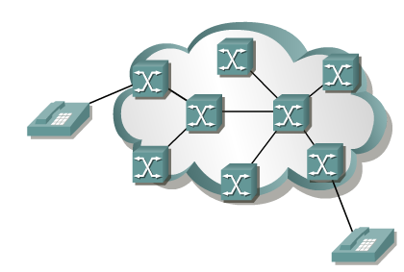
Packet and circuit switching
Packet-switched networks were developed to overcome the expense of public circuit-switched networks and to provide a more cost-effective WAN technology.
When you makes a telephone call, the dialed number is used to set switches in the exchanges along the route of the call so that there is a continuous circuit from the originating caller to that of the called party. Because of the switching operation used to establish the circuit, the telephone system is called a circuit-switched network. If the telephones are replaced with modems, then the switched circuit is able to carry computer data.

Slide 79
Network Operating systems
Is the software that allows a workstation to connect to a LAN
It manages a range of network functions for the client, including
  Connecting to the internet
  Prioritising print jobs
  Network access permissions
Examples: Novell Netware, Windows NT, 2000 and XP, UNIX, Linux.
The two major types of network OS are:
  Peer-to-peer
  Client/server

Slide 80
Peer to peer network OS
In peer to peer network OS, there is no file server or central management source; all computers are considered equal
Peer to peer networks are design primarily for small to medium LANS
AppleShare and Windows for Workgroups are examples of programs that can function as peer to peer

Slide 81
Client/Server network OS
Client/server network OS centralise functions and applications in one or more dedicated file servers.
The file server provides access to resources and provides security
Novelle Netware and Windows NT Server are examples of client/server network operating systems

