Slide 1
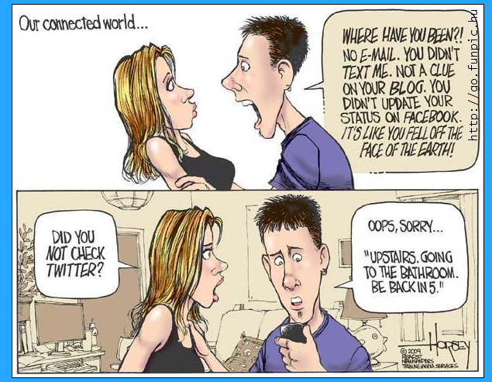

Slide 2
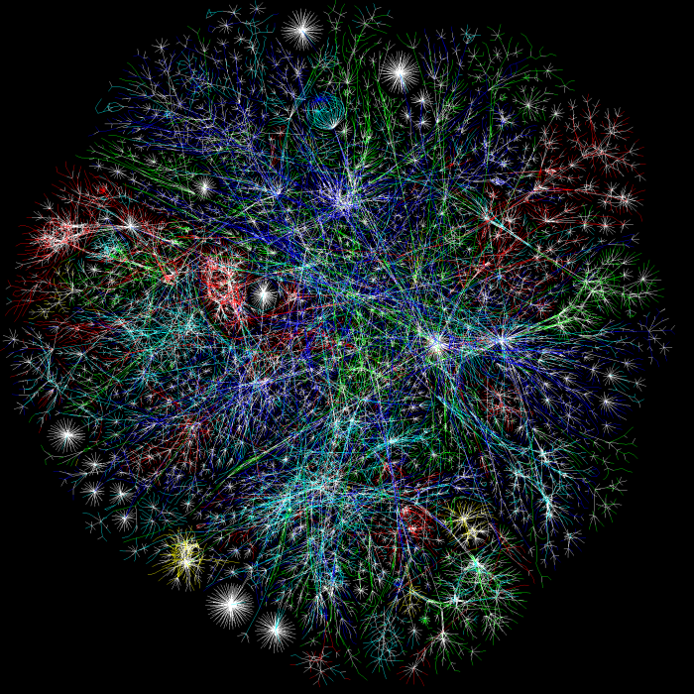
The Internet
Asia Pacific - Red
Europe/Middle East/Central Asia/Africa - Green
North America - Blue
Latin American and Caribbean - Yellow
RFC1918 IP Addresses - Cyan Unknown - White

Slide 3
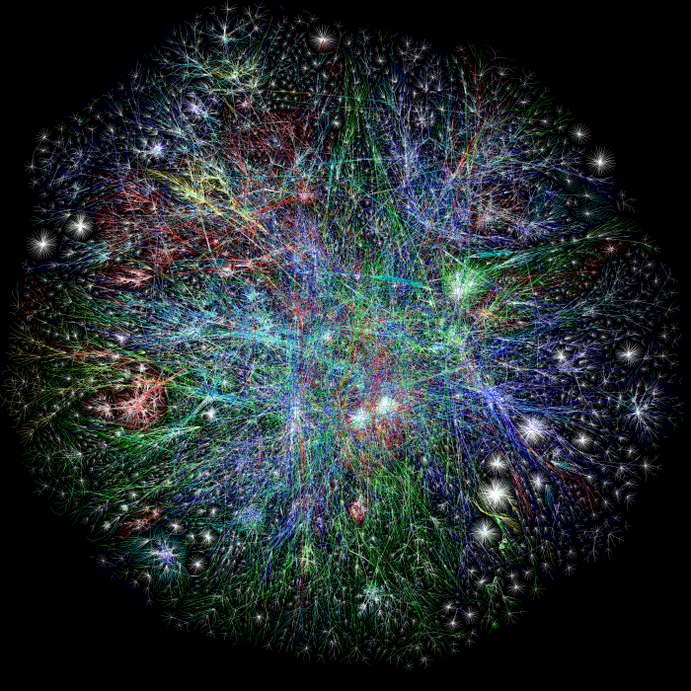

Slide 4
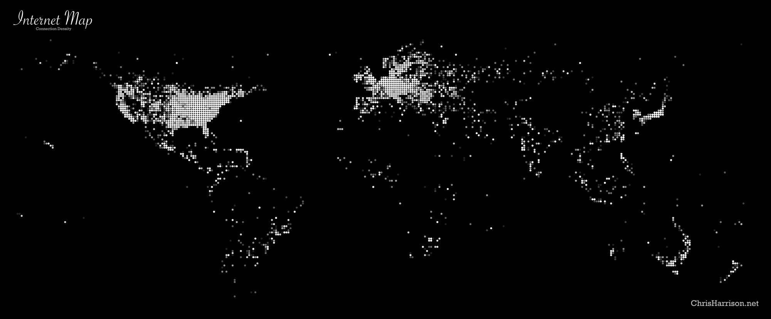

Slide 5
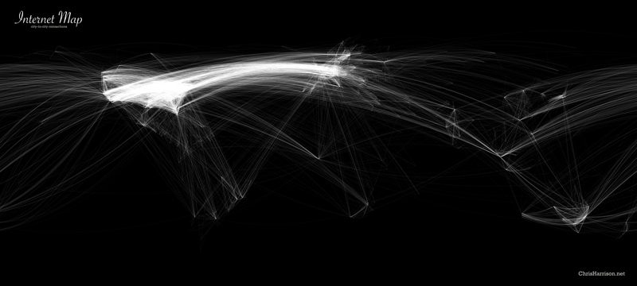
World City-to-City Connections
www.chrisharrison.net/projects/InternetMap/

Slide 6
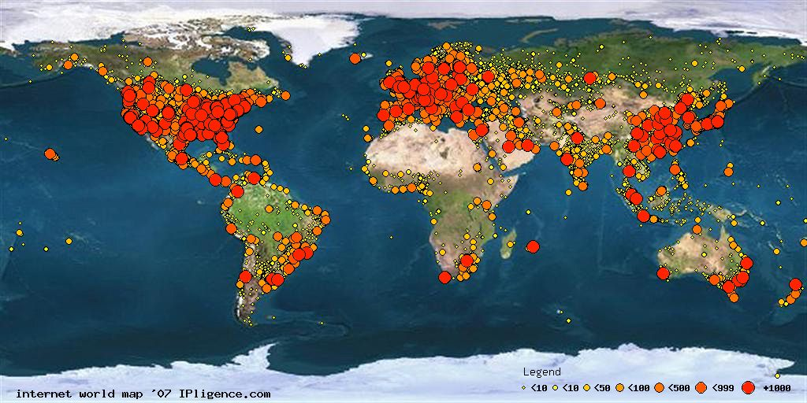
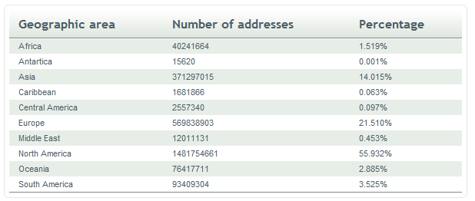
http://www.ipligence.com/worldmap/

Slide 7
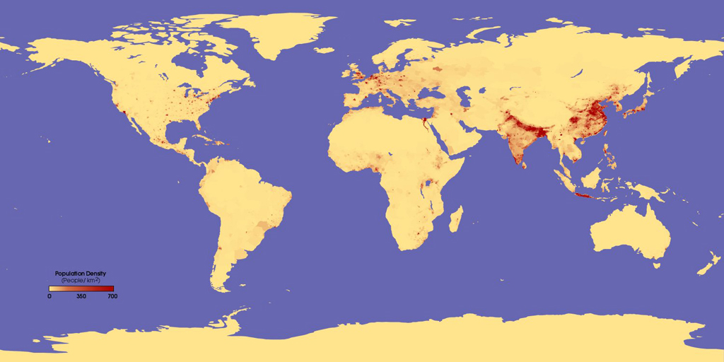
The human populated world this image shows the number of people per square kilometer

Slide 8
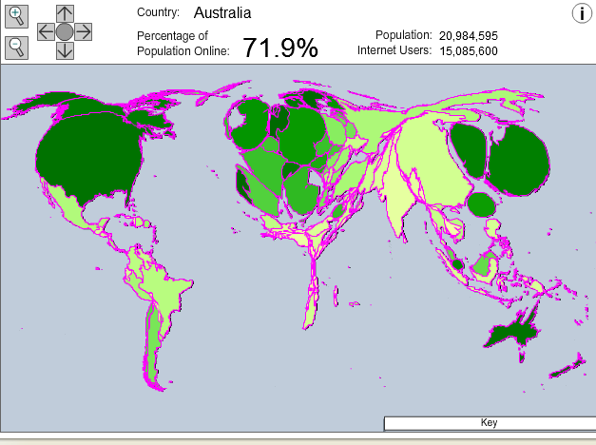
Click to View Map Online

Slide 9
AusCert - Australian Computer Emergency Response Team
Internet Usage of 18 year old and above 84% use their computer for Internet banking;
66% for Internet based payments, such as PayPal; 52%for buying or selling goods or services online;
13% for connecting to work virtual private networks
11% for online stock trading
35% connect to peer-to-peer (P2P) networks
5% reported using their neighbour’s unsecured WiFi access point to access the Internet
Source: AusCERT Home Users Computer Security Survey 2008

Slide 10
Risky Security Practices
11% and 8% never update their operating system and anti-virus software respectively
30% clicked on links in spam email
23% had confirmed malware infections and 14% took no action to fix the problem
36% of respondents with home WiFi networks, 9% do not secure them
Source: AusCERT Home Users Computer Security Survey 2008

Slide 11
Sharing personal information online –when you shop, join a group, or open a new account.
Follow these guidelines when you share confidential information online:
-Be careful who you do business with online. -Read the privacy statement on a Web site before you share personal information. -Check for signs that the Web site protects sensitive data. Look for https (“s” for secure) in the Web address and for security icons, such as a closed padlock or unbroken key.

Slide 12
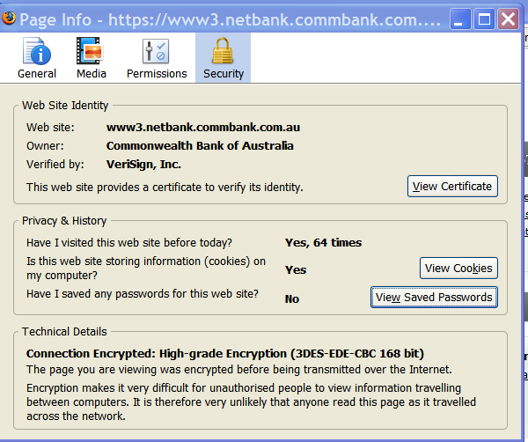
Protect your personal information online
Make sure the Web site is authentic. Unfortunately, the padlock or key icons can be faked. Double-click the padlock them to look for a match between the name in the Web address and on the security certificate. If the name differs, you may be on a fake site.
Billions of times each day, our SSL, identity and authentication, and domain name services allow companies and consumers to engage in trusted communications and commerce.

Slide 13
Secure Sockets Layer (SSL), are cryptographic protocols that provide security for communications over the Internet.
At the browser level, it means that the browser has validated the server's certificate, i.e. checked the digital signatures of the server certificate. Once validated, the browser is justified in displaying a security icon "closed padlock".
Source: AusCERT Home Users Computer Security Survey 2008

Slide 14
How Do Security Certificates Work?
Certificates can be used to protect: -your personal information on the Internet -verify the identity of a person or the security of a Web site Uses technology that associates an identity with a public key. Only the owner (Bank) of the certificate knows the corresponding private key. This use of public / private key technology permits the owner to make a digital signature or decrypt information encrypted with the corresponding public key. When your password is associated with your user name, the two pieces of information put together as a login give you permission to access your data, email, etc. Using SSL technology (security certificates) allows you to send your information encrypted or digitally-signed.

Slide 15
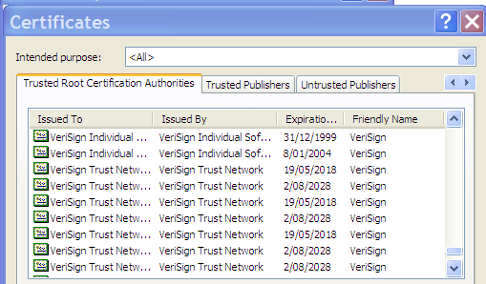
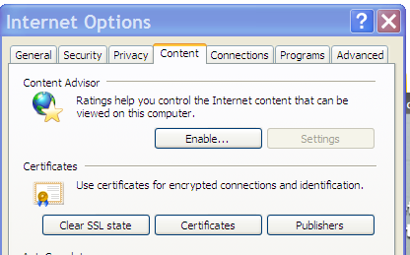
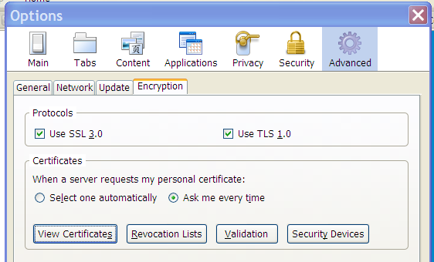
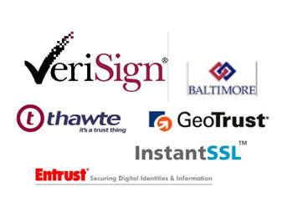
View certificates IE- Tools/Internet Options Firefox – Tools/Options/Advanced/ Encryption
6 primary SSL certificate providers. All six have 128-bit key encryption.

Slide 16
Phishing
Phoney fraud alerts
Scammers pretend to be from your bank or financial institution and tell you that there is a problem with your account. They ask for your account details to protect your money, but then use these details to steal your money.
'Nigerian 419' scams
You are promised huge rewards if you help someone transfer money out of their country by paying fees or giving them your bank account details.
Work from home scams
Employment opportunities that promise huge incomes with little work – usually by asking you to transfer money for someone else or recruit new victims.
Transferring money for someone else
If you agree to transfer money for someone you don’t know, you let scammers use your bank account to ‘launder’ their dirty money. This puts you and your money in the firing line.
Spyware & key-loggers
Spyware is a type of software that spies on what you do on your computer. Key-loggers record what keys you press on your keyboard. Scammers can use them to steal your online banking passwords or other personal information.

Slide 17
ROGER FLETCHER BAKER SOLICITORS & Co"<email.accountsupport1@gmail.com> To: Cc: Subject: Re Sent: Mon, 3 May 2010 MANAGING PARTNER ROGER FLETCHER BAKER SOLICITORS & Co 326-328 Old Street London, EC1V 9DR England I am Roger Baker, an attorney at law. A deceased client of mine, that shares the same last name as yours, died as a result of a heart-related condition on March 12th 2005. His heart condition was due to the death of all the members of his family in the tsunami disaster on the 26th December 2004 in Sumatra Indonesia. http://en.wikipedia.org/wiki/2004_Indian_Ocean_earthquake I am contacting you to seek your consent to present you as the next of kin to my late client. He has a deposit of Seventeen Million Five hundred Thousand Dollars (US$17,500,000) left behind. This will be executed under a legitimate arrangement that will protect you from any breach of the law. If this business proposition offends your moral values, do accept my apology. I can be reached on : email.rogerbaker@gmail.com. Sincerely Yours, Barrister Roger Fletcher Baker. Attorney at LawTel : +44-704-579-1071 Fax :916-258-0236

Slide 18
Top threats to computer security
• Viruses are software programs designed to invade computers and to copy, damage, or delete data and interfere with the computer’s operations.
E-mail viruses - An e-mail virus travels as an attachment to e-mail messages, and usually replicates itself by automatically mailing itself to dozens of people in the victim's e-mail address book.
• Worms are computer programs that claim to do one thing (it may claim to be a game) but instead does damage when you run it. They are sophisticated viruses that can reproduce themselves and spread to other computers without your interaction, it may erase your hard disk.

Slide 19
Top threats to computer security
• Trojans, A file which can open a connection (a backdoor into the machine) and that pretend to be helpful programs while destroying your data, damaging your computer, and stealing personal information. A trojan horse does not replicate or spread like a virus. Most virus checking programs detect trojan horses.
• Spyware is software that tracks your online activity. Spyware may bombard you with pop-up advertising, collect your personal information, or change the settings on your computer without your knowledge or consent.

Slide 20
How to Prevent a Virus Invasion!
-Load only software from original disks or CD's. Pirated or copied software is always a risk for a virus.
-Execute only programs of which you are familiar as to their origin. -Programs sent by email should always be suspicious.
-Check all shareware and free programs downloaded from on-line services with a virus checking program.
-Purchase a virus program that runs as you boot or work your computer. Up-date it frequently.
Use Scotty!

Slide 21
POLITICALLY CORRECT VIRUS: Never calls itself a "virus," but instead refers to itself as an "electronic microorganism.“
FEDERAL BUREAUCRAT VIRUS: Divides your hard disk into hundreds of little units, each of which does practically nothing, but all of which claim to be the most important part of the computer.
AIRLINE VIRUS: You're in Dallas, but your data is in Singapore.

Slide 22
FREUDIAN VIRUS: Your computer becomes obsessed with marrying its own motherboard.
ELVIS VIRUS: Your computer gets fat, slow, and lazy and then self destructs, only to resurface at shopping malls and service stations across rural America.
STAR TREK VIRUS: Invades your system in places where no virus has gone before.

Slide 23
Peer to Peer Networks
Unlike a centralised web server (site), computers on a P2P network are distributed ordinary computers (called peers) used by users at home or at work and should not necessarily be trusted in the way web sites with digital certificates might be.
Source: AusCERT Home Users Computer Security Survey 2008

Slide 24
Peer to Peer Networks
In order to access content from any P2P network, it is necessary for the user to install the relevant P2P software which opens incoming P2P connections through a firewall or modem/router. This software turns your own computer into a peer node on the P2P network. This means that if you do not configure this software correctly, you may inadvertently open your computer up to receive connections from any other computers. Can also add to your internet uploads/downloads.
Source: AusCERT Home Users Computer Security Survey 2008

Slide 25
Peer to Peer Networks
Thirdly, because you are connecting and downloading content from ordinary computers that are not necessarily securely maintained or managed, you increase the risk of infection from malware that may be installed on that peer computer whether it was put there with or without the knowledge of the peer computer owner.
Source: AusCERT Home Users Computer Security Survey 2008

Slide 26
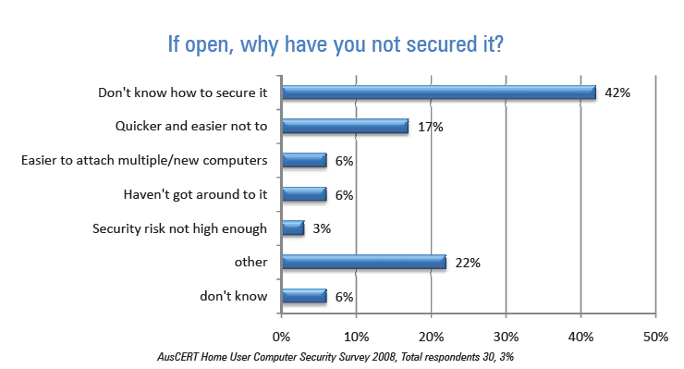
Home WiFi
5% of respondents admitted they used their neighbour’s open (ie insecure) WiFi network to connect to the Internet. When people surf the Internet at the neighbour’s expense the download usage will count towards the neighbour’s overall use. Some may find their speed is slowed due to shaping policies when bandwidth limits are exceeded.
Source: AusCERT Home Users Computer Security Survey 2008

Slide 27
Malware
23% percent of respondents reported one or more confirmed malware infections on their home computer.
15% reported that the infection was detected by their AV or anti-spyware software.
11% had been advised by a trusted third party (such as their bank, ISP or other professional organisation) that their computer was infected with malware.
This rate (23%) of all home computers used by the respondents had malware.
The actual infection rate may be higher because those
who do not have AV software or who don’t keep it up to date have no real capacity to know if they have an infection
Source: AusCERT Home Users Computer Security Survey 2008

Slide 28
Malware
Current trends show that a large proportion of malware now being developed is for illicit financial gain and includes the theft of personal identifying information or online access credentials.
it is possible that close to one quarter of all home computer users have had sensitive information about them and other users of the compromised computers captured. Sensitive information typically includes all usernames and passwords stored on the computer including for online banking, web portals or email accounts and web form data displayed or submitted during encrypted SSL sessions.
Source: AusCERT Home Users Computer Security Survey 2008

Slide 29
Malware
Hacked Ad Seen on MySpace Served Spyware to a Million
DeckOutYourDeck.com, his browser asked him whether he wanted to open a file called exp.wmf. Microsoft released a patch in January to fix a serious security flaw in the way Windows renders WMF (Windows Metafile) images, and online criminal groups have been using the flaw to install adware, keystroke loggers and all manner of invasive software for the past seven months.

Slide 30
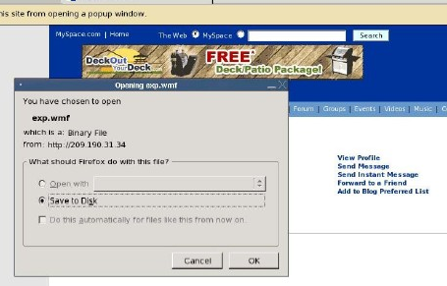
Malware
Hacked Ad Seen on MySpace Served Spyware to a Million
Internet Explorer users who visited a Web page containing this ad and whose IE was not equipped with the WMF patch would not get that warning. Rather, their machines would silently download a Trojan horse program that installs junk software on the PC.

Slide 31
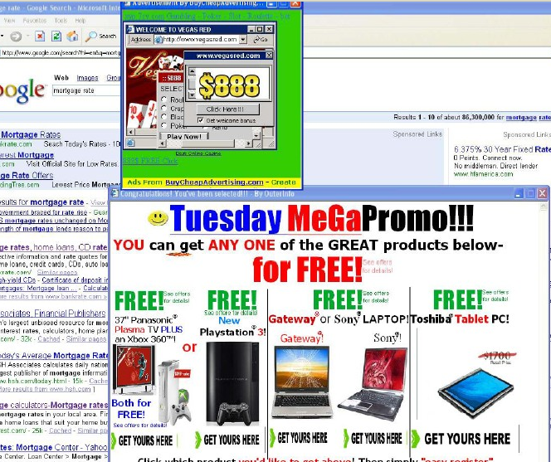
PurityScan/ClickSpring family of adware. This stuff bombards the user with pop-up ads and tracks their Web usage. Only a little more than half of the anti-virus programs used at anti-virus testing service AV-Test.org flagged the various programs that the Trojan tried to download as malicious or suspicious.

Slide 32
September 20th, 2009
Sections Of PBS.org Website Hijacked, Serving A Cocktail Of Dangerous Exploits
Automated Malware Attacks Hit Facebook, CAPTCHA Possibly Cracked
Friday, October 2nd, 2009
Hackers have figured out how to create computer-generated Facebook profiles and are using them to trick unsuspecting users into installing malware.
Using software that captures and analyzes Web traffic, La Pilla found that the installation program contacted a Russian-language Web server in Turkey that tracks how many times the program was installed, presumably because most of this adware is installed by third parties who get paid for each installation. The data there indicate that the adware was installed on 1.07 million computers.

Slide 33
A botnet masters installs malware on PCs all around the world, turns off anti-virus, opening the floodgates. A Botnet is a series of compromised machines (zombies), in which the owner has downloaded a file and unwillingly executed a trojan or worm.
Most cases will consist of your average rapideshare website offering a free download of some form of keygen or illegal software, this encourages users to download.
Another commonly used way to spread the .exe of the worm is to advertise via porn chats, msn and social networks.

Slide 34
Botnets - How does it work; Once the file has been opened on the target machine. Registry changes will take effect. Usually adding an auto-start key, and various other file changes. such as embedding itself inside explorer.exe etc. The file then creates an outbound connection to an IRC server (Internet Relay Chat (IRC) is a form of real-time Internet text messaging), which in turn joins the specific channel and idles, waiting for commands from the bot-master. Usually, an IRC bot/worm binary contains a password, which is used to register the zombie computer with the set master.

Slide 35
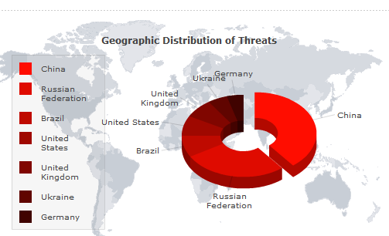
Souce: http://www.threatexpert.com/

Slide 36
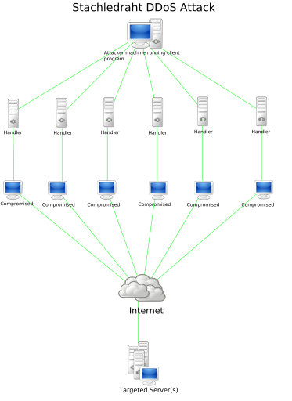
A denial-of-service attack (DoS attack) or distributed denial-of-service attack (DDoS attack) is an attempt to make a computer resource unavailable to its intended users.
It generally consists of the concerted efforts of a person or people to prevent an Internet site or service from functioning efficiently or at all. Click Here for Video Clip!

Slide 37
A DoS attack may include execution of malware intended to:
Max out the processor's usage, preventing any work from occurring.
Trigger errors in the microcode of the machine.
Trigger errors in the sequencing of instructions, so as to force the computer into an unstable state or lock-up.
Exploit errors in the operating system, causing resource starvation and/or thrashing, i.e. to use up all available facilities so no real work can be accomplished.
Crash the operating system itself.

Slide 38
Rootkit
A rootkit is a collection of tools (programs) that enable administrator-level access to a computer or computer network. Typically, a cracker installs a rootkit on a computer after first obtaining user-level access, either by exploiting a known vulnerability or cracking a password. Once the rootkit is installed, it allows the attacker to mask intrusion and gain root or privileged access to the computer and, possibly, other machines on the network.A rootkit may consist of spyware and other programs that: monitor traffic and keystrokes; create a "backdoor" into the system for the hacker's use; alter log files; attack other machines on the network; and alter existing system tools to escape detection.

Slide 39
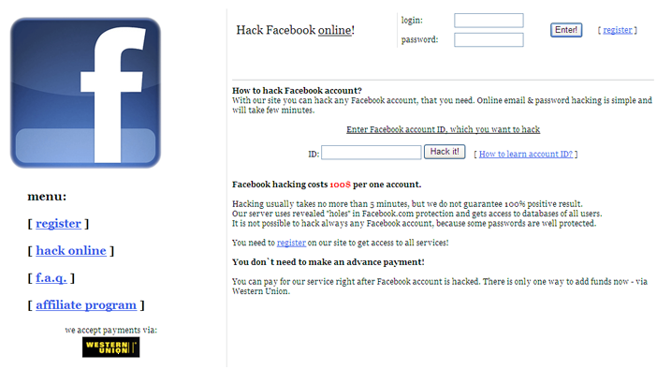
Identity Theft
Ukrainian Scammers Will Hack Any Facebook, Myspace, ICQ Account For Just 100.USD Monday, September 21st, 2009 Eastern European hackers are offering to crack into any Facebook, Myspace and ICQ account for a fee of $100, payable online through Western Union, though circumstantial evidence suggests that the scheme might just as easily be geared towards ripping-off potential clients while delivering nothing.

Slide 40
In one recent case, AusCERT found stolen user data from 404,206 separate computers from around the world. The data recorded capture dates from 21 November 2007 to 4 February 2008. A proportion of these computers belonged to residents of Australia.
Source: AusCERT Home Users Computer Security Survey 2008

Slide 41
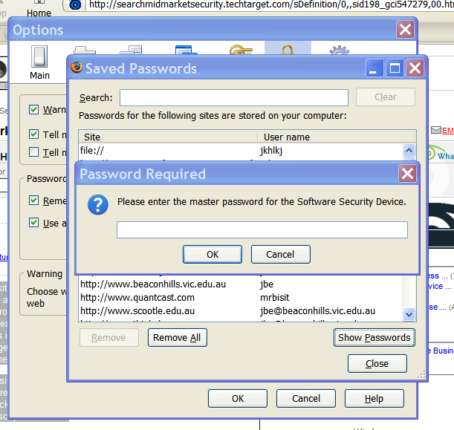
Password Protect your Passwords

Slide 42
Choosing a Good Password - An intruder only needs one password!
Some simple rules of thumb
A password should be a minimum of eight characters long.
Use mixed case passwords if possible.
Choose a phrase or a combination of words, that make the password easier to remember.
Do not use a word that can be found in any dictionary (including foreign language dictionaries).
Do not use a keyboard pattern such as qwertyui (keyboard).
Do not repeat any character more than once in a row like zzzzzzzz.
Do not use all punctuation, all digit or all alphabetic.
Do not use things that can be easily determined such as:
Phone numbers.
Car registration.
Friends' or relatives' names.
Your name or employment details.
Any Date.
Never use your account name as its password.
Change the password regularly and do not reuse passwords.
Source: AusCERT Home Users Computer Security Survey 2008

Slide 43
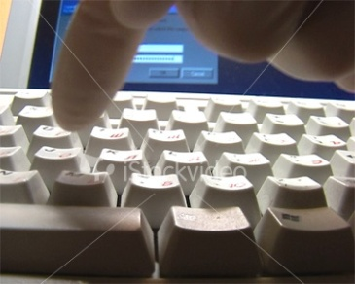
Cracking passwords
The principle behind password cracking is simple: take a large word list, encrypt each word and check if the encrypted string matches the user's password.
Word lists that are used frequently include English and other language dictionaries, common names, pet names, television and movie characters, character patterns on keyboards (qwerty) and jargon or slang terms.
Dictionary crackers can “manipulate” each word in the wordlist by using filters. These rules/filters allow you to change “idiot” to “1d10t” The best known of these mutation filters are the rules that come with Crack (for Unix). These filtering rules are so popular they have been ported over to cracking software for NT.
Source: AusCERT Home Users Computer Security Survey 2008

Slide 44
Cracking passwords
A dictionary password cracker simply takes a list of dictionary words, and one at a time encrypts them to see if they encrypt to the one way hash from the system. If the hashes are equal, the password is considered cracked, and the word tried from the dictionary list is the password.
Typical rules include appending and prepending digits and other punctuation characters to words, reversing words, capitalising words, converting words to all upper or all lower case, substituting letters or digits for other letters.
Since computers are fast, applying these rules and encrypting the resulting guess doesn't take much time and a lot of guesses can be made in a very short time.
Source: AusCERT Home Users Computer Security Survey 2008

Slide 45
Cracking passwords
CD based database is supposed to have been produced that contains every word in a large dictionary plus many rule based permutations of these words encrypted in every possible manner.
This reduces password cracking to a simple (and fast) database lookup.
In September 1993, the record for the speed of cracking passwords was 6.4 million passwords per second could be tested.
A brute force cracker simply tries all possible passwords until it gets the password. From a cracker perspective, this is usually very time consuming. However, given enough time and CPU power, the password eventually gets cracked.
Source: AusCERT Home Users Computer Security Survey 2008

Slide 46
What are the dangers of cracking passwords? The dangers are quite simple, and quite real. If you are caught with a password file you do not have legitimate access to, you are technically in possession of stolen property in the eyes of the law.
For this reason, some hackers like to run the cracking on someone else’s systems, thereby limiting their liability.
Source: AusCERT Home Users Computer Security Survey 2008

Slide 47
Source: AusCERT Home Users Computer Security Survey 2008
How long is a good password?
The simple answer to this is that in general the longer the password the better.
Number of passwords for each length
Length | Number of Passwords | Number of passwords | Cracking Time
1 | 62 | Not nearly enough | Try this by hand
2 | 3844 | Three thousand | Almost no time
3 | 238328 | One quarter of a million | Less than one second
4 | 14776336 | Fourteen million | Two seconds
5 | 916132832 | Almost one billion | Two and a half minutes
6 | 56800235584 | Fifty six billion | Two and a half hours
7 | 3521614606208 | Three and a half trillion | One week
8 | 218340105584896 | Two hundred trillion | One year
9 | 13537086546263552 | Thirteen quadrillion | Seventy years
10 | 839299365868340224 | Eight hundred and forty quadrillion | Forty centuries
11 | 52036560683837093888 | Lots | A quarter of a million years
12 | 3226266762397899821056 | Even more | Sixteen million years

Slide 48
Good Passwords
Some examples of using a phrase
rsKf0myH - Raindrops keep falling on my head.
wru2rxy? - Who are you to ask why.
bWiIso3! - Beware the ides of March!
Password Check
Source: AusCERT Home Users Computer Security Survey 2008

Slide 49
IRC - Internet Relay Chat Bot-master - The owner of the botnet/creator of the file Zombie - A computer which is unwillingly being controlled from a remote location DDoS - Distributed Denial of Service (A network of computers attacking an address with packet spam) Clone - A secondary connection maintained by a different proxy

