Slide 1
VITTA Conference
Software Development
U4O2: Key Knowledge & Skills
Anthony Sullivan
The Peninsula School
asullivan@tps.vic.edu.au

Slide 2
Unit 4 Outcome 2
Outcome
Recommend and justify strategies for evaluating the effectiveness and efficiency
of solutions that operate in a networked environment
Assessment
40 marks out of 100 for Unit 4
Written Report or Class Test

Slide 3
Unit 4 Outcome 2
Problem-Solving Methodology
Focus on the Evaluation Stage
Problem-Solving Methodology
Analysis
Design
Development
Evaluation
Solution Requirements
Solution
Design
Manipulation
(Coding)
Strategy
Solution Constraints
Evaluation
Criteria
Validation
Report
Scope of Solution
Testing
Documentation

Slide 4
Unit 4 Outcome 2
Key Knowledge & Key Skills
Key Knowledge
What content needs to be taught to students
11 KK points in U4O2
Key Skills
How to apply the Key Knowledge in the Assessment Task
7 Key Skills in U4O2

Slide 5
Unit 4 Outcome 2
Key Knowledge & Key Skills
There is a link between the two
Key Skill 1
Describe the networked environments within which solutions operate
Key Knowledge 1
Technical underpinnings of intranets, the Internet and virtual private networks
Characteristics of wired & wireless networks

Slide 6
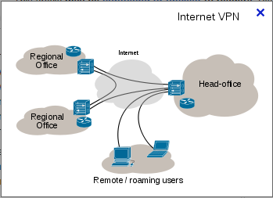
Unit 4 Outcome 2
Key Knowledge 1
Technical underpinnings of intranets, the Internet and virtual private networks
Internet
Internet
Virtual Private Network

Slide 7
Unit 4 Outcome 2
Key Knowledge 2
Characteristics of wired and wireless networks
Fibre optic Twisted pair
Microwave Satellite
Radio waves
Infrared
VCAA Glossary

Slide 8
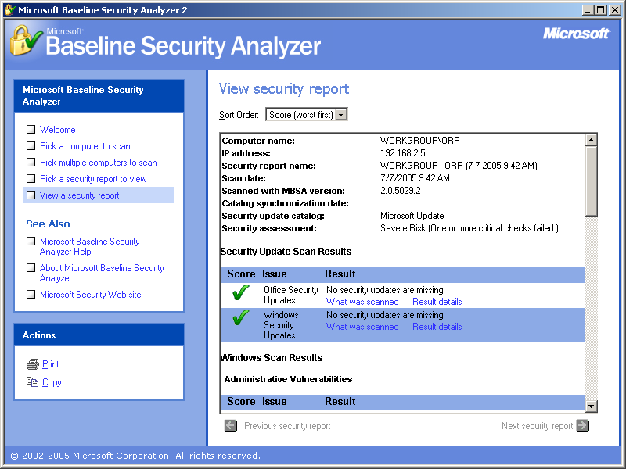
Unit 4 Outcome 2
Key Knowledge 3
Techniques for measuring the reliability and maintainability of networks
Network Audits
Error Logs
Tracking Tools

Slide 9
Unit 4 Outcome 2
Key Knowledge 4
Criteria and techniques for testing the security of networked environments
Criteria - What is being measured?
Is the password policy being followed?
Techniques - How it will be measured?
Attempt to access staff accounts
using common passwords

Slide 10
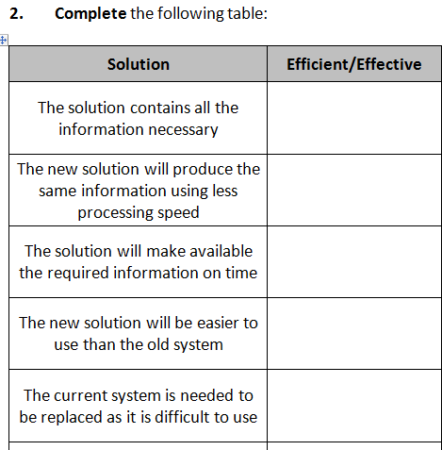
Unit 4 Outcome 2
Key Knowledge 5
Characteristics of efficient and effective solutions
VCAA Glossary
Effective
Completeness, Readability,
Attractiveness, Clarity,
Accuracy…
Efficient
Time, Effort, Cost

Slide 11
Unit 4 Outcome 2
Key Knowledge 6
Strategies and techniques for acquiring evaluation data about the quality of solutions
Strategy – A series of steps
Install the software on the network
Allow three months to pass
Interview management regarding performance
Observe staff using the software
Survey customers… Review error logs

Slide 12
Unit 4 Outcome 2
Key Knowledge 7
Criteria and techniques for testing acceptance by users of solutions
Actual users of the software are involved
Criteria
Is the solution easy to use
Technique
Have a number of staff from
the organisation use the
solution and give feedback

Slide 13
Unit 4 Outcome 2
Key Knowledge 8
Types of training and techniques for measuring the suitability of training programs
Off-site training
On-site training
Train the trainer
On-line training
How to measure the suitability of training?
Evaluation forms
Cost Errors made

Slide 14
Unit 4 Outcome 2
Key Knowledge 9
Types of system support documentation offered and criteria for determining their appropriateness
User manual
Technical Reference
Manual
Help Guide
Tutorials
Appropriate Criteria?
Can the user find the help required? Does the tutorial cover the functions of the software?

Slide 15
Unit 4 Outcome 2
Key Knowledge 10
Practices that cause conflict between stakeholders
Privacy issues e.g. work database
Reluctance to use new software
Development running over budget
Development running late
Many more…

Slide 16
Unit 4 Outcome 2
Key Knowledge 11
Suitability of strategies for managing ethical dilemmas
Code of Ethics
Imposing Sanctions
Education Programs
Decision Support
Frameworks
Privacy Issue
A clear code of ethics on what is and is not acceptable Have a decision support framework to help resolve issues

Slide 17
Unit 4 Outcome 2
Key Knowledge 10 & 11
2011 Exam
Explain how a code of ethics will help Brian?
A code of ethics explains how people in that company should behave
The code would guide Brian in to making the right decision with his dilemma

Slide 18
Unit 4 Outcome 2
Key Knowledge 10 & 11
2011 Exam
Assuming Brian's organisation has a code of ethics, outline how a decision support framework could assist in resolving this ethical dilemma
A decision support framework will outline the steps needed to resolve the conflict Brian can follow these steps which will assist to resolve the dilemma

Slide 19
Unit 4 Outcome 2
Key Skills
As a starting point…
The 7 key skills can become the 7 questions for the SAC
Include enough detail in the case study that all questions can be answered

Slide 20
Unit 4 Outcome 2
Key Skill 1
Describe, using technical language, the networked environments within which solutions operate
Client-Server, Peer to Peer
Router, Access Points, Switches
LAN, WAN
VPN, Internet, Intranet
Wired, Wireless
Protocols

Slide 21
Unit 4 Outcome 2
Key Skill 2
Propose criteria and recommend techniques for testing the security of networks
Criteria
Can non authorised users gain access to the wireless network
Technique
Attempt to access the wireless network both within and outside the building

Slide 22
Unit 4 Outcome 2
Key Skill 3
Recommend criteria and techniques for measuring the efficiency and effectiveness of solutions
Describe the solution in the case study
Criteria
Can data be entered easily and quickly into the solution?
Technique Observe and time users entering data into the solution

Slide 23
Unit 4 Outcome 2
Key Skill 4
Justify the suitability of recommended strategies for evaluating solutions
Justification
The time taken by users can be compared to the time taken with the previous solution to identify if the new solution is more efficient

Slide 24
Unit 4 Outcome 2
Key Skill 5
Recommend criteria and techniques for measuring the extent to which the needs of users of solutions are met
Criteria
Can users solve problems by using the user documentation
Technique
Survey users asking how often they consulted the manual and how many times a solution was found

Slide 25
Unit 4 Outcome 2
Key Skill 6
Justify the appropriateness of recommended strategies for evaluating the extent to which users’ needs are met
Justification
If most problems are solve using the manual it can be concluded that the manual is appropriate

Slide 26
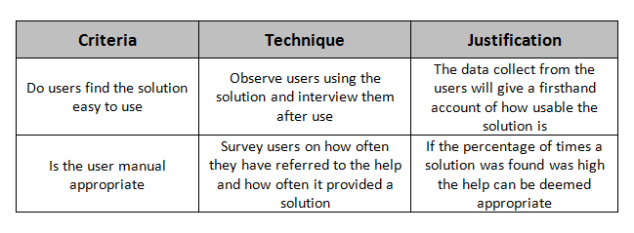
Unit 4 Outcome 2
Key Skills 3, 4, 5 & 6
Table Format???

Slide 27
Unit 4 Outcome 2
Key Skill 7
Justify the suitability of strategies for managing ethical dilemmas
Add an ethical dilemma to the case study
Employee personal details will be accessible by all other users
This has upset many staff
Management has stated that it will fire anyone found accessing details without a valid reason…

Slide 28
Unit 4 Outcome 2
Assessment Task
Include enough information in the case study so each key skill can be covered
Attempt to incorporate each key knowledge point into task
Create strategies with faults so students can propose a better strategy which they can then justify

Slide 29
Unit 4 Outcome 2
The End
Questions
Anthony Sullivan
asullivan@tps.vic.edu.au

