Slide 1
Using PHP in Software Development 2011 - 2014
Presenter: Kevork Krozian
Ringwood Secondary College
kkrozian@ringwoodsc.vic.edu.au

Slide 2
What are the task(s) … ?
There are 2 software SACs to be assessed with specifications as follows ………..
students must use the SAME language for both SACs

Slide 3
What ?
Outcomes | Percentage of Unit | Highest Descriptor – marking scheme
SAC 32 Represent a software design and apply a range of functions and techniques using a programming language to develop a prototype solution to meet a specific need. In response to software requirements specifications create a prototype solution to meet a specific need. | 60 % - Solution | An accurate interpretation of the provided software requirements specifications is evident in the design of a feasible solution. Solution requirements are accurately and clearly represented in a detailed algorithm. Data types and structures are accurately described using appropriate design methods. Soundly based and complete set of criteria are proposed for evaluating the efficiency and effectiveness of the solution. The prototype solution is efficiently coded with all data types and data structures being appropriately used and integrated. An appropriate range of test data is expressed in a testing table, with both expected and actual output stated. All tests are successfully applied to enable the performance of the prototype solution to be verified. Internal documentation is complete, contains relevant program comments, and is clearly stated and well formatted. The solution meets all of the software requirements specifications.

Slide 4
What ?
Outcomes | Percentage of Unit | Highest Descriptor – marking scheme
SAC 41 apply stages of the problem-solving methodology to produce a solution for use on a mobile device, which takes into account technical and legal requirements. A solution (including internal documentation) in response to a design brief. And User documentation and an explanation of how security and legal matters are managed when creating solutions in one of the following: • a written report • a test. | 45 % - Solution 15% - report or test | An accurate interpretation of the provided software requirements specifications is evident in the design of a feasible solution. The design of the software solution is clear, technically accurate and takes into account the constraints of the mobile device. The algorithm is clearly written and logically represents what is required. The software solution conforms to all accepted coding conventions and includes appropriate and clear internal documentation. All techniques and procedures, including data validation, are efficiently and effectively applied. A comprehensive range of test data is expressed in a testing table, with the expected and actual output stated. The solution meets all of the software requirements specifications. .

Slide 5
Why PHP ?
An approved language for IT Software Development
Students must use the same language all year
Free and universally accessible with any browser
Most serious commercial deployment nowadays has a web presence/client capability
Allows teaching of client/server principles in a networked environment which dovetails into the SD course with a large networked information systems content
Can run on almost any web server and connect to any database and run on almost any browser including portable device specific browsers
Allows for teaching of sound programming principles in reasonable time
Flexible, portable, OOP capable
Allows the teaching of truly networked solutions and applications for “anytime anywhere” access.
Allows teacher independence from technicians yet delivers a networked solution

Slide 6
VCAA Advice
Students will use one programming language from the accompanying list, to develop purpose-designed solutions. In the development of solutions, students should be able to:
develop a graphical user interface (GUI), for use in mobile computing devices, such as laptops, personal digital assistants, gaming consoles, mobile phones
construct and use data structures, for example multi-dimensional arrays, records, queues and stacks
design, construct and use files (not databases) to store and retrieve data
design and apply data validation techniques
use program control structures: selection, iteration and sequencing.
the purpose-designed solutions will entail the use of objects, methods and their properties, and event-driven programming.
Discussion on databases vs files later in this session

Slide 7
VCAA Advice ..contd
List of approved languages
Basic (object-oriented variations only, e.g. VB.NET) C++ C# Objective-C Pascal (object-oriented variations only, e.g. Delphi) Java Perl PHP Python Ruby
With all of the above languages, databases are not to be used to support the construction of solutions. Students should be able to demonstrate the highest level of achievement using only the selected programming language. Additional languages can be used to embellish a solution, for example JavaScript with web pages; however, these would be supplementary to the main language and not replace it.

Slide 8
Specifics
Here is a table of contents
Installation of either Xampp or Server2Go or Ubuntu
18 Learning Activities with Extension work in each
3 sample SACs for first SAC
3 sample SACs for second SAC
Student workbook currently in production

Slide 9
17 Learning Activities
Introductory Learning Activity
Aims
Anatomy of a web page
Html code
PHP code
How PHP runs in a html page
Sample page using html and PHP

Slide 10
Learning Activity 1
Aims
Special characters and how to display them
Cascading Style Sheets
How to insert a table
Extension activities

Slide 11
Learning Activity 2
Aims
Using variables and constants in a PHP page
Numeric variables
Constants
Calculations
String variables
Working with Strings
Changing Case
Ascii values
Format a String
Length of a String
Divide a String
Trim a String
Compare Strings
Substrings
Replace data in a String
Extension activities

Slide 12
Learning Activity 3
Aims
Using programming structures – branching and looping
Using the If statement
Using the Switch statements
Using the While loop
Using the For loop
Extension activities

Slide 13
Learning Activity 4
Aims
Accessing System information
Access client information
Using the include a File statement
Extension activities

Slide 14
Learning Activity 5
Aims
Using Arrays
Working with Arrays
Working with Associative arrays
Move, add, remove, replace elements of an array
Sort elements of an array
Sort elements of an associative array
Extension activities
$baskteam = array ("Peter", "John", "Tim", "Van", "Paul", "Terry", "Jim");
$baskteam[0] is “Peter”; $baskteam[1] is “John” etc.
Associative Arrays:
$students_surname[john] = “Williams”;
$students_surname[jenny] = “Duong”;
$students_surname[james] = “Morrison”;
$students_surname[bart] = “Simpson”;

Slide 15
<?php
function totalcost ( $length, $width )
{
$area = $length * $width;
$cost = $area * 55;
return $cost;
}
$length = 12;
$width = 9;
echo totalcost($length, $width);
?>
Learning Activity 6
Aims
Using Functions
Understanding variable scope
Parameter passing
by value
by reference
Extension activities

Slide 16
Learning Activity 7
Aims
Data Structures in PHP
Using 2 dimensional arrays
Working with queues
Implementing stacks
Extension activities
<?php $myarray =array(‘apple’,55, ‘orange’,true,54.56); print_r($myarray); ?>
<?php
$myarray =array('apple‘, 55, array('plum','peach','apricot'),true,54.56);
print_r($myarray);
?>

Slide 17
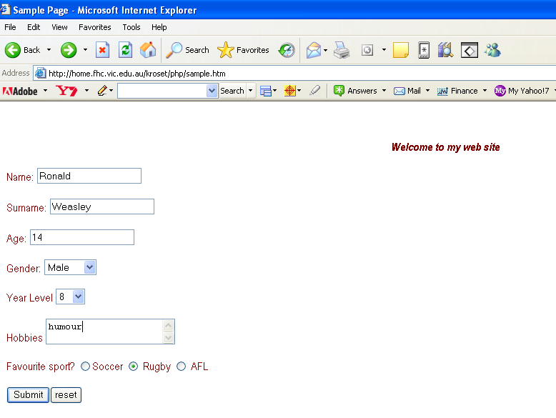
Learning Activity 8
Aims
Using Forms
Create a Form
Add elements to a Form
Process a Form
Validate elements of a Form
Extension Activities

Slide 18
Learning Activity 9
Aims
Introduction to file input output
Write to a file
Read from a file
Extension activities

Slide 19
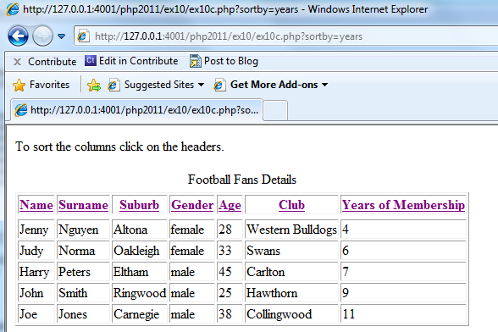
Learning Activity 10
Aims
Saving data behind a web server – an introduction
Using Files
Format output from retrieved data
Sorting output from retrieved data
A PHP page calling itself
Extension Activities

Slide 20
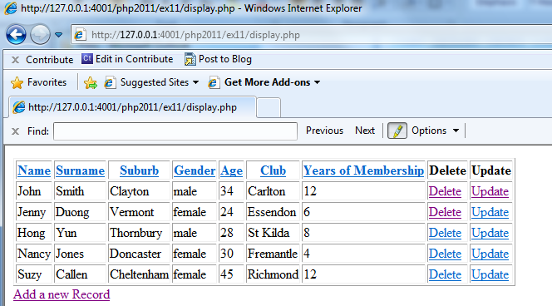
Learning Activity 11
Aims
Editing data in arrays in a file
Adding data to a file
Deleting data in a file
Editing data in a file
Extension Activities

Slide 21
Learning Activity 12
Aims
Introduction to Object Oriented Programming
Classes
Objects
Records in PHP
Saving to a File
Reading from a File
Extension Activities
class Student {
public $name;
public $age;
public $form;
public function writeStudent($fh)
writeStudent($fh) method is part of the Student class
{
$contents = "$this->name\t$this->age\t$this->form\n";
fwrite($fh, $contents);
}
}
$fileName = "allStudents.txt";
$fh = fopen($fileName, 'w');
$john = new Student();
$john->name = "John";
Instantiation or creation of 3 objects ($johnny, $jenny, $jane) each based on class Student.
$john->age = "12"; $john->form = "6A";
$john->writeStudent($fh);

Slide 22
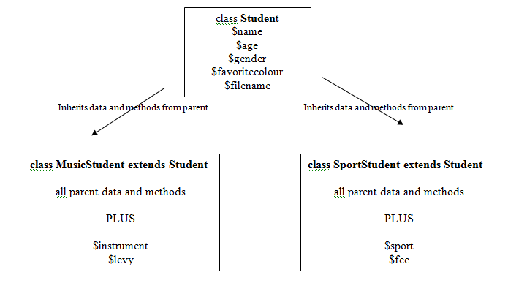
Learning Activity 13
Aims
Constructors and Destructors
Parent class, child class and Inheritance
Case Study
Design A – use of separate files for each class to write/read
Design B – use of one file for all classes to write/read
Public, private and protected property or method – visibility
Useful diagnostic class functions
Extension Activities

Slide 23
Learning Activity 13

Slide 24
Learning Activity 13

Slide 25
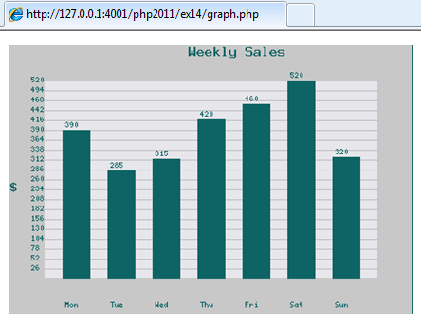
Learning Activity 14
Aims
An introduction to data visualization/business intelligence
Functions required
Graphical representation of data
Bar Graph
Extension Activities

Slide 26
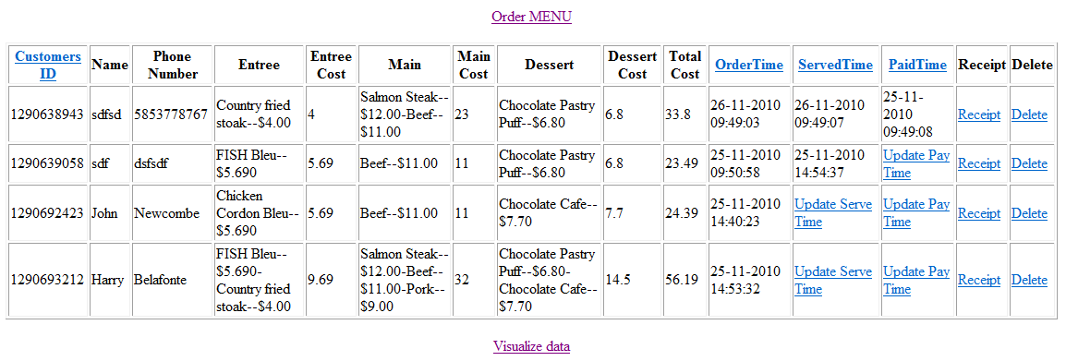
Learning Activity 15
Aims
Case Study: Restaurant Ordering System
OOP
saving to file
Adding purchases to order
Edit/confirm order
Billing and payment
Extension Activities

Slide 27
Learning Activity 16
Aims
UML – Use Case essentials
SRS - background and outline
Case study Exercise 15 retrospective
Use Case and
SRS
worked example
Extension Activities

Slide 28
Learning Activity 17
Aims
Mobile devices and PHP
Detect client browser and details
Customise output based on client environment
CSS for mobile devices
Case Study: Travelling utility sales representative
Mobile device
saving to file
forwarding data for processing
email to confirm
Extension Activities

Slide 29
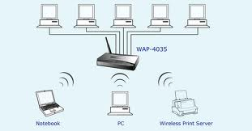
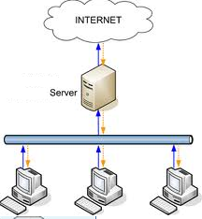
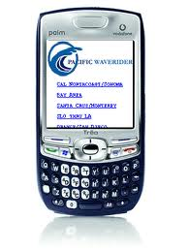
Learning Activity 17 Mobile Device Program
Connect to a LAN through a wireless access point and browse the php page
Connect through the mobile phone carrier using a plan that allows internet access and browse web site. The web site must have public access in this example.

Slide 30
Learning Activity 18
Aims
Debugging hints and tips
Debugging worked example from Exercise 14
Common mistakes in PHP programming

Slide 31
3 sample SACs for SAC32
Scenario 1
Aims
OOP : RACV roadside service
Vehicle as the parent class
Car, truck and motorbike as child classes
OR single class with types describing vehicle type
Set up a queue
Response times can be graphed
Scenario 2
Aims
OOP : School musical instrument borrowing system
Instrument as the parent class
Woodwind, brass, string and percussion as child classes
OR single class with types describing instrument type
Set up a queue
Popularity of different categories can be graphed
Scenario 3
Aims
OOP : Utility company sales service
Utility as the parent class
Electricity, Gas, Water as child classes
OR single class with types describing utility type
Popularity/volume of sales of different categories can be graphed

Slide 32
3 sample SACs for SAC41
Scenario 1
Aims
Online fitness instructor ( BMI calculation )
Validation
Adding user to a file
Email confirmation and form data and server response
Scenario 2
Aims
Booking movie tickets through a mobile device
Validation
Adding user to a file
Email confirmation and form data and server response
Scenario 3
Aims
Reserving a position for online gaming through a mobile device
Validation
Adding user to a file
Email confirmation and form data and server response

Slide 33
PHP 2011 - incorporating OOP and Data Visualization ( ebook )
Teacher text ebook ( 210 pages ) and student workbook ebook ( 100 pages )
Available through VITTA or www.edulists.com.au
VITTA to conduct extensive PD early next year to support teachers
For questions and queries contact Kevork Krozian on kevork@edulists.com.au or 0419 356 034

Slide 34
Files vs Databases
Transactions problematic with files ( read whole file into memory, locate record, edit, write back whole file )
Sorting contrived and cumbersome ( see Ex 10 ). Must either sort file to apply binary sort or read each record sequentially
Fiddling with delimiters painful and cumbersome
Relationships as in 2 tables or more not possible
Random access of data in storage not possible

Slide 35
Contact details
I am available at kevork@edulists.com.au
My mobile number is 0419 356 034

