Slide 1
Data Dictionaries
Data Item | Data Type | Format/Length/Size | Description of Purpose
What you need to know for your SAC!

Slide 2
Purpose
Rigorously define each and every
data element
data structure (files and records)
data transform (eg on data flow diagrams)*.
Includes data
stored in the system (variables declared in VB)
inputs to the system (format of input file)
outputs generated by the system (format of output file)
*But you don’t need to do that this year

Slide 3
Why?
Helps to improve communication between analysts and users and between technical personnel by establishing a set of consistent data definitions.
If programmers develop data descriptions from a common data dictionary, several potentially serious module interface problems can be avoided.
At a higher level, different systems must often be linked or interfaced, and a common set of data definitions helps to minimize misunderstandings.

Slide 4
Data Element
Smallest unit of data which can not be further decomposed.
Also referred to as “data item” or “field”.
The building blocks for all other data in the system (eg records and files).
Include ALL of the variables you declare in your Visual Basic Program.
Data Item | Data Type | Format/Length/Size | Description of Purpose

Slide 5
Data Element Dictionaries
Some of the typical components of a data dictionary entry are:
• Name of the table
• Name of the fields in each table
• Data type of the field (integer, date, text…)
• Brief description of expected data for each field
• Length of the field
• Default value for that field
• Is the field Nullable or Not Nullable
• Constraints that apply to each field, if any

Slide 6
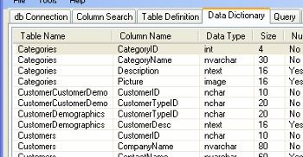
A Data Dictionary from a database system

Slide 7
Data Structure
Data elements when clubbed together as a group make up a data structure.
Includes record structures and file structures
These data elements are related to one another and together they stand for some meaning.

Slide 8
Examples of Data Structure Definitions
record structure name
curly bracket indicates a repeating field
data elements
Note that they look like a formula with “+” signs between the individual data elements
bracket indicates an optional data element

Slide 9
Entity Relationship Diagrams
Supposing we have more than one Data Structure (record or file), we should show the relationship between these.
These Data Structures are called Entities.
An entity is an object (a person, group, place, thing, or activity) about which data are stored.
A relationship links two entities and is shown by drawing a line between them

Slide 10
E-R Diagram examples
Each relationship can read as a sentence with a verb linking the two entities.
Read each of these relationships as a sentence.
Add your own E-R diagram to your Playtime Theatre practice SAC to show the relationship between your customer and the theatre seat.

Slide 11
Data Structure Diagrams
More complex version of an ER diagram.
Shows entities, their relationships, and the constraints that binds them.
It is a graphical representation of the data definitions.

Slide 12
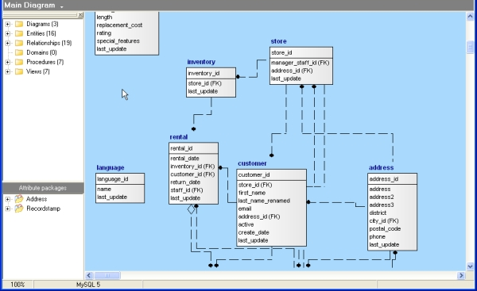
An example Data Structure Diagram for a Database

