Slide 1
Pigs Galore Spreadsheet
oink
oink
oink
oink
oink
oink
oink
oink
oink
oink
oink
oink
oink
oink
oink
oink
oink
oink
oink
oink
User Documentation
oink
oink
oink
oink
oink
Begin
oink
oink
oink
oink
oink
oink
oink
oink
oink
oink
oink
oink

Slide 2
Contents
Opening the Spreadsheet
Adding and Editing Data
Producing Output
Saving Data
Exiting the Spreadsheet
Press Esc to exit

Slide 3
Opening the Spreadsheet
Navigate to the folder containing the spreadsheet (as shown below), and double click on it to open the spreadsheet.

Slide 4
Adding Data
In the ‘Employee Payment’ worksheet (located at the bottom of the spreadsheet), data can be entered in the white cells
Next

Slide 5
Adding Data
Grey cells are calculated cells; data cannot be entered directly into these cells
To enter data, left click a white cell and type the required data, followed by enter
Next

Slide 6
Adding Data
Other worksheets allow variables to be adjusted, including employee commission, prices, phone extensions and bonuses
Changing these variables will automatically change the output of the calculated cells in the ‘Employee Payment’ worksheet
Next

Slide 7
Adding Data
If it is necessary to add a new employee, phone extension (department) or bonus, new cells must be created
First, unprotect the worksheet by clicking format > unprotect sheet (this allows cells to be edited)
Next

Slide 8
Adding Data
Highlight the last existing row as shown below by clicking on the leftmost cell and dragging across to the right
Next

Slide 9
Adding Data
Click the ‘Insert’ button to make a new row
Enter the new data
Next

Slide 10
Adding Data
When creating new employees, the calculated cells can be automatically transferred by clicking on the calculated cell of the previous employee and dragging down the small black square
Next

Slide 11
Adding Data
When creating a new phone extension, follow the same process as when creating a new employee
Next

Slide 12
Adding Data
Once the new data is entered, the departments must be arranged alphabetically
Highlight all the data-containing cells (department & number) and click ‘Sort & Filter’ > Sort A to Z
Next

Slide 13
Adding Data
Finally, the modified worksheets must once again be protected to avoid accidental data loss
Highlight any cells that will need to be changed on a regular basis (non-calculated cells)
Next

Slide 14
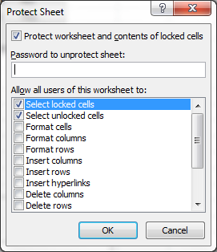
Adding Data
Once again click format > protect sheet > OK
The sheet is now protected from accidental data deletion

Slide 15
Adding Data
Click format and ensure that they are not locked by checking that the ‘Lock Cell’ box is NOT selected
Next

Slide 16
Producing Output
After all data has been entered and/or edited for a particular week, payslips for each employee can be produced automatically
First, click on the ‘Payslips’ worksheet
Next

Slide 17
Producing Output
Click on the cell containing an employee’s name, next to the cell labelled ‘Employee’ in grey
Click on the dropdown arrow next to the name to change the employee being viewed
Next

Slide 18
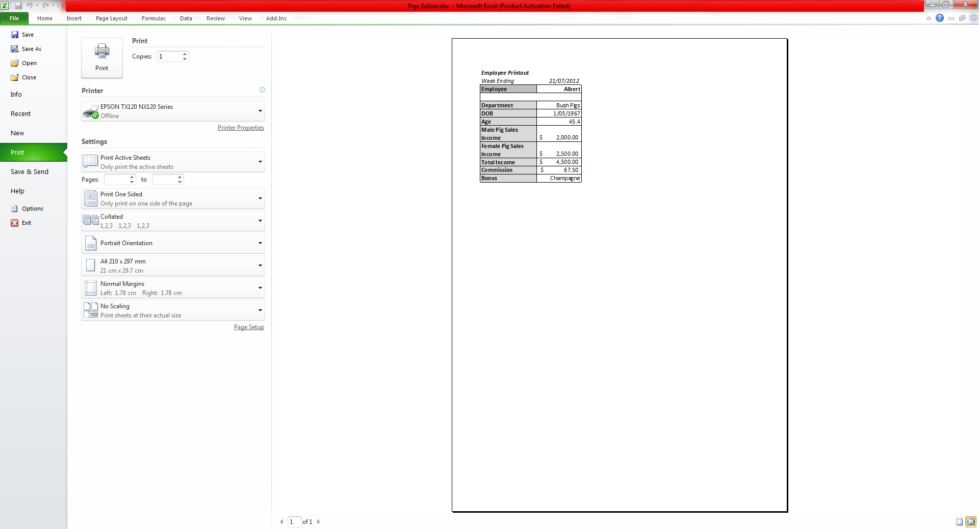
Producing Output
These slips can be printed by selecting the desired employee and then selecting file (located in the ribbon, top left) > print

Slide 19
Saving Data
After all data has been entered or edited, the spreadsheet must be saved before exiting. This can be done by pressing the ‘floppy’ icon in the top left hand corner of the spreadsheet, or by pressing CTRL + S
It is a good idea to do this frequently throughout usage to minimise the risk of data loss.

Slide 20
Exiting the Spreadsheet
Once all data has been entered and/or edited, printed (if required) and saved, the spreadsheet can be exited by clicking the red ‘x’ in the top right hand corner of the spreadsheet.

