Slide 1
Glossary Terms
All Glossary Terms from http://www.vcaa.vic.edu.au/vce/studies/infotech/itapplications3-4.html

Slide 2
Choose Your Move!
Left
Right
Forward
Back
Left
Right
Forward
Back
Left
Right
Forward
Back
Left
Right
Forward
Back
Left
Right
Forward
Back

Slide 3
A category of software that enables users to create multimedia and web solutions without the need to write programming code. The software generates the code required to run the application created. Often used for developing web pages (for example, Adobe Dreamweaver), multimedia presentations (for example, Sunburst Hyperstudio, Ulead DVD MovieFactory, Microsoft PhotoStory, and Apple iMovie and Apple Final Cut Express for video productions) and games (for example, Game Creator 3D Gamemaker, Conitec 3D GameStudio, Conitec Atari Lite-C).

Slide 4
Back
Authoring Software
A category of software that enables users to create multimedia and web solutions without the need to write programming code. The software generates the code required to run the application created. Often used for developing web pages (for example, Adobe Dreamweaver), multimedia presentations (for example, Sunburst Hyperstudio, Ulead DVD MovieFactory, Microsoft PhotoStory, and Apple iMovie and Apple Final Cut Express for video productions) and games (for example, Game Creator 3D Gamemaker, Conitec 3D GameStudio, Conitec Atari Lite-C).

Slide 5
A service provided by large Internet-based, specialised data centres that offers offsite storage, processing and computer resources to individuals and organisations. The services are shared, on-demand and usually simple to use. For example, Google’s gmail uses cloud computing processing powers and storage facilities; Amazon’s Elastic Compute Cloud offers computing resources without a development platform layer.

Slide 6
Cloud computing
Back
A service provided by large Internet-based, specialised data centres that offers offsite storage, processing and computer resources to individuals and organisations. The services are shared, on-demand and usually simple to use. For example, Google’s gmail uses cloud computing processing powers and storage facilities; Amazon’s Elastic Compute Cloud offers computing resources without a development platform layer.

Slide 7
A process of using software tools to select and access data from large repositories and present the data as effective graphics. Graphical presentations usually take the form of charts, graphs, spatial relationships, histograms, maps and network diagrams. Some data visualisation tools allow the presentations to be dynamic. Examples of data visualisation tools include programming languages, such as Python, spreadsheet software, database software, Google Docs (gadgets/motion charts), InfiView, Nexus (social graph browser).

Slide 8
Data visualisation
Back
A process of using software tools to select and access data from large repositories and present the data as effective graphics. Graphical presentations usually take the form of charts, graphs, spatial relationships, histograms, maps and network diagrams. Some data visualisation tools allow the presentations to be dynamic. Examples of data visualisation tools include programming languages, such as Python, spreadsheet software, database software, Google Docs (gadgets/motion charts), InfiView, Nexus (social graph browser).

Slide 9
A statement that contains an outline of a situation, context, problem, need or an opportunity, any conditions that apply to a problem and the future needs. It provides a basis from which students can apply some or all of the stages of the problem-solving methodology when solving information problems.

Slide 10
Design brief
Back
A statement that contains an outline of a situation, context, problem, need or an opportunity, any conditions that apply to a problem and the future needs. It provides a basis from which students can apply some or all of the stages of the problem-solving methodology when solving information problems.

Slide 11
Factors that contribute to the functionality and appearance of solutions. In this study the elements related to functionality are structure, usability and accessibility, including navigation and load time, appropriateness and relevance. Design elements related to appearance are proportion (visual hierarchy), orientation (direction/aspect), clarity and consistency, colour and contrast.

Slide 12
Design elements
Back
Factors that contribute to the functionality and appearance of solutions. In this study the elements related to functionality are structure, usability and accessibility, including navigation and load time, appropriateness and relevance. Design elements related to appearance are proportion (visual hierarchy), orientation (direction/aspect), clarity and consistency, colour and contrast.

Slide 13
Methods for representing the functionality and appearance of solutions. Tools to represent designs include data flow diagrams, entity-relationship diagrams, hierarchy charts, data dictionaries and data structure diagrams, object descriptions, flowcharts, pseudocode, input-process-output (IPO) charts, structure charts, annotated diagrams/mock-ups, storyboards, site maps, layout diagrams, use cases, context diagrams. The choice of tools is dependent on the nature of the solutions.

Slide 14
Design tools
Back
Methods for representing the functionality and appearance of solutions. Tools to represent designs include data flow diagrams, entity-relationship diagrams, hierarchy charts, data dictionaries and data structure diagrams, object descriptions, flowcharts, pseudocode, input-process-output (IPO) charts, structure charts, annotated diagrams/mock-ups, storyboards, site maps, layout diagrams, use cases, context diagrams. The choice of tools is dependent on the nature of the solutions.

Slide 15
A measure of how little time, cost and/or effort is applied in order to achieve intended results. Measures of an efficient solution include the speed of processing, the functionality of the solution, the ease of use of the solution and the cost of information file manipulation. Measures of an efficient network include its productivity, processing time, operational costs and level of automation.

Slide 16
Efficiency
Back
A measure of how little time, cost and/or effort is applied in order to achieve intended results. Measures of an efficient solution include the speed of processing, the functionality of the solution, the ease of use of the solution and the cost of information file manipulation. Measures of an efficient network include its productivity, processing time, operational costs and level of automation.

Slide 17
A measure of how well something works, such as a solution, a file and information management strategy and a network, that is, the extent to which it achieves its intended results. Measures of an effective solution include completeness, readability, attractiveness, clarity, accuracy, accessibility, timeliness, communication of message, relevance and usability. Measures of an effective file and information management strategy include integrity of data, security, ease of retrieval and currency of files. Measures of effective networks include reliability and maintainability.

Slide 18
Effectiveness
Back
A measure of how well something works, such as a solution, a file and information management strategy and a network, that is, the extent to which it achieves its intended results. Measures of an effective solution include completeness, readability, attractiveness, clarity, accuracy, accessibility, timeliness, communication of message, relevance and usability. Measures of an effective file and information management strategy include integrity of data, security, ease of retrieval and currency of files. Measures of effective networks include reliability and maintainability.

Slide 19
Ways in which information should be treated and organised within onscreen solutions. This includes the structuring or grouping of sets of information and determining navigation pathways. Effective and efficient information architecture enables users to intuitively and confidently locate information they require.

Slide 20
Information architecture
Back
Ways in which information should be treated and organised within onscreen solutions. This includes the structuring or grouping of sets of information and determining navigation pathways. Effective and efficient information architecture enables users to intuitively and confidently locate information they require.

Slide 21
The combination of people, procedures, equipment and data that process data and information

Slide 22
Information system
Back
The combination of people, procedures, equipment and data that process data and information

Slide 23
Legal obligations that individuals and organisations have with respect to the ownership and privacy of information, and freedom of expression. For the purposes of this study the key provisions of the following acts are relevant: Privacy Act 1988, Information Privacy Act 2000, Health Records Act 2001, Copyright Act 1968, Charter of Human Rights and Responsibilities Act 2006 (VIC) (sections 13, 14 and 15), and the Spam Act 2003 (Part 1.3, Simplified outline).

Slide 24
Legal obligations
Back
Legal obligations that individuals and organisations have with respect to the ownership and privacy of information, and freedom of expression. For the purposes of this study the key provisions of the following acts are relevant: Privacy Act 1988, Information Privacy Act 2000, Health Records Act 2001, Copyright Act 1968, Charter of Human Rights and Responsibilities Act 2006 (VIC) (sections 13, 14 and 15), and the Spam Act 2003 (Part 1.3, Simplified outline).

Slide 25
A seven-layer network protocol: physical (Layer 1), data link (Layer 2), network (Layer 3), transport (Layer 4), session (Layer 5), presentation (Layer 6), application (Layer 7). The emphasis in the study design is on Layer 1.

Slide 26
Open Systems Interconnection (OSI)
Back
A seven-layer network protocol: physical (Layer 1), data link (Layer 2), network (Layer 3), transport (Layer 4), session (Layer 5), presentation (Layer 6), application (Layer 7). The emphasis in the study design is on Layer 1.

Slide 27
Equipment used to assist in the protection of information systems and the files produced, received and stored by individuals and organisations, including zoned security strategies, barrier techniques, biometrics. Also see Software security measures/devices.

Slide 28
Physical security measures/devices
Back
Equipment used to assist in the protection of information systems and the files produced, received and stored by individuals and organisations, including zoned security strategies, barrier techniques, biometrics. Also see Software security measures/devices.

Slide 29
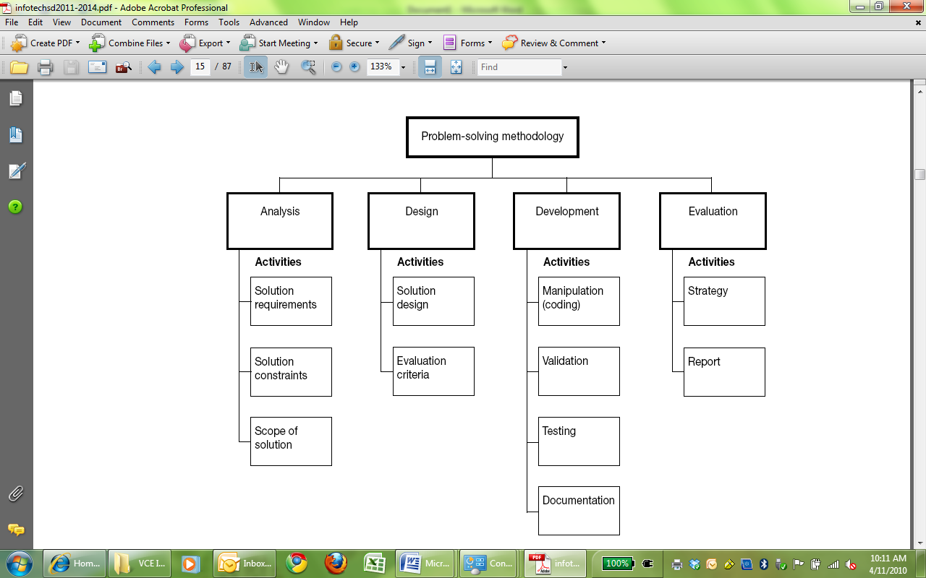

Slide 30
Problem-solving methodology
Back

Slide 31
Actions, devices and events that threaten the integrity and security of data and information stored within, and communicated between, information systems. The threats can be accidental, such as losing a portable storage device containing files; deliberate, such as denial of service and worms; and events-based, such as a power surge.

Slide 32
Security threats
Back
Actions, devices and events that threaten the integrity and security of data and information stored within, and communicated between, information systems. The threats can be accidental, such as losing a portable storage device containing files; deliberate, such as denial of service and worms; and events-based, such as a power surge.

Slide 33
Accepted ways of behaving on websites that support communication. Protocols usually relate to identity, the nature of information exchanged, language used in communications and the rights of members. Examples of breaches of social online protocols include fraudulent identity, cyberbullying, harassment, posting of inappropriate information and use of inappropriate language.

Slide 34
Social online protocols
Back
Accepted ways of behaving on websites that support communication. Protocols usually relate to identity, the nature of information exchanged, language used in communications and the rights of members. Examples of breaches of social online protocols include fraudulent identity, cyberbullying, harassment, posting of inappropriate information and use of inappropriate language.

Slide 35
A comprehensive description of the intended purpose and environment for purpose-designed software solutions. It documents the key tasks associated with the analysing stage of the problemsolving methodology. The software requirements specifications (SRS) fully describes the functional requirements (what it is required to do) and non-functional requirements of the solution (solution attributes) such as user-friendliness, response rates, robustness, portability, reliability and maintainability, the conditions affecting the solution (constraints) and the parameters of the solution (scope). Software requirements specifications fulfils the purposes of breaking down the problem into component parts, providing input to the designing stage and serving as a reference point for further stages of the problem-solving methodology.

Slide 36
Software requirements specifications
(SRS)
Back
A comprehensive description of the intended purpose and environment for purpose-designed software solutions. It documents the key tasks associated with the analysing stage of the problemsolving methodology. The software requirements specifications (SRS) fully describes the functional requirements (what it is required to do) and non-functional requirements of the solution (solution attributes) such as user-friendliness, response rates, robustness, portability, reliability and maintainability, the conditions affecting the solution (constraints) and the parameters of the solution (scope). Software requirements specifications fulfils the purposes of breaking down the problem into component parts, providing input to the designing stage and serving as a reference point for further stages of the problem-solving methodology.

Slide 37
Software and procedures used to assist in the protection of information systems and files produced, received and stored by individuals and organisations, including user names and passwords, access logs and audit trails, access restrictions, encryption and security protocols such as Transport Layer Security (TLS) and Secure Sockets Layer (SSL), firewalls and system protection.

Slide 38
Software security measures/devices
Back
Software and procedures used to assist in the protection of information systems and files produced, received and stored by individuals and organisations, including user names and passwords, access logs and audit trails, access restrictions, encryption and security protocols such as Transport Layer Security (TLS) and Secure Sockets Layer (SSL), firewalls and system protection.

Slide 39
A method of producing required information through the application of technology (hardware and software) and techniques.

Slide 40
Solution
Back
A method of producing required information through the application of technology (hardware and software) and techniques.

Slide 41
Ways of ensuring a solution operates as intended. Testing is normally performed immediately after the development of a solution.

Slide 42
Testing techniques
Back
Ways of ensuring a solution operates as intended. Testing is normally performed immediately after the development of a solution.

Slide 43
Software tools that allow students to clarify thoughts and to identify patterns and form relationships between sets of data and information. They are tools that support abstract reasoning. Examples include graphic and word processing software, concept/mind mapping software, simulation software, graphic organisers, wikis, database software and spreadsheet software.

Slide 44
Visualising thinking tools
Back
Software tools that allow students to clarify thoughts and to identify patterns and form relationships between sets of data and information. They are tools that support abstract reasoning. Examples include graphic and word processing software, concept/mind mapping software, simulation software, graphic organisers, wikis, database software and spreadsheet software.

Slide 45
Types of transmission media, including wired (fibre optic, twisted pair) and wireless (microwave, satellite, radio and infrared).

Slide 46
Wired and wireless communications technology
Back
Types of transmission media, including wired (fibre optic, twisted pair) and wireless (microwave, satellite, radio and infrared).

