Slide 1
Department of Education and Training Requirements Technology Teaching Areas

Slide 2
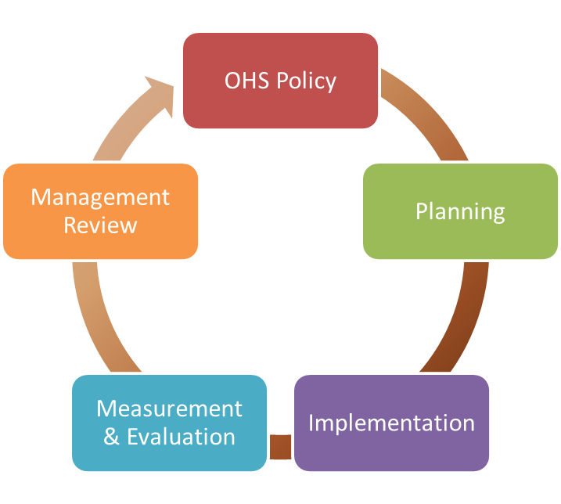
OHS in DET Workplaces
The Department of Education and Training (DET) is committed to providing a healthy and safe environment for all employees, students, contractors, volunteers and visitors and preventing workplace injuries and illnesses.
This commitment is endorsed by the Secretary in DET’s OHS Policy. To assist schools and other workplaces to meet this commitment DET has developed an Occupational Health and Safety Management System (OHSMS).
Continuous Improvement

Slide 3
DET OHS MANAGEMENT SYSTEM
The DET OHS Management System is a where all the policies, procedures, forms and guides related to OHS an be located.
Technology teaching covers a wide range of areas within the OHS Management System including:
Risk Management Forms and Safe Work Procedures
Appropriate Use of Plant and Equipment
Guarding and Safety Stops
Ventilation, Extraction and Dust Suppression
Class Size*
Class Spacing and Layout*
Appropriate Choice of Activities*
Chemical Management
Required Training

Slide 4
Risk Management Forms and Safe Work Procedures

Slide 5
Risk Management Forms - OHSMS
The DET OHS Management System (OHSMS) includes procedures and documents to allow employees to formally document a risk assessment process. These include:
Task Based Risk Management Form;
Plant and Equipment Risk Management Form; and
Hazardous Manual Handling Risk Management Form.
These forms should be used when the impact of performing a task, using plant and equipment or conducting a manual handling process need to be formally assessed. They will form part of the information required when determining whether conducting a class is appropriate with the available resources

Slide 6
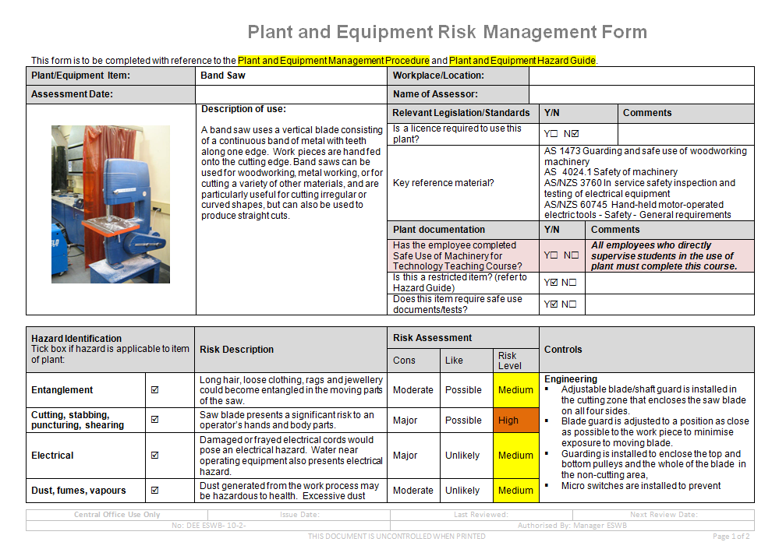
Risk Management Forms - OHSMS

Slide 7
Safe Work Procedures- OHSMS
Safe Work Procedures (SWP) outline the safest and most appropriate way to perform a designated task. They are required in all DET Workplaces for high risk tasks and equipment.
As Technology areas contain a great deal of high powered/high risk equipment, Safe Work Procedures should always be current, appropriate and on display near where the equipment is used or stored.

Slide 8
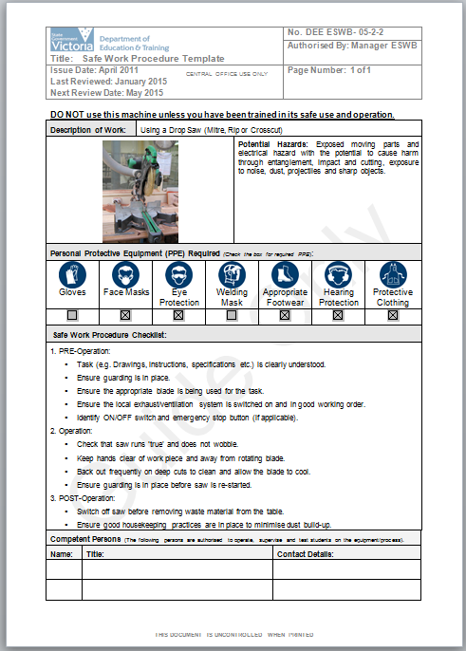
Safe Work Procedures- OHSMS
SWP indicate:
The Personal Protective Equipment that is required
The Potential Hazards
What the Pre-use, During-use and Post-use expectations are.
There is a section at the bottom for the names of those who are qualified to operate, or in the case of students use, supervise the operation of the equipment
If a person’s name is not listed on the SWP, then they are not permitted to use/supervise the use of the equipment.

Slide 9
Appropriate Use of Plant and Equipment

Slide 10
Appropriate Use of Plant and Equipment - OHSMS
Students and teachers in the art, design and technology areas are likely to be using a range of tools and machines that, by their nature, present a higher risk than other areas of the curriculum. Injuries involving plant can have serious consequences resulting in permanent impairment to students and employees. These consequences include, but are not limited to:
crushing;
sheering
burns;
amputation;
degloving;
scalping; and
Hearing loss.
As such, there are two categories of plant and equipment that require additional formal controls.

Slide 11
Appropriate Use of Plant and Equipment - OHSMS
Plant requiring completion of a Safe Use Test - Safer Plant for Students –
The following list includes examples of plant which has been assessed as safer for student use. However, items can only be used by students under general supervision after the student has passed a Safe Use Competency test.
A full list of items, grouped according to their useful work purpose, is available on the DET Website at:
http://www.education.vic.gov.au/school/principals/management/Pages/technology.aspx
Only teachers who have attended the VRQA short course and been assessed as competent in the use of a restricted item of plant are permitted to assess and supervise a student using a restricted plant item.

Slide 12
Appropriate Use of Plant and Equipment - OHSMS
Plant requiring completion of a Safe Use Test - Safer Plant for Students –
Cold Metal Drop Saw
Power Hacksaw
Jig Saw
Scroll saw
Lathe (wood and metal)
Milling Machine
Angle Grinder
Dowling or Horizontal Drill
Drill Press (Pedestal or Bench)
Linisher

Slide 13
Appropriate Use of Plant and Equipment - OHSMS
Restricted Plant –
Restricted plant items have been assessed as representing a greater risk of injury to students. Consequently their use is restricted to senior secondary students only who have passed a Restricted Plant Safe Use Competency test. (A ‘Restricted’ Plant Safe Use Competency Test follows the same format as the ‘Safer’ Plant Test.)
A full list of items, grouped according to their useful work purpose, is available on the DET Website at:
http://www.education.vic.gov.au/school/principals/management/Pages/technology.aspx

Slide 14
Appropriate Use of Plant and Equipment - OHSMS
Restricted Plant –
Only teachers who have attended the VRQA short course and been assessed as competent in the use of a restricted item of plant are permitted to assess and supervise a student using a restricted plant item.
N.B. Schools are strongly advised to seek alternative methods of achieving curriculum aims through the use of safer plant (refer Safer Plant list).

Slide 15
Appropriate Use of Plant and Equipment - OHSMS
Examples of Restricted Plant requiring completion of a Restricted Plant Safe Use Competency test –
Rip Saw (Table Saw, Bench Saw)
Band Saw
Docking Saw (Cross-Cut Saw, Radial Arm Saw)
Portable Circular Saw
Circular Saw Table
Grinder (Pedestal or Bench)
Buzzer (Surface Planer)
Thicknesser
Power Wood Shaper
Portable Planer
Metal Cut-off Saw

Slide 16
Guarding and Safety Stops

Slide 17
Guarding and Safety Stops
It is a mandatory requirement that all non-essential moving parts on powered equipment be isolated, locked out, or guarded at all times.
All high powered/high risk equipment must have emergency stops located within easy reach – this is recommended to be on the floor where it can be stepped on as, in the event of an emergency, the user’s hands may not be free.

Slide 18
Ventilation, Extraction and Dust Suppression

Slide 19
Ventilation, Extraction and Dust Suppression
Adequate ventilation is essential in technology areas. This can take the form of passive ventilation (e.g. open window) or active ventilation, attached to specific pieces of equipment.
Despite having good ventilation, fine particulate matter can still build up over time, therefore it is important to maintain a clean work area.

Slide 20
Ventilation, Extraction and Dust Suppression
Some risks associated with fine particulate matter:
Inhalation causing health implications such as asthma
Fire hazard
Slip hazard
Eye irritation/injury

Slide 21
Ventilation, Extraction and Dust Suppression
The DET recommends that the technology areas, particularly woodworking, be cleaned daily to eliminate the risk of fine particulate matter buildup.
This can be through the use of ‘wet mopping’ to keep from kicking up the dust into the air, or through the use of a HEPA-filtered vacuum cleaner.
In between scheduled cleaning times and during activities resulting in quick buildup, the area can be swept to remove larger particulates.

Slide 22
Class Size

Slide 23
Class Size
The Victorian Government Schools Agreement (2013) has information in relation to class sizes.
The principal will consult appropriate employees when considering the class sizes in a school taking into account different forms of teaching arrangements.
Class size should be planned on the minimum possible. Provided that class sizes should be planned generally on the following basis:
P to 6 - an average of 26 provided that the average class size of 21 at P-2 is maintained;
7 to 12 – groups of up to 25 students.

Slide 24
Class Size
Practical class sizes
Schools are required to provide and maintain, so far as is practicable, a working environment that is safe and without risks to health.
Schools should plan for the minimum practical class sizes possible given available resources with regard to
the nature of the activities
the nature of the equipment used
the maturity and competence of the students
the capabilities of the teacher to provide expert supervision
Ultimately the principal is to determine appropriate class
sizes with consideration to the above factors.

Slide 25
Class Spacing and Layout

Slide 26
Class Spacing
The workplace must ensure that spacing is appropriately assessed in technology areas.
The overall size of the room
Can all of the required equipment, students and school employees physically fit into the space. An assessment of the overall size of the room should include:
effective walkways;
lines of site;
additional space for the effective use of plant and equipment;
additional space to allow for the handling of materials (e.g. moving timber);
additional space required for materials storage; and
additional space required for the storage of works/projects that are in progress or completed.

Slide 27
Class Spacing
Spacing around Individual Plant and Equipment
Can each item of plant and equipment be used safely and efficiently with respect to spacing?
In general, it is recommended that there is at least 800mm free space around the point of use of any plant. This is taken from Compliance Code - Workplace Amenities and Work Environment (Worksafe Victoria, September 2008) which states:
‘Movement in and around workstations needs to be free of obstructions such as plant, furniture, materials or other employees. Employers need to ensure that the space for employees to move and work between plant, equipment, structures and materials is at least 800mm. This is to enable employees to work safely between machines, benches or counters. It will also allow them to evacuate quickly in an emergency.’

Slide 28
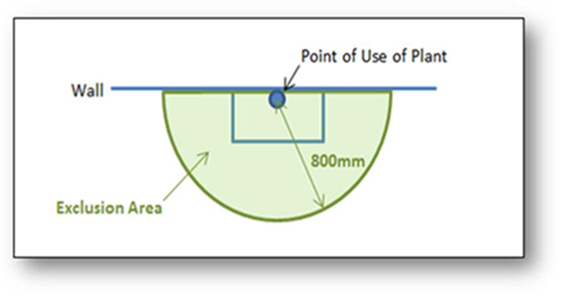
Class Spacing
Spacing around Individual Plant and Equipment (cont.)
It should be noted that 800mm is only a general recommendation. The operation of the specific plant should be taken into account when determining appropriate spacing. For example a drop saw may require more space to either side to allow for the material being cut. Conversely, a fully enclosed CNC machine may only require 800mm.

Slide 29
Class Spacing
Layout of the Room
Has the layout of the room been considered in terms of:
Frequency of plant and equipment use.
Are the most frequently used items easily accessible?
Are the most frequently used items grouped together? Could this cause congestion?
Location of higher risk equipment or activities (are higher risk equipment or tasks located in an easily visible location, to enable active supervision, or located away from high traffic walkways)
Location of store areas (does the location of stored materials have any impact on the placement of plant/equipment and/or activities)
Project progression (have plant/equipment and/or activities been located so that minimum movement is required. This would be especially relevant when one task logically follows on from another (e.g. clay storage ➔ potter’s wheel ➔ kiln))

Slide 30
Appropriate Choice of Activities
The programming of activities within a technology area greatly effects what is manageable.
Complexity
of Task
Number of
People

Slide 31
Appropriate Choice of Activities
Reducing the number of students in a class that will be completing higher risk/complexity tasks
Scheduling lessons so that multiple activities are happening simultaneously i.e. half of the class is completing a higher risk/complexity task while the remaining students are completing lower risk/complexity tasks
A formal assessment of an activity can be conducted using the Task Based Risk Management Form. The use of a documented process to inform decision-making with consultation between all stakeholders will help to develop a common understanding and manage expectations of all parties.

Slide 32
Chemical Management - OHSMS
It is a legislative requirement to manage the risks associated with all chemicals stored and used in technology areas. These areas may use Dangerous Goods and/or Hazardous Substances.
A school-wide process should already be in place to manage chemicals.
The hazards involved with the use of chemicals by completing a risk assessment of their use (this assessment can be completed using the Task Based Risk Management Form).
This assessment should include (but may not be limited to):
The classification of the chemical (is it a dangerous good or a hazardous substance?);
PPE;
ventilation;
first aid;
training; and
Storage.

Slide 33
Required Training
Teachers working in art, design and technology areas must have appropriate training and experience with the use of the machines, equipment and chemicals that students will use in their classes.
The requirements for teaching technology subjects are outlined in the Victorian Institute of Teaching Specialist Area Guidelines.
Teachers must have completed one year of study in Technology Studies which includes a range of materials and systems.
All woodwork and metalwork teachers are required to pass the prescribed competency test in the VRQA accredited ‘Course in Safe Use of Machinery for Technology Teaching (Woodwork and Metalwork) (22231VIC)'.

Slide 34
Required Training
Teachers who wish to specialize in a particular material or system, such as Agriculture, Automotive Studies, Electronics, Food (including Food Preparation and Food Technology), Horticulture, Metalwork, Textiles/Clothing or Wood, must hold one of the following:
Sub-major study in the specialist area
or
Industry or Vocational Education and Training (VET) qualifications equivalent to Certificate IV or higher in the specialist area
or
Certificate of Proficiency in a relevant trade area

Slide 35
Required Training
All employees whose role requires the use of plant and equipment shall complete the Technology Safety and Understanding and Following Safe Work Procedures eLearning modules

Slide 36
Other
Welding Bays and Visibility
Emergency/First Aid Resources
Floor Surfaces
Slips, Trips and Falls
Notifiable Incidents
Issue Resolution Process
Other?

Slide 37
Return to work
DET OHS Advisory Service
1300 074 715 safety@edumail.vic.gov.au (Marsh consultants available 8:30-5:00
Monday to Friday, including school holidays)

Slide 38
Questions?
The information contained in this facsimile message is confidential, may be privileged, and is intended for the use of the individual or entity named above. If you, the reader of this message, are not the intended recipient, the agent, or employee responsible for delivering this transmission to the intended recipient, you are expressly prohibited from copying, disseminating, distributing or in any other way using any of the information in this facsimile message.
If this communication contains personal information we expect you to treat that information in accordance with the Australian Privacy Act 1988 (Cth) or equivalent. You must advise us if you cannot comply.
Notes:
Remember that there will be an information package being sent out
---------------------------------------------------------------------------------------
LEADING SAFETY???
Prioritising
Where are schools doing well/ where are the ongoing issues? (provide OHSMS profile)
What have you done with your audit?
Dealing with ‘wicked’ issues?
What if I don’t have the resources to fix something big?
What do I do then?
Empowerment
Link to School review process, strategic planning and annual plan. The annual plan has an attestation the school complies with VRQA requirements – which include having OHS policies and procedures in place.
Remember this is in the strategic management for principals suite of units. Make the link to Bastow

Slide 39
Important links
Use of Machinery in Technology Teaching page: http://www.education.vic.gov.au/school/principals/management/Pages/technology.aspx
List of OHS Training Providers including Safe Use of Machinery providers: http://www.education.vic.gov.au/Documents/school/principals/management/ohstrainingshcourses.docx
Plant and Equipment Risk Management Forms and Safe Work Procedures: http://www.education.vic.gov.au/school/principals/management/Pages/plantequipriskmgt.aspx
Notifiable Incidents Flowchart: http://www.education.vic.gov.au/Documents/school/principals/management/incidentnotificationflowchart.docx
Issue Resolution Flowchart: http://www.education.vic.gov.au/Documents/school/principals/management/issueresolutionflowchart.docx
Chemical Management: http://www.education.vic.gov.au/school/principals/management/Pages/chemicalmgt.aspx
Noise (including hearing test reimbursement information for DET schools): http://www.education.vic.gov.au/school/principals/management/Pages/noise.aspx
eLearning module login page (for DET schools): http://deecd.lms.elmolms.com/

